Slide 1
MicroGuide
PROJECT KICK OFF MEETING
11th and 12th July 2022
Dipl.-Ing. Hagen H. Hochrinner, senior lecturer
Ing. Manuel Pichler BSc MSc, lecturer
Mag. Maja Dragan, researcher
Project number: 2021-1-RS01-KA220-HED-000027585

Slide 2
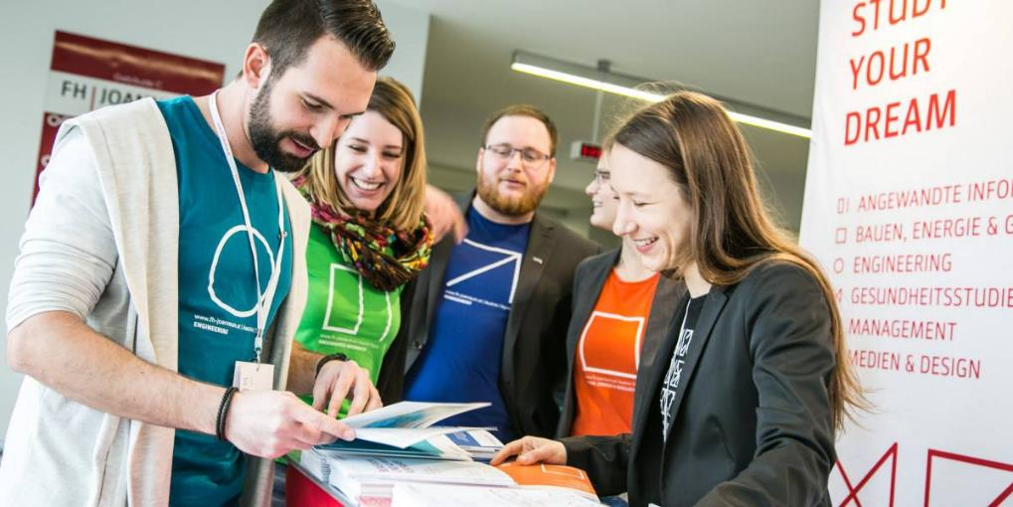
About us - Study your dream…
make the world you like


Slide 3
Picture speaks for itself…
Here we are !

Slide 4
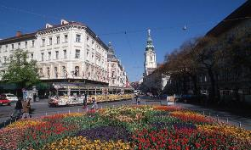
The City of Graz
Austria‘s second largest city
(~ 300.000 population)
2 hours south of Vienna (Austria)
2 hours north of Zagreb (Croatia)
45 minutes north of Maribor (Slovenia)
1 hour from Hungary
3 hours from Italy
UNESCO World Cultural Heritage
European Cultural Capital in 2003
Culture, Wine, Skiing

Slide 5
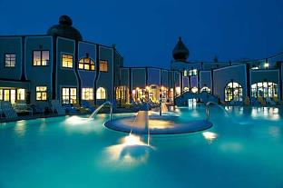
The City of Graz
4 universities
2 universities of applied sciences
1 academy of fine arts
~ 60.000 students
Center of Austrian
automotive
microelectronics
wellness industries

Slide 6
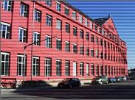
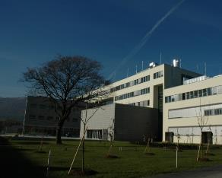
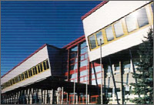
FH JOANNEUM
3rd largest University of Applied Sciences
Start 1995; 3 locations, main campus in Graz
2020: > 53 programmes (Bachelor/Master)
~5,500 students, 300 full-time faculty

Slide 7
Structure FH JOANNEUM Gesellschaft mbH (Ltd.)
Province of Styria (Main owner) (75.1% province of Styria, 14.9% JOANNEUM RESEARCH, 10% SFG)
Board
Scientific CEO: Univ.-Prof. DI Dr. Karl P. Pfeiffer
Financial CEO: Mag. Martin Payer
6 Departments
Head of academic board
DI Uwe Trattnig
25 Institutes
College: Head of academic board (college)
6 Heads of degree programs. 6 Representatives of teaching and research staff 4 Students representatives
53 Bachelor and Master programs Transfer centers
7 postgraduate courses
12 (facility) management services
Budget Committee
Innovation Committee
Working groups on nostrification
examination regulations, evaluations, ...

Slide 8
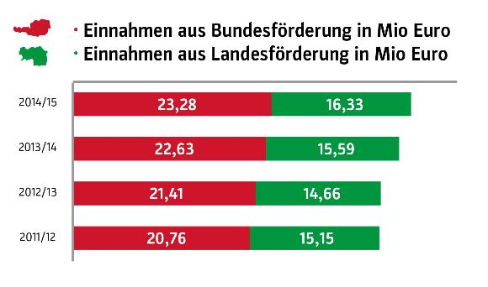
Financing of studies
Contribution by Austrian government
Contribution by Styrian provincial government
[ x 10⁶ € ]
[ x 10⁶ € ]
[ x 10⁶ € ]
[ x 10⁶ € ]

Slide 9
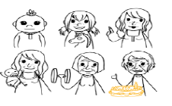
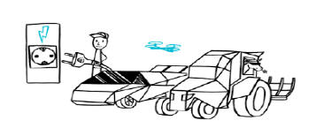
Study programs at FH JOANNEUM
Applied Computer Sciences
Building, Energy, Society
Health Studies
Engineering
Management
Media & Design

Slide 10
Austrian education
PhD
3 – 5 years
(tech.) University
(tech.) University or University of appl. sciences
tertiary
Master 2 years
Bachelor
3 years
tertiary level
Dual study program
(tech.) University or University of appl. sciences
Graduation 2 y.
College tech./busin.
2 years
20
Vocational training
& school
3-4 years
BHS 5 y.
- HTL (techn.)
- HAK (busin.)
- HLW
18
BMS
technical or business
Highschool II
4 years
Secundary level
apprenticeship
15
secondary
14
Middle school
4 years
Highschool I
4 years
10
Elementary school
4 years
pre - school
6
Kindergarden / nursery school
primary
0

Slide 12
R&D activities at the Institute of Applied Production Sciences
Inter- and transdisciplinary
Production engineering and product development
System and organizational sciences
Food technology and product development
process development
plant development
product development
production organization
quality management
cost Engineering
food analytics
extraction of natural substances
entomophagy
development of dual study programs
systems research
sustainability research

Slide 13
partner microcredX

Slide 14
European Universities
A UNIVERSITY ALLIANCE TO BUILD THE FIRST TRANSNATIONAL UNIVERSITY FOR COOPERATIVE (DUAL) EDUCATION
MISSION
To educate future generations of young Europeans through practical training based on the dual-study model of cooperative education, closely linked to companies and organizations in order to support the business transformation of European regions.

Slide 15
Expectations and challenges
Identifying barriers (legal on national level, mindset at institutions…)
Learning about the status of microcredentials – implementation phase
Quality assurance issues
Developing a microcredential
Finding practical solutions in agreement with all partners
Strengthen the position of
FH JOANNEUM in the educational landscape
in Austria and Europe

Slide 16
General comparison
“Traditional university“ vs. “University of Applied Sciences“
Traditional university
University of Applied Sciences
occasionally entrance exams
placement test & assessment talk
unlimited number of students
small size classes
frequent changes and dropouts
low drop-out rate
higher average duration of study
fixed length of study
discipline oriented
industry orientation
theory & basic research
theory & application research
no compulsory internship
min. 1 internship

Slide 17
Traditional vs. Dual / Cooperative University
Education
1st semester
1st semester
2nd semester
2nd semester
summer internship
3rd semester
3rd semester
internship
4th semester
4th semester
internship
5th semester
5th semester
internship
work
experience
6th semester / BT
6th semester
bac thesis

Slide 18
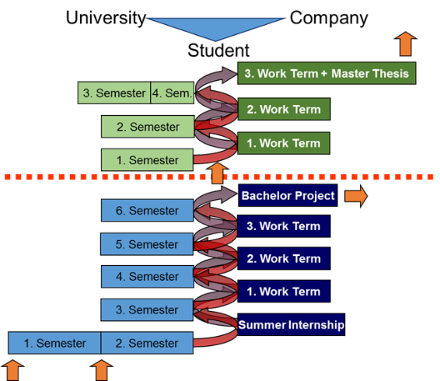
Succession of dual/cooperative bachelor and
master programs
e.g.
ENP(MSc)
Engineering and Production
Management
e.g.
PTO (BSc)
Production,
Technology and Organisation

