Slide 1
Project acronym: MICROGUIDE Project full title: DEVELOPING GUIDELINES FOR THE IMPLEMENTATION OF MICRO-CREDENTIALS IN HIGHER EDUCATION Project No. 2021-1-ProjectRS01-KA220-HED-000027585 Funding Scheme: Erasmus+
II ANALYSIS REPORT
Micro-credentials: legal framework in Germany & making a proposal for a best legislative model
Prepared by:
ACEEU Junior International Project Officer
Nazlygul Mingazova

Slide 2
TARGET & OBJECTIVES OF THE REPORT
Implementation of micro-credential in higher education in Germany:
The qualities and weaknesses of legal framework
Proposal for a best legislative model
Notes:
Even though most of the universities in Germany today follow the modern scientific approach, it does not mean giving up on long, successful tradition that was born and built upon over centuries.
The organizational structure of German universities goes back to the university model introduced by Wilhelm von Humboldt in the early 19th century, which identifies the unity of teaching and research as well as academic freedom as ideals.
Being part of the European Higher Education Area, Germany follows the directives..

Slide 3
EDUCATION SYSTEM IN GERMANY: PRINCIPLES
FEDERALISM
IDEOLOGICAL & SOCIAL PLURALISM
BOLOGNA PROCESS MEMBER
Bachelor's degree: 6 semesters
Master's programme: 2 - 4 semesters
Doctorate: individual duration
ECTS (European Credit Transfer & Accumulation System)
The freedom of curriculum design & the independence of staff selection
The plurality of confessions & world views
Regulation at the level of each individual federal state with local acts & guidelines
No nation-wide legislation
Notes:
German higher education landscape is presented as a field with plural actors, different forms of organisation and numerous formats of provision. The crediting and certification of these formats does not yet follow a uniform structure, but regulated at the level of each individual federal state (since 1990, the Federal Republic of Germany has consisted of 16 states) with local acts and guidelines meaning there is no nation-wide legislation. Moreover, universities are given a lot of authority to define their own policies, as well as admission and application processes.
Federalism is in keeping with Germany's historically evolved regional structure and is an element of the separation of powers and a guarantor of diversity, competition and proximity to the citizens in a democratic state.
Being part of the European Higher Education Area, Germany follows the directives of the Bologna Process with three levels of higher education qualifications: Bachelor, Master, doctorate.

Slide 4
EDUCATION SYSTEM IN GERMANY: STRUCTURE
Early childhood education
Primary education
Secondary education
Tertiary education
Continuing education
Notes:
German higher education landscape is presented as a field with plural actors, different forms of organisation and numerous formats of provision. The crediting and certification of these formats does not yet follow a uniform structure, but regulated at the level of each individual federal state (since 1990, the Federal Republic of Germany has consisted of 16 states) with local acts and guidelines meaning there is no nation-wide legislation. Moreover, universities are given a lot of authority to define their own policies, as well as admission and application processes.
Federalism is in keeping with Germany's historically evolved regional structure and is an element of the separation of powers and a guarantor of diversity, competition and proximity to the citizens in a democratic state.
Being part of the European Higher Education Area, Germany follows the directives of the Bologna Process with three levels of higher education qualifications: Bachelor, Master, doctorate.

Slide 5
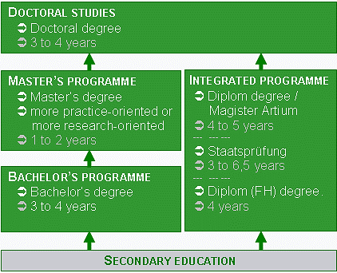
TERTIARY EDUCATION: OVERVIEW
210 universities for applied science
Fachhochschule or FH
108 universities
Universität
52 art colleges
Kunsthochschulen
30 administrative training institutes
Verwaltungsfachhochschulen
16 theological institutes
Theologische Hochschulen
6 teacher training colleges
Pädagogische Hochschulen
Notes:
Germany's universities are internationally accredited - according to the Academic Ranking of World Universities (ARWU), 6 of the top 100 universities worldwide are German. As per 2021, Germany had a total of 420 state-maintained and state-recognised institutions of higher education

Slide 6
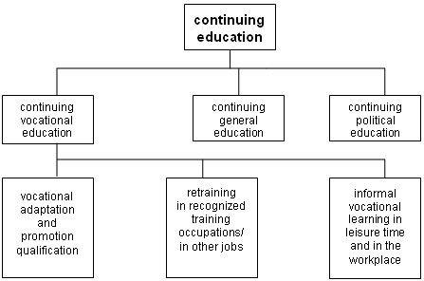
CONTINUING EDUCATION: OVERVIEW
Municipal institutions (Volkshochschulen)
Public libraries & music schools
Private institutions
Church institutions
The various chambers of industry and commerce
Family education centres
Academies, Fachschulen, institutions of HE and distance learning institutions
Notes:
Germany's universities are internationally accredited - according to the Academic Ranking of World Universities (ARWU), 6 of the top 100 universities worldwide are German.

Slide 7
REGULATIONS IN THE FIELD OF EDUCATION
The Basic Law (Grundgesetz – R1)
Unless it awards legislative powers to the Federation, the Länder have the right to legislate
Federal Government's responsibilities:
Admission to higher education institutions and degrees
Financial assistance for pupils and students
Promotion of scientific and academic research and technological development
Child and youth welfare
Regulations on entry to the legal profession
Administration of the education system is almost exclusively a matter for the Länder.
Detailed regulations are laid down in the constitutions of the Länder (R13–28) and in separate laws
The Higher Education Framework Act (HRG)
a framework law
Joint tasks (Gemeinschaftsaufgaben)
cooperation between the Federation and the Länder
Notes:
Germany's universities are internationally accredited - according to the Academic Ranking of World Universities (ARWU), 6 of the top 100 universities worldwide are German.

Slide 8
REGULATIONS IN THE FIELD OF EDUCATION
The Standing Conference of the Ministers of Education and Cultural Affairs
It addresses “educational, higher education, research and cultural policy issues of supra-regional significance with the aim of forming a joint view and intention and of providing representation for common objectives”.
The education report for Germany is published every two years.
Notes:
Germany's universities are internationally accredited - according to the Academic Ranking of World Universities (ARWU), 6 of the top 100 universities worldwide are German.

Slide 9
CONCLUSION
There is still a lack of a uniform understanding of quality and terms for micro-credentials and micro-degrees. "National and international initiatives and education policy actors largely agree that existing standards and essential elements from higher education should be used as a starting point for the quality assurance of micro-credentials and micro-degrees"
In the coalition agreement, the federal government stipulated that it would examine the introduction of micro-degrees as part of academic further education.
Notes:
that despite the growing interest in micro-credentials, the attitude towards it as part of the traditional general education system in Germany is not as unequivocal. The Federal Government expresses scepticism and points out that micro-credentials could represent a disproportionate administrative or financial burden for the Member States, as they could overlap with other existing structures. Moreover, from the German point of view, there is a general danger that the value of qualifications in all educational sectors will be diluted.

Slide 10
CONCLUSION
The German Rectors' Conference (HRK) points out that micro-degrees should not be able to be combined into a complete university degree.
HRK Vice President: “with the accreditation procedure, the universities have a proven tool at their side: If universities take modules from already accredited courses and offer them as micro degrees, these could be considered accredited“
Notes:
that despite the growing interest in micro-credentials, the attitude towards it as part of the traditional general education system in Germany is not as unequivocal. The Federal Government expresses scepticism and points out that micro-credentials could represent a disproportionate administrative or financial burden for the Member States, as they could overlap with other existing structures. Moreover, from the German point of view, there is a general danger that the value of qualifications in all educational sectors will be diluted.

