Slide 1
Project acronym: MICROGUIDE Project full title: DEVELOPING GUIDELINES FOR THE IMPLEMENTATION OF MICRO-CREDENTIALS IN HIGHER EDUCATION Project No. 2021-1-ProjectRS01-KA220-HED-000027585 Funding Scheme: Erasmus+
Analysis on MCs legal framework practice in Spain Lleida, 30 November 2022
Speaker: Ferran Badia
Institution: University of Lleida

Slide 2
Short learning programmes - Micro-credentials
Short learning programmes (SLPs) are a type of course (unit, module, etc.) in a particular subject area that focus on specific societal needs which can be a part of larger degree programmes.
A micro-credential is proof of the learning outcomes acquired by students on an SLP.
SLPs have evolved into an opportunity not only to establish bridges between the academic system and the professional world but also to promote lifelong learning.
Notes:
https://www.aqu.cat/en/Universities/Programmes-Assessment/Short-learning-programmes-Micro-credentials
https://education.ec.europa.eu/education-levels/higher-education/micro-credentials
https://www.youtube.com/watch?v=ZaPFuNCs9g8
https://microcredentials.eu/working-groups/working-group-on-qualifications-framework-and-ects/
https://uas4europe.eu/open-talk-the-european-approach-to-micro-credentials-8-march-2022/
https://seb.ktu.edu/projects/skills4employability-enhancing-the-presence-of-soft-skills-in-higher-education-curricula/

Slide 3
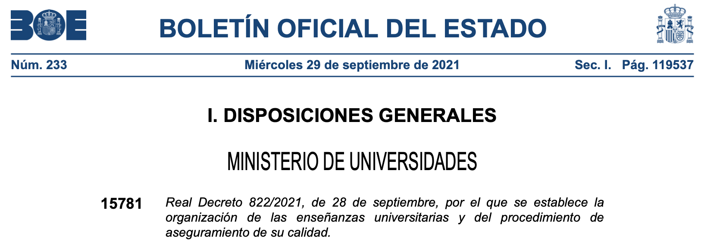
Royal Decree 822/2021, of September 28, which establishes the organization of university education and the procedure for ensuring its quality

Slide 4
Artículo 37. La formación permanente.
8. Igualmente, las universidades podrán impartir enseñanzas propias de menos de 15 ECTS que requieran o no titulación universitaria previa, en forma de microcredenciales o micromódulos, que permitan certificar resultados de aprendizaje ligados a actividades formativas de corta duración. En ningún caso estas enseñanzas podrán confundirse con las titulaciones ofertadas por los centros de Formación Profesional de Grado Medio o Grado Superior.
Article 37, Lifelong Learning.
8. Likewise, universities may teach their own courses of less than 15 ECTS that require or not a previous university degree, in the form of micro-credentials or micro-modules, which allow certifying learning outcomes linked to short-term training activities. In no case can these teachings be confused with the qualifications offered by the Intermediate or Higher Level Vocational Training centers.

Slide 5
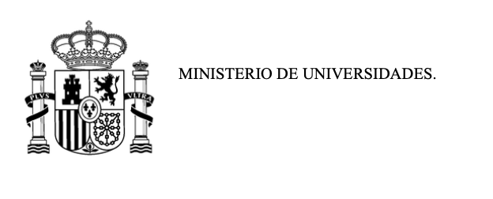
Anteproyecto de Ley Orgánica del Sistema Universitario
Draft Organic Law of the University System
Artículo 7. Los títulos universitarios
1. Las universidades impartirán enseñanzas conducentes a la obtención de títulos universitarios oficiales, con validez y eficacia en todo el territorio nacional, y podrán impartir enseñanzas conducentes a la obtención de títulos propios, incluidos los de formación a lo largo de la vida, en los términos establecidos reglamentariamente.
La formación a lo largo de la vida podrá desarrollarse mediante distintas modalidades de enseñanza, incluidas microcredenciales, microgrados u otros programas de corta duración.
2. Todos los títulos universitarios deberán reunir los estándares de calidad establecidos en el Espacio Europeo de Educación Superior.
Article 7. University degrees
1. Universities will teach courses leading to obtaining official university degrees, valid and effective throughout the national territory, and may teach courses leading to obtaining their own degrees, including lifelong training courses, in the terms established by law.
Lifelong learning may be developed through different teaching modalities, including micro-credentials, micro-degrees or other short-term programmes.
2. All university degrees must meet the quality standards established in the European Higher Education Area.

