Slide 1
Project acronym: MICROGUIDE Project full title: DEVELOPING GUIDELINES FOR THE IMPLEMENTATION OF MICRO-CREDENTIALS IN HIGHER EDUCATION Project No. 2021-1-ProjectRS01-KA220-HED-000027585 Funding Scheme: Erasmus+
Analysis of the legal framework
practice in Serbia Lleida, 30. November – 02. December 2022
Prof. Dr. Sinisa Djurasevic
University of Belgrade

Slide 2
The legal framework
1) The Law on Higher Education
2) The Law on the Dual Model of Studies in Higher Education
not applicable, since main regulation is given in the Law on higher education
3) The Law on Regulated Professions and the Recognition of Professional Qualifications
not applicable, since main regulation is given in the Law on higher education
4) The Law on the National Qualifications Framework

Slide 3
LOW ON HIGHER EDUCATION
Option A vs Option B
Microcredentials (MCs) as the more or less formal study program
vs
MCs as the lifelong learning program

Slide 4
LOW ON HIGHER EDUCATION
Article 34 - Formal study programs
The activity of higher education is achieved through academic and applied studies based on accredited study programs for obtaining higher education.
Academic studies prepare students for the development and application of scientific, artistic and professional achievements.
Applied studies prepare students for the application and development of applied knowledge and skills needed for inclusion in the work process.
For the applied training of persons with acquired secondary education for inclusion in the work process, a short study program is carried out that has a clearly defined structure, purpose and learning outcomes and for which a certificate is issued on the completion of the short study program and acquired competencies.

Slide 5
Article 35/39
Short study program (30-60 ECTS).
First degree studies are:
1) BSc academic studies (180-240 ECTS);
2) BSc applied studies (180 ECTS);
3) specialist applied studies (60 ECTS).
Second degree studies are:
1) master academic studies (60-120 ECTS, i.e., 300-360 if program is integrated);
2) master applied studies (120 ECTS);
3) specialist academic studies (60 ECTS).
Third degree studies are doctoral academic studies (180 ECTS).

Slide 6
Article 111 – lifelong learning programs
A higher education institution within the framework of its activity can implement education programs outside of the study programs for which it has received a work permit.
The conditions, method and procedure for implementing the program from paragraph 1 of this article are regulated by the institution's general act. The institution issues a certificate to the person who has mastered the program from paragraph 1 of this article.
A person enrolled in the program referred to in paragraph 1 of this article does not have the status of a student, in the sense of this law.

Slide 7
Option A vs Option B
Short programs in Serbia (as well as the Short cycles in the EU), are positioned outside 3 formal study cycles (Option A), in a way similar to the lifelong learning programs in Serbia (Option B).
This allows both options to define MCs outside 3 cycles, making them being able to be equally delivered for persons with secondary and people with tertiary education.
Option A vs Option B - Draw

Slide 8
Article 39
Each subject from the study program or short study program is expressed by the number of corresponding ESPB credits, and the scope of the program is expressed by the sum of ESPB credits.
The sum of 60 ESPB credits corresponds to the average total engagement of the student in the scope of a 40-hour work week during one school year.
The total engagement of the student consists of active teaching (lectures, exercises, practical work, seminars, etc.), independent work, colloquiums, exams, preparation of final papers, student practice, voluntary work in the local community and other types of engagement.
The conditions, way of organizing and evaluating voluntary work are regulated by the higher education institution in its general act. The total number of hours of active teaching cannot be less than 600 hours during the school year.

Slide 9
Option A vs Option B
Currently, lifelong programs do not have credit evaluation.
However, MCs, defined as the special case of lifelong learning programs, could have credit evaluation.
Option A vs Option B - Draw

Slide 10
Article 37
Study programs are realized within one or more of the following educational-scientific, i.e., educational-artistic fields:
Natural and mathematical sciences;
Social and humanistic sciences;
Medical sciences;
Technical and technological sciences;
Art
Scientific, artistic and applied areas within the fields referred to in paragraph 1 of this article are determined by the National Council, upon the proposal of the Conference of Universities and the Conference of Academies and Colleges

Slide 11
Option A vs Option B
Currently, lifelong programs are not realised within one or more of the educational-scientific, i.e., educational-artistic fields.
However, MCs, defined as the special case of lifelong learning programs, could become realised on this way.
The question is WHY (with probably no reason for that)?
Option A vs Option B - Draw

Slide 12
Article 41
ESPB credits can be transferred (i.e., recognised) between different study programs within the same cycle and type of study.
The criteria and conditions for the transfer of ESPB credits and the corresponding knowledge check are prescribed by the general act of the independent higher education institution, that is, by the agreement of the higher education institutions.
Exceptionally from paragraph 1 of this article, for students who participate in international mobility programs, ESPB credits can be transferred between different study programs within all degrees and types of studies.

Slide 13
Option A vs Option B
Currently, lifelong programs do not have credit evaluation, and are not a part of ECTS transfer system in Serbia.
However, MCs, defined as the special case of lifelong learning programs, could become credit evaluated, and possible transfered.
The question is WHY (for example, MCs recognition in case of full study enrolment)?
Option A vs Option B - Draw

Slide 14
Article 110
Upon completing a study programme, the person obtains an appropriate applied, academic or scientific title (qualification), namely:
the person who completes bachelor academic studies of the scope of 180 ECTS credits obtains the qualification “bachelor” in an appropriate area, and the person who completes bachelor academic studies of the scope of 240 ECTS credits qualification „bachelor with honours“;
the person who completes bachelor applied studies of the scope of 180 ECTS credits obtains the qualification “bachelor (appl.)“ in an appropriate area, and the person who completes specialised applied studies of the scope of 60 ECTS (in total 240 ECTS throughout the entire studies) the qualification “bachelor specialist (appl.)“;

Slide 15
Article 110 - continue
the person who completes master academic studies obtains the qualification “master“ in an appropriate area, and the person who completes master applied studies the qualification “master (appl.)“;
the person who completes specialised academic studies (at least 360 ECTS throughout the entire studies) obtains the qualification “master specialist“ in an appropriate area;
the person who completes doctoral academic studies obtains the qualification doctor of sciences (Ph.D.), or doctor of arts (D.A.), with the indication of the field, or area.
Public documents obtained upon completing a study programme are the Diploma and the Diploma Supplement. The diploma supplement must also contain the description of the higher education system in the Republic of Serbia.

Slide 16
Option A vs Option B
Currently, lifelong programs are not a part of the title obtaining system in Serbia.
However, MCs, defined as the special case of lifelong learning programs, could become part of this system.
The question is WHY and HOW (because they are not full qualification)?
Option A vs Option B - Draw

Slide 17
Recognition of foreign HE documents
ENIC/NARIC Centre, as an internal organisational unit of the Qualifications Agency, evaluates the foreign study programme, or a part of the study programme for the purpose of employment. Based on the evaluation, the ENIC/NARIC Centre issues a decision on professional recognition.
The decision on professional recognition contains the name, type, degree and duration (scope) of the study programme, the scientific, artistic or applied field within which the study programme was completed, the qualification as it is stated in the foreign higher education document – in the original language and translated into Serbian, as well as the NQFS level to which the qualification corresponds

Slide 18
Evaluation of foreign HE documents
The evaluation of a foreign study programme in order to continue the education is carried out by the professional body of an independent higher education institution to which an application for academic recognition has been submitted.
Based on the evaluation, the independent higher education institution issues a decision on academic recognition.
if it is determined that there is a substantial difference between the knowledge and skills achieved in relation to the conditions for enrolment in a particular study programme, further education or enrolment in higher education cycle may be either denied or conditioned by the obligation to obtain additional learning outcomes.
Criteria for determining the existence of a significant difference between the type and level of acquired knowledge and skills in relation to the conditions for enrolment in a particular study programme are prescribed by an independent higher education institution.

Slide 19
Option A vs Option B
Currently, lifelong programs are not a part of the ENIC/NARIC recognition system in Serbia.
However, MCs, defined as the special case of lifelong learning programs, could become part of this system.
They can be easilly recognised for the purpose of the professional recognition (i.e., labour market) by the Qualification Agency.
Option A vs Option B - Draw

Slide 20
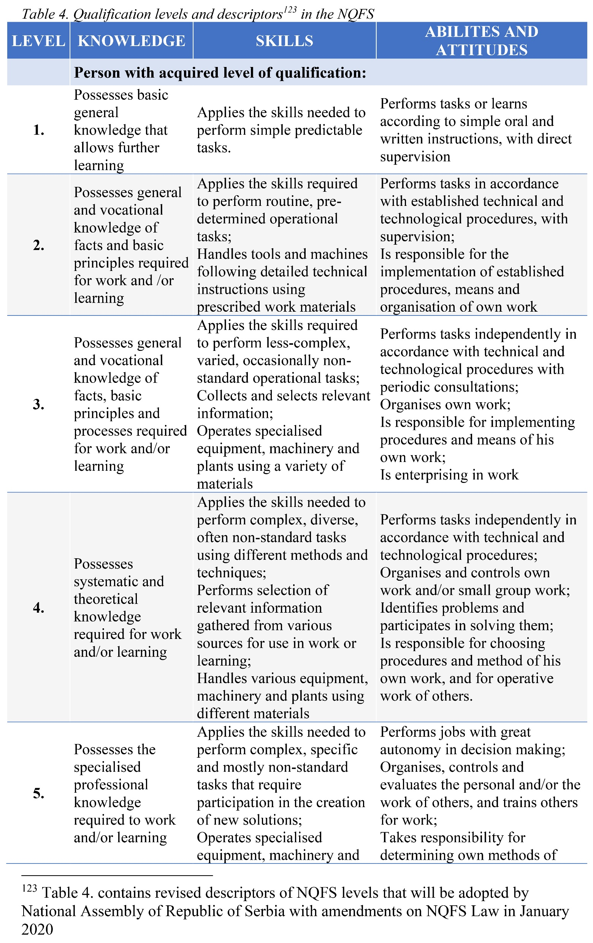
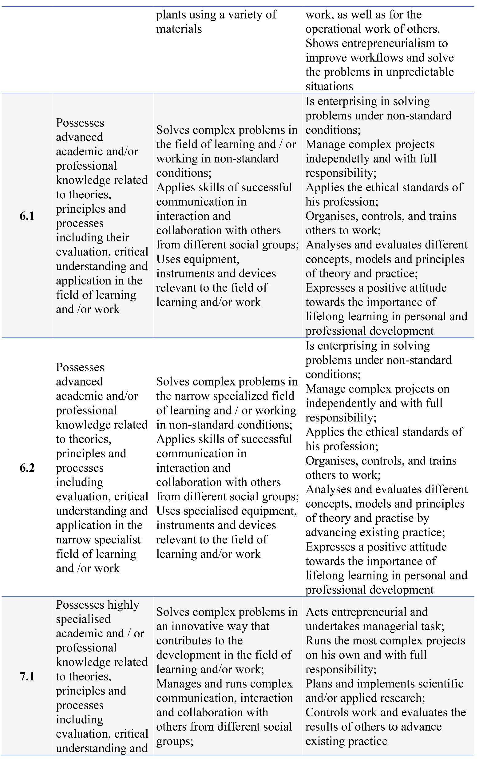
National Qualification Framework

Slide 21
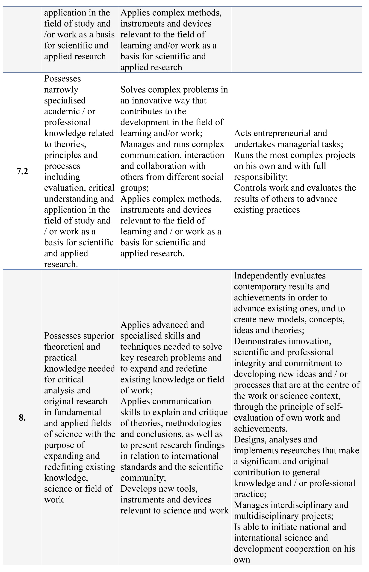
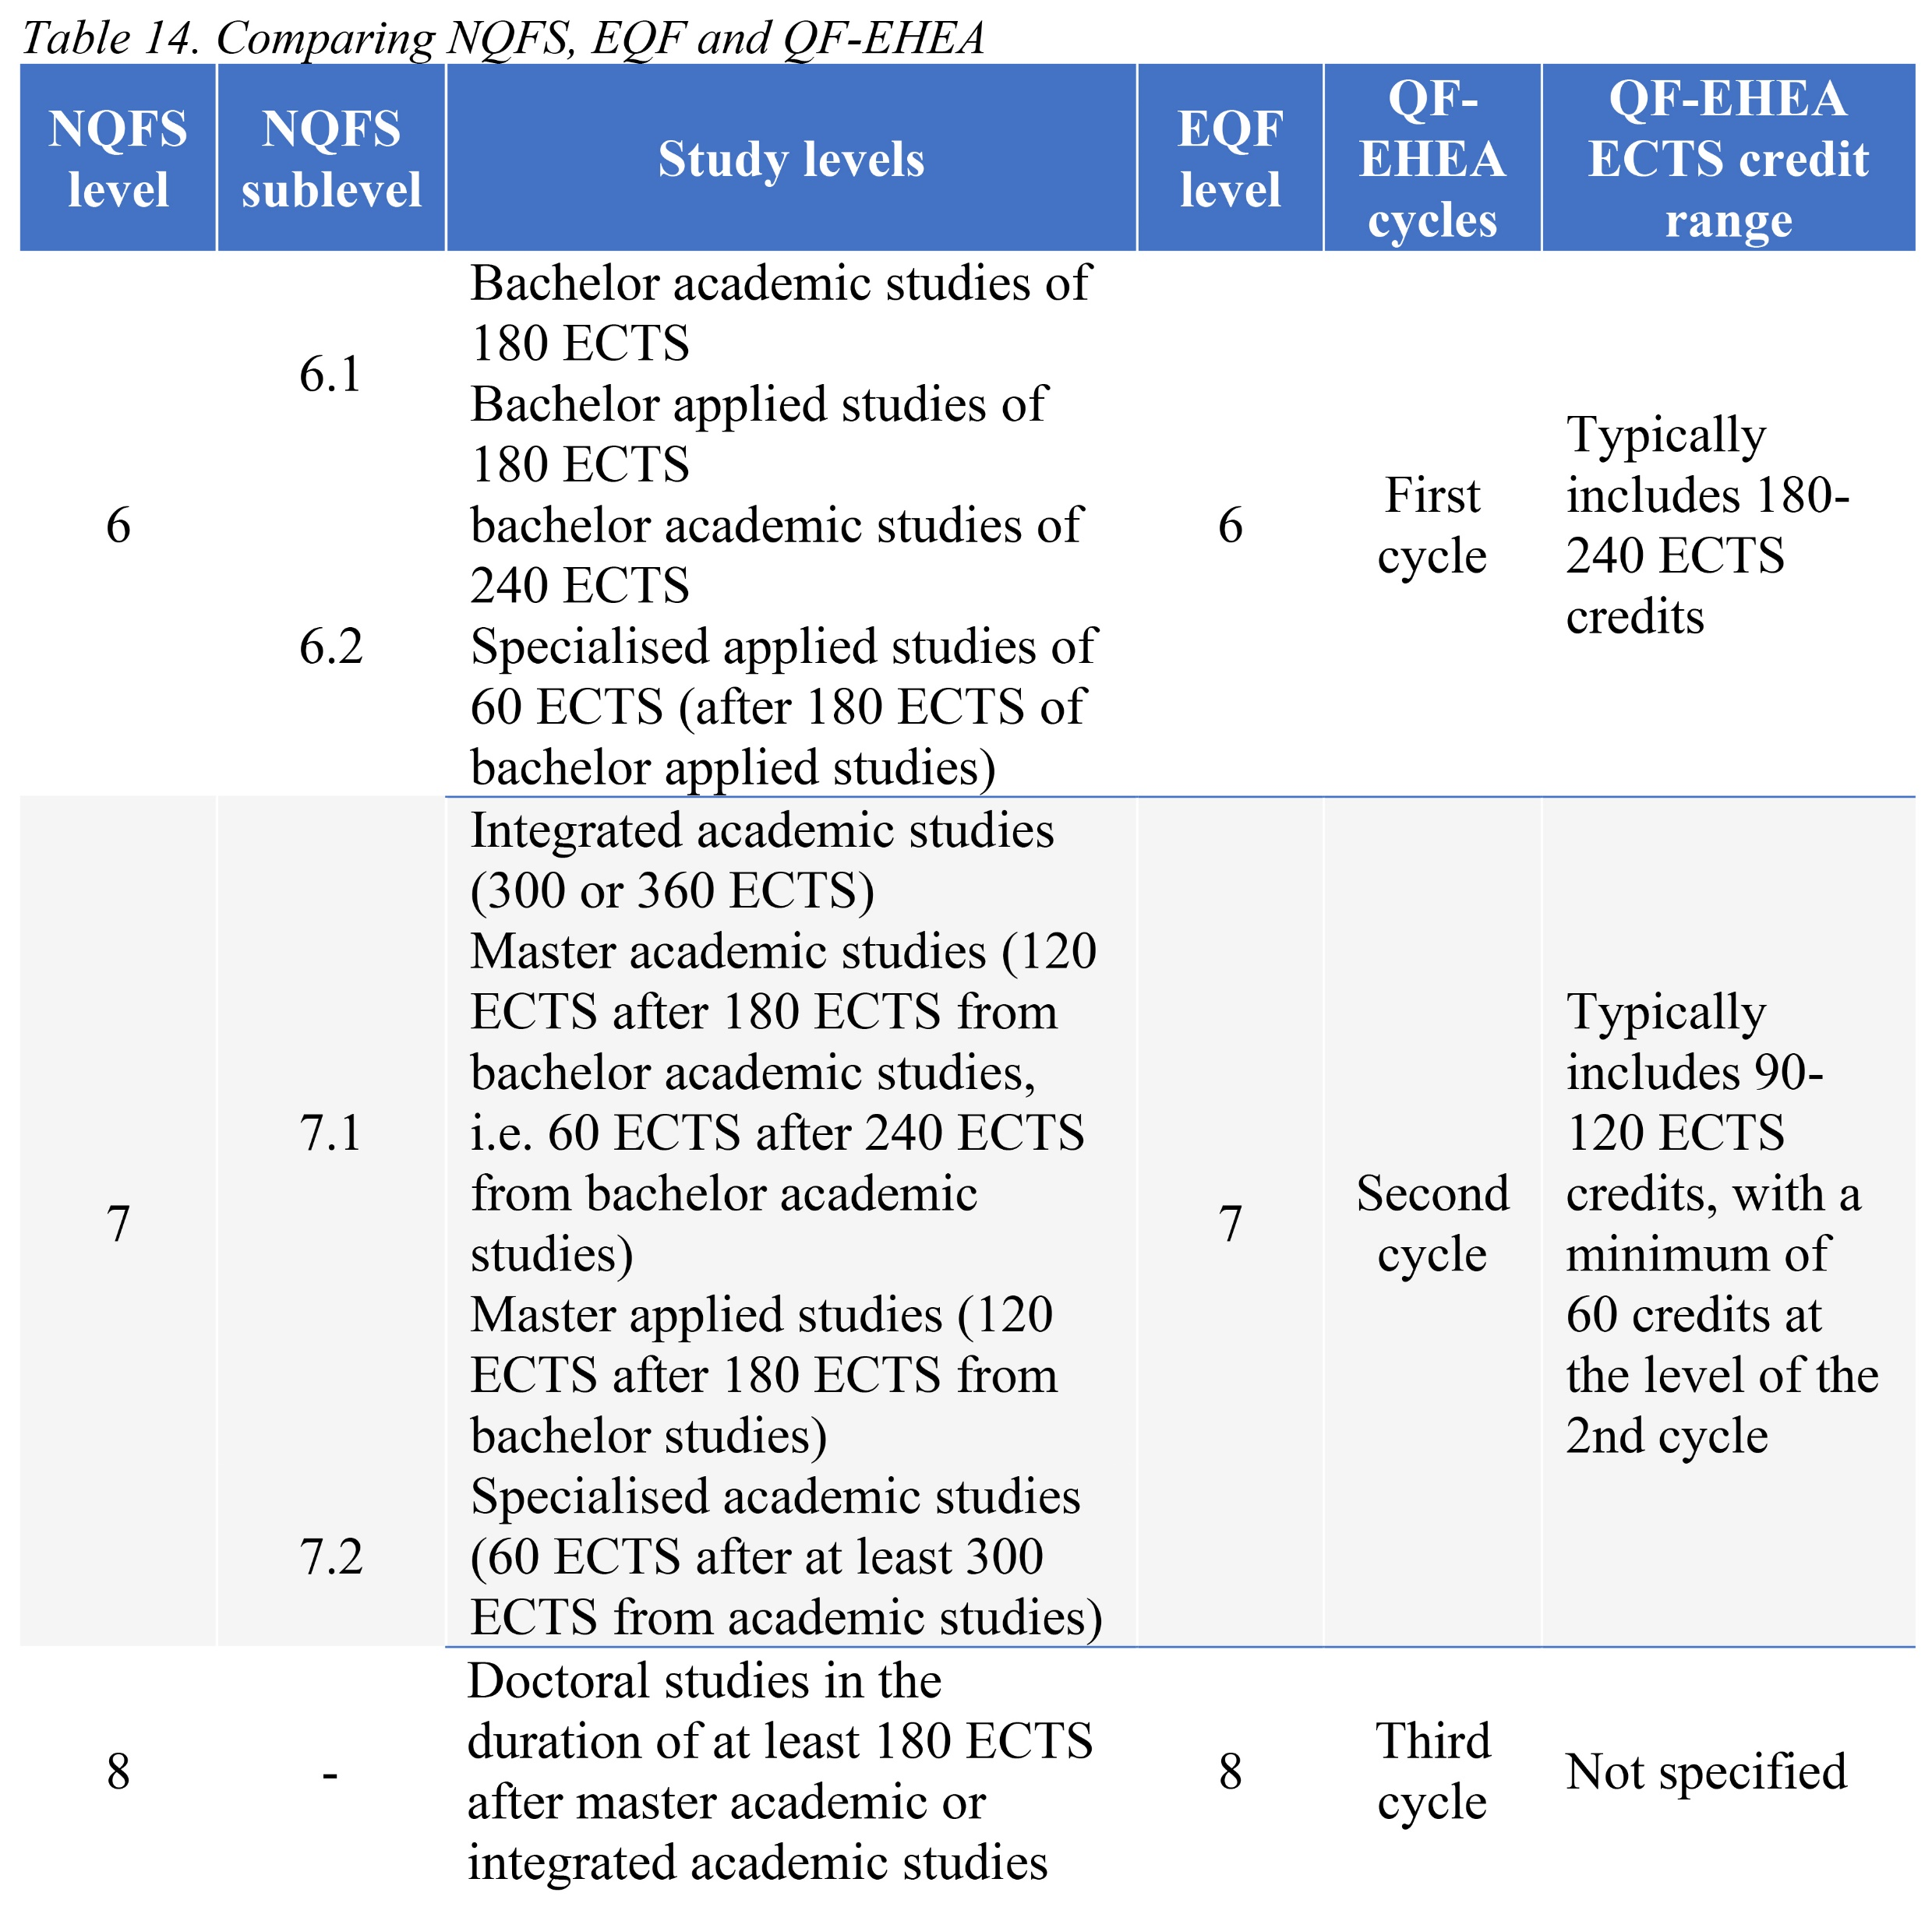
National Qualification Framework

Slide 22
Option A vs Option B
Currently, lifelong programs are not a part of the NQF in Serbia.
However, MCs, defined as the special case of lifelong learning programs, could become part of this system.
The question is HOW (based on the content of the MCs curricula?)?
Option A vs Option B - Draw

Slide 23
Article 111 – lifelong learning programs
A person enrolled in the program referred to in paragraph 1 of this article does not have the status of a student, in the sense of this law.
What does it mean not to be student?

Slide 24
Student rights - Article 101
The student of the higher education institution has the rights set out in this Law :
for quality education and objective evaluation;
on a timely and accurate information on issues related to studies;
on active participation in decision-making, in accordance with the Law;
for self-organization and expression of one's own opinion;
on privileges arising from student status;
to equally quality study conditions for all students;
for education in the language of the national minority, in accordance with the law and accredited study program;
for diversity and protection against discrimination;
compliance with personality, dignity, honor and reputation;
To choose and be dialed in the Student Parliament and other bodies of the higher education institution.

Slide 25
Student records - Article 113
The higher education institution leads: Student Book of Students and Diploma Diplomas and Appendices, Employees' Records, Records on Recognized Foreign Higher Education to continue to continue schooling and minutes of exam leasing.
Records of participants and issued certificates on completed short program of study.
Data enrolled in the records of higher education institutions are submitted to the Ministry for conducting the law of established tasks, in accordance with this Law.

Slide 26
Option A vs Option B
Currently, lifelong programs are not a part of the records system in Serbia.
However, MCs, defined as the special case of lifelong learning programs, could become part of this system.
The question is HOW (based on the content of the MCs curricula?)?
Option A vs Option B - Draw

Slide 27
Option A vs Option B
AND OUR CONCLUSION IS?

Slide 28
Thank you for your attention
Vielen Dank für Ihre Aufmerksamkeit
Gracias por su atención
sine@bio.bg.ac.rs
www.bio.bg.ac.rs

