Slide 1
Project acronym: MICROGUIDE Project full title: DEVELOPING GUIDELINES FOR THE IMPLEMENTATION OF MICRO-CREDENTIALS IN HIGHER EDUCATION Project No. 2021-1-ProjectRS01-KA220-HED-000027585 Funding Scheme: Erasmus+
ANALYSIS REPORT:
ANALYSIS OF THE ACCREDITATION PRACTICE IN GERMANY
Adisa Ejubovic
ACEEU Executive Director

Slide 2
German Accreditation System
The German accreditation system is organized in a decentralized way and characterized by its two approaches to accreditation.
On the one hand the accreditation of degree programmes (programme accreditation) and on the other the accreditation of the quality assurance system within a university (system accreditation), both conducted by accreditation agencies which need authorisation from the Accreditation Council (accreditation of agencies).
Basics
• Both types of accreditation are equally valid
• HEIs freely choose one of the types

Slide 3
Legal basis
International
• Standards and Guidelines for Quality Assurance in the European Higher Education Area (ESG)
• Communiqués of the EHEA ministerial conferences
• Lisbon convention
National
• Interstate Study Accreditation Treaty
• Specimen Decree/State Decrees on the accreditation of study programmes

Slide 4
German Accreditation Council
Central decision-making body on
• Programme accreditation
• Institutional accreditation
• Authorisation of agencies
Mission
• ensuring the consistency and coherence of accreditation decisions
• supporting the states in the further development of the German quality management system
• promoting international cooperation in the field of accreditation and quality assurance

Slide 5
German Accreditation Council
The German Accreditation Council ensures that the accreditation procedures are carried out quickly, reliably, on time and transparently from the application to the decision of the Accreditation Council. In particular, the administrative work involved in submitting applications should be kept to a minimum for higher education institutions and agencies.
It acts in accordance with the European Standards and Guidelines (ESG) and the Interstate Study Accreditation Treaty as well as its implementation through corresponding decrees of the Länder.
It ensures that accreditation decisions are taken independently of third parties and that potential conflicts of interest are prevented by means of appropriate measures.
It promotes the dialogue between all actors involved in the accreditation system and works towards a trustful cooperation of all represented stakeholders.

Slide 6
Programme Accreditation
The subject of programme accreditation are Bachelor's and Master’s programmes offered by state or state-recognised HEIs in Germany.
Differentiation between formal and academic criteria
Agencies assess the formal criteria
• Structure and duration
• Admission requirements
• Adequate academic degree
• Modularisation
• Credit-Point System

Slide 7
Programme Accreditation
Expert panels assess the academic criteria
• Qualification objectives and learning outcomes
• Curriculum
• Academic Mobility
• Teaching Staff
• Resources
• Examinations
• Workload and organisation
• Adequacy and up-to-dateness of the programme
• Quality assurance measures
• Gender equality and compensation of disadvantages
• Special regulations for joint degree programmes and other forms of cooperation

Slide 8
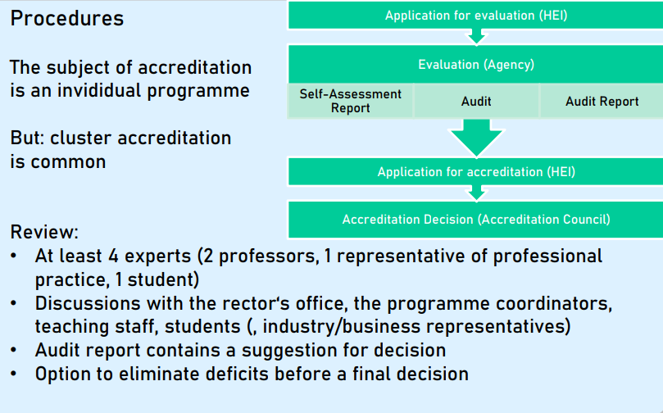
Programme Accreditation

Slide 9
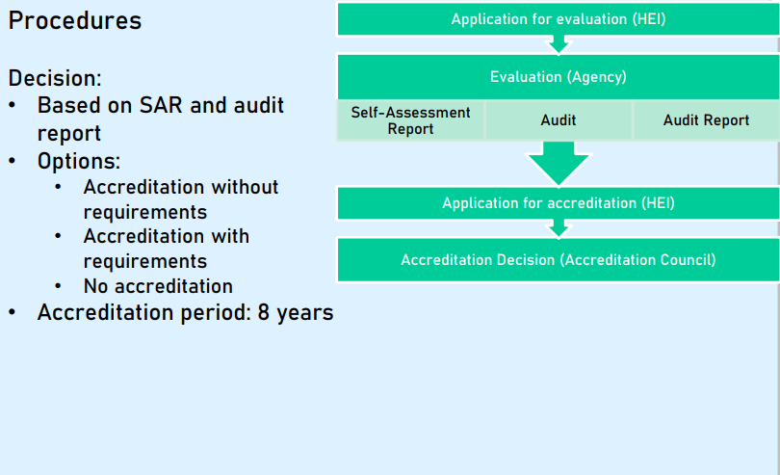
Programme Accreditation

Slide 10
Institutional Accreditation
The subject of institutional accreditation is an internal quality assurance system at an HEI. Institutional accreditation means that this QA system is able to ensure the compliance of all degree programmes with the formal and academic criteria.

Slide 11
Criteria
• Mssion statement for teaching
• Systematic realisation of formal and academic criteria for degree programmes
• Defined responsibilities and processes for design, continuous development and internal accreditation of degree programmes
• Involvement of all internal and external stakeholders
• Independence of assessment, appeals
• Sufficient resources
• Continuous development and revision of QA system
• Assessment of all areas relevant for teaching and learning
• Collection and utilisation of adequate data
• Documentation and transparency

Slide 12
Institutional Accreditation Procedure

Slide 13
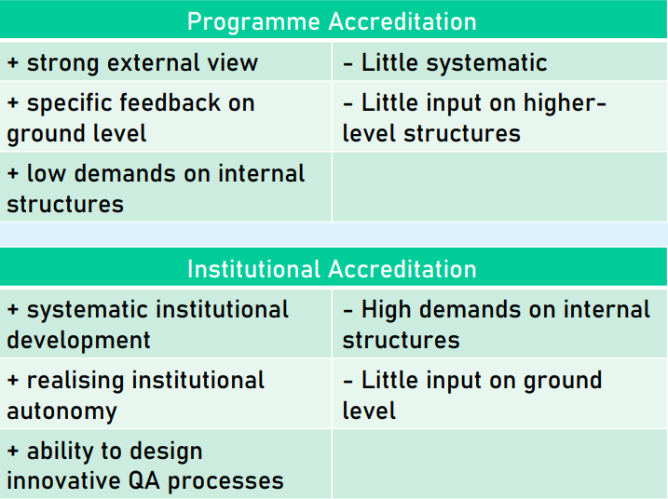
Comparison

Slide 14
Accreditation Agencies
The following agencies have been authorised by the Accreditation Council to operate in Germany:
AAQ Swiss Agency for Accreditation and Quality Assurance
ACQUIN Accreditation, Certification and Quality Assurance Institute
AHPGS Accreditation Agency in Health and Social Sciences
AKAST Agency for Quality Assurance and Accreditation of Canonical Programmes
AQ Austria Agency for Quality Assurance and Accreditation Austria
AQAS Agency for Quality Assurance through Accreditation of Study Programmes
ASIIN Accreditation Agency for Study Programmes in Engineering, Informatics, Natural Sciences and Mathematics
evalag Evaluation Agency Baden-Württemberg
FIBAA Foundation for International Business Administration Accreditation
MusiQue Music Quality Enhancement
ZEvA Central Evaluation and Accreditation Agency

