Slide 1
Introduction to Microcredentials and European Universities
Source: National framework for microcredentials (collegesinstitutes.ca)

Slide 2
Microcredentials?
The European community started a strong focus on
- cooperation,
- flexible learning (individualized) paths,
- modular course designs and
- micro-credentials

Slide 3
ERASMUS+ program guide 2021
Priorities applying to Erasmus+ Cooperation Partnership Programme
Addressing digital transformation through
- development of digital readiness,
- resilience and
- capacity
Horizontal
Priority
Promoting inter-connected higher education systems
strengthen the strategic and structured cooperation between higher education institutions through:
support for developing and testing various types of cooperation models, including virtual and blended cooperation and the use of different digital tools and online platforms;
improving mobility by implementing automatic mutual recognition of qualifications and learning outcomes, and by embedding mobility in curricula;
Sector -
Specific
Priorities

Slide 4
ERASMUS+ program guide 2021
Priorities applying to Erasmus+ Cooperation Partnership Programme
Stimulating innovative learning and teaching practices
tackle societal challenges through support for:
the development of learning outcomes and student-centred curricula that better meet the learning needs of students and reduce skills mismatches, while also being relevant for the labour market and for the wider society;
the development, testing and implementation of flexible learning pathways and modular course design (part-time, online or blended) and appropriate forms of assessment, including the development of online assessment;
c) promoting the lifelong learning dimension of higher education, including by facilitating the take-up, validation and recognition of short learning courses leading to micro-credentials;
Sector -
Specific
Priorities

Slide 5
What are Microcredentials ?
Flexible, inclusive learning opportunities
Micro-credentials certify the learning outcomes of short-term learning experiences,
for example, a short course or training.
They offer a flexible, targeted way to help people develop the knowledge, skills and competences they need for their personal and professional development.
Given their flexibility, micro-credentials can be
designed and delivered by a variety of providers
in many different formal, non-formal and informal
learning settings.

Slide 6
A micro-credential is a small volume of learning certified by a credential.
It explicitly defines outcomes in terms of specific knowledge, skills or competence with an indication of the associated workload required to achieve such outcomes.
Micro-credentials can be generally defined as sub-unit of credential or credentials that can be stacked into larger credentials.
In terms of workload they can be ranged from 2 to 30 ECTS.
Camilleri, A. (2019). Micro Credentials 101: What are they and why should we care? MicroHE MasterClass, Bled Slovenia, October 2019: https://microcredentials.eu/wp-content/uploads/sites/20/2019/10/20191021- Policy-Roadmaps-for-MicroCredentials.pdf

Slide 7
Shorter forms of learning opportunities than traditional qualifications are being developed rapidly across Europe and the world.
These opportunities are made available by a wide variety of public and private providers in response to the demand for more flexible, learner centred forms of education and training.
Micro-credentials can be particularly useful for people
who want to upskill or reskill to meet labour market needs
or to develop professionally after starting work.

Slide 8
Beneficiary
People who want to build on their knowledge but don't want to complete a full degree
are interested in further training or retraining to keep up with the needs of the labour market, or
to develop professionally after starting work
Microcredential providers
Microcredentials are offered by higher and vocational education and training institutions as well as by private institutions.
Source: Ein europäischer Ansatz für Microcredentials | European Education Area (europa.eu)

Slide 9
Project MicroCredX - Partners

Slide 10
Project MicroCredX - key questions
How can this cooperation be strengthened in order to cater to the skill demand of employers, and at the same time improve the employability rate of university students and raise the profile of HEIs embracing the adoption of study programme unbundling and micro-credential recognition?
What are the skills and competences the industry requires the most?
How can curricula adapt to current and emerging labour market needs?
How can we redesign our modules to become more market-oriented?
How can we develop efficiently MCs and provide them as online courses or MOOCs, catering not only to the needs of students of one’s own institution, but also to international students and employees needing professional development?

Slide 11
Project MicroCredX - targeted achievements
Work with institutional leadership in HE to identify and dismantle barriers to making course offerings more flexible via micro-credentials
Assist our institutions to extend their educational offerings in the field by integrating modules from other national and international providers
Launch combined course offerings made up of micro-credentials, specifically tailored to emerging industrial needs
Enable students to engage in virtual mobilities, taking advantage of these micro-credentials to enhance their studies and integrate them into their final qualifications.
Establish a network of institutions active in preparing students for industry 4.0 who recognise micro-credentials from within the network for access and progression
Distil the lessons of the consortium in implementing these offerings into a set of tools which can facilitate other HEIs in following the same path

Slide 12
Project MicroCredX - performance indicators
Our vision of achievements in numbers is as follows:
20 study programmes will be analysed by HEI partners to identify courses relevant for industry specific skill and competence provision (unbundling of study programmes)
4 study programmes for each partner
25 courses for these study programmes will be carefully selected or defined for MC development and uploaded into the MicroCredX Platform
5 MCs for each partner
12 micro-credentials from external MOOC and other course platforms will be selected for recognition in our HEI partners’ study programmes

Slide 13
Project MicroCredX - European activities
Microbol
2020-2022
https://microcredentials.eu/about-2/microbol/
MicroHE
2017-2020
https://microcredential.eu
MicroCredX
01.2022-12.2024
OEPass
2017-2020
https://oepass.eu/
DigiProf
01.2022-12.2024
ECCOE
2018-2022
https://eccoe.eu
13

Slide 14
Microcredentials - further informations
MicroCredentials 101: What are they an why should we care? - VideoLectures.NET
A European approach to micro-credentials | European Education Area (europa.eu)
MicroHE – Supporting Learning Excellence through Micro-Credentials in Higher Education (microcredentials.eu)
Micro-Credential – Wikipedia
(inzwischen wahrscheinlich schon leicht überholt)

Slide 15
European Universities Initiative
video:
European Universities
source: European Universities Initiative | European Education Area (europa.eu)

Slide 16
European Universities Initiative
European Universities are transnational alliances that will become
- the universities of the future,
- promoting European values and identity, and - revolutionising the quality and competitiveness of European higher education.
In order to achieve this major step forward, the initiative is offering opportunities to support diverse cooperation models for European Universities through the Erasmus+ calls for proposals.
source: European Universities Initiative | European Education Area (europa.eu)

Slide 17
European Universities Initiative
The alliances
include partners from all types of higher education institution and cover a broad geographic scope across Europe
are based upon a co-envisioned long-term strategy focused on sustainability, excellence and European values
offer student-centred curricula jointly delivered across inter-university campuses, where diverse student bodies can build their own programmes and experience mobility at all levels of study
adopt a challenge-based approach according to which students, academics and external partners can cooperate in inter-disciplinary teams to tackle the biggest issues facing Europe today
source: European Universities Initiative | European Education Area (europa.eu)

Slide 18
Project Application EU4Dual
A UNIVERSITY ALLIANCE TO BUILD
THE FIRST TRANSNATIONAL UNIVERSITY FOR COOPERATIVE (DUAL) EDUCATION

Slide 19
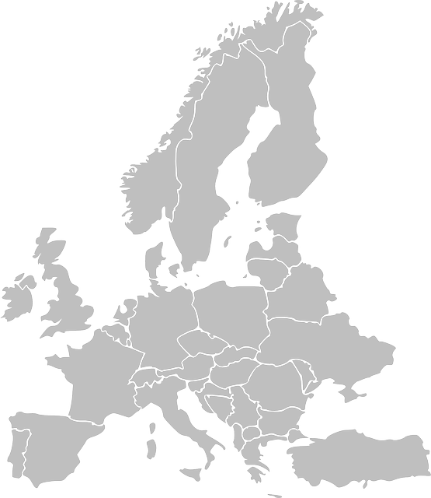
Project Application EU4Dual
Partner Name | Country | Type of partner
Mondragon Unibertsitatea (MU) | ES | Full Partner
Duale Hochschule Baden-Württemberg (DHBW) | DE | Full Partner
FH JOANNEUM (FHJ) | AU | Full Partner
Savonia UAS | FI | Full Partner
ESTIA Institute of Technology | FR | Full Partner
John von Neumann University (JNU) | HU | Full Partner
PAR University College | HR | Full Partner
Malta College of Arts, Science and Technology (MCAST) | MT | Full Partner
Koszalin Technological University (KTU) | PL | Full Partner

Slide 20
Project Application EU4Dual - The strategic triangle
Student
University
Company

Slide 21
Project Application EU4Dual - The strategic triangle =>stakeholder
Knowledge acquired
Stakeholder
Perspectives
Knowledge provided
Knowledge expected

Slide 22
Project Application EU4Dual collaboration in the strategic triangle
Self
development
Students /
Employee
Demands
Demands
Skills
Needs
Skills
Needs
Quality
Quality
Modularity
Customization
Collaboration
Qualifications
Micro-credentials
Business
development
Institutions
development
HE Institutions
Flexibility
World of Work
People
management
Demands
Skills
Needs
Quality

Slide 23
Project Application EU4Dual
Higher Education struggles with its position in society
flexible,
individual learning – personal relationship
labour market driven employability
training and recruiting
significant and rising graduate / academic un-employment
and mis-employment
priority for R&D and third party financing
excellence in teaching and student mentoring
lack of skilled workers and higher value of hands-on-skills
“pure education” / personal development („follow your dreams“)
massification and open source courses – anonymous

Slide 24
Project Application EU4Dual Fiche – European Universities 2021-11-30
Objectives of European Universities Alliance
Achieving the ambitious vision of an innovative, globally competitive and attractive European Education Area by 2025
Transforming the institutional cooperation between higher education institutions and bring it to the next level
Mobilising all four missions of higher education institutions:
education,
research,
innovation and
service to society

Slide 25
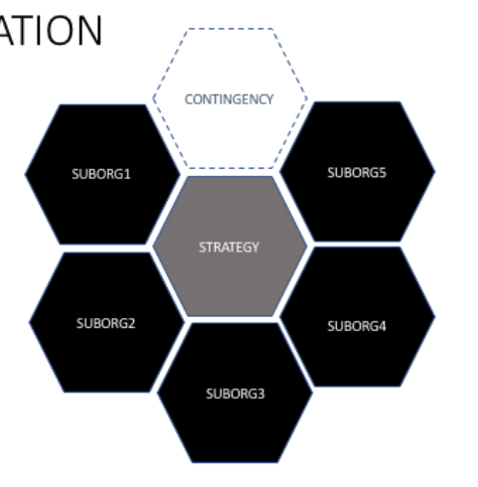
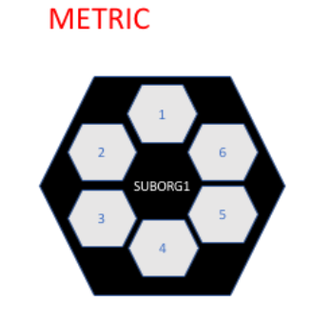
Project Application EU4Dual Project structure 1
Organisation
of Hubs

Slide 26
Project Application EU4Dual - Project structure 2
WP1
Governance & Strategy
& Management
& Standards
WP8
WP2
Quality & Cooperation Standards
Dual-Education Center of Excellence
WP7
WP3
Stakeholder Engagement (University-Business)
Work
packages
Innovation Challenges
(Grand & Specific Challenges)
WP6
WP4
Mobility
New Learning Pathways
(Micro-credentials)
WP5
Research Coordination
FHJ

Slide 27
Project Application EU4Dual - Grand Challenges (GC)
Partner 3
Partner 5
GC 1
World of Work
Infrastructure
Partner2
Partner 5
Partner 8
Partner5
Partner 7
GC 2
Healthy Ageing
Partner7
GC 3
Green Economy
Partner9
Tools
WP 3
Gesundheitsinstitute
IAP

Slide 28
Project Application EU4Dual - Structure of GC 1
Interdisciplinary
Collaboration
HEI Staff
Students
Skills for Future
Business
Twin Transition
Serviti-sation
GC 1
Future of work
Tools
Smart Industry
Circular Economy
Collaborative Intelligence
Infrastructure

Slide 29
Project Application EU4Dual - Structure of GC 2
Interdisciplinary
Collaboration
HEI Staff
Students
Food Management
Business
Personalized
Nutrition
Culinary Science
GC 2
Healthy
Aging
Tools
Inter-professional health care
??
Applied Health Sciences
Infrastructure

Slide 30
Project Application EU4Dual - Structure of GC 3
Interdisciplinary
Collaboration
HEI Staff
Students
Business
GC 3
Green Economy
Tools
Infrastructure

Slide 31
Project Application EU4Dual

