Slide 1
Qualifications Agency
Developing Guidelines for the implementation of micro credentials in HE, MicroGuide Erasmus Project, Qualifications Agency, 11-12thJuly 2022.

Slide 2
THE FOUNDER
Government of the Republic of Serbia ("Official Gazette of RS", No. 27/2018)
JURISDICTION
Providing expertise and professional support in the process of developing qualifications and ensuring quality in the implementation of the National Qualifications Framework of the Republic of Serbia and connecting the qualifications system with the European Qualifications Framework.

Slide 3
Serbian Government
12 SSC
252 members
Ministry of Education, Science and Technological Development
Management Board
Director
Director’s office
Deputy director
ENIC/NARIC Centre
Centre for qualifications development and support to Sector Skills Councils
Centre for Accreditation of providers in Adult Education
Office for general and legal affairs
Accounting and finance department

Slide 4
Main tasks
assessment of initiatives for the introduction of new qualifications;
provision of expertise and administrative-technical support to sector skills councils (SSC), and development of proposals for qualification standards;
management of the NQFS Register according to the The National Qualifications Classification System (CLASSNQFS), aligned with the International Standard Classification of Education (ISCED 13-F);
recognition of foreign school qualifications and professional recognition;
accreditation of providers in non-formal AE (PROAEA);
external evaluation of PROAEA;
monitoring the measures and effects of the implementation of (new) qualifications on employment and lifelong learning;
preparation of developmental projects, analysis and research of importance for the development of qualifications.

Slide 5
National qualification framework of RS - NQFS

Slide 6
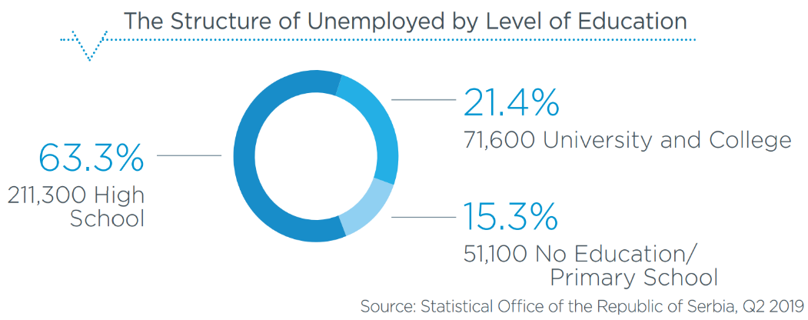
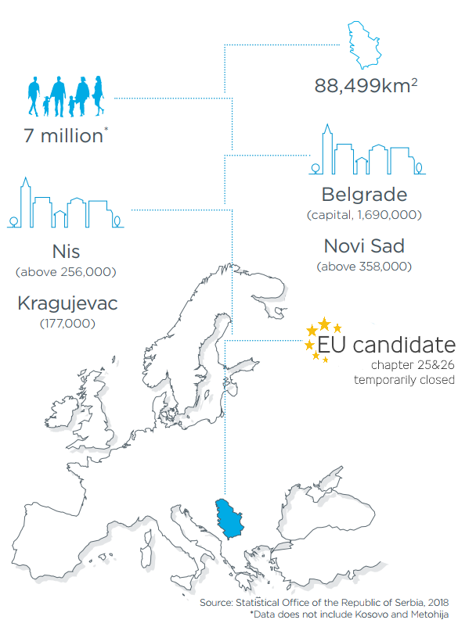
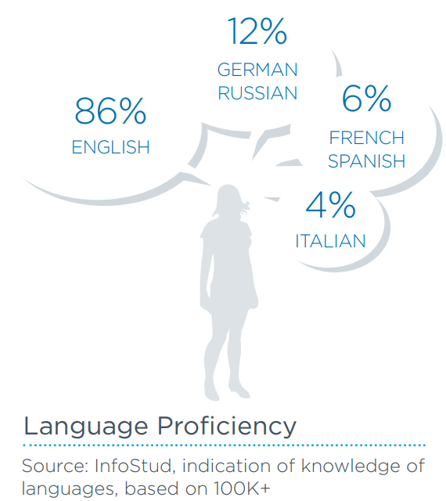

Slide 7
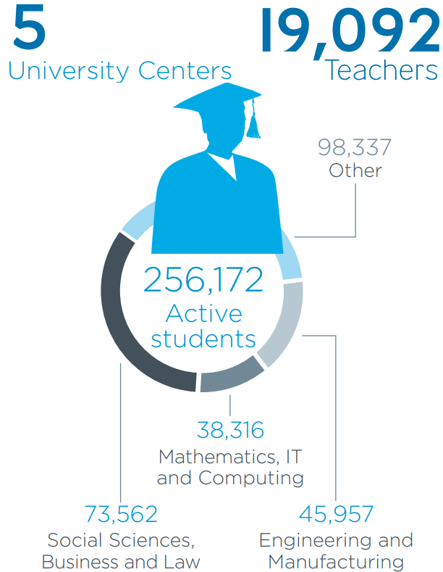
Education system in numbers

Slide 8
ŠEMA
2

Slide 9
Main characteristics of NQFS
NQFS is the system that regulates qualifications in the Republic of Serbia;
It includes the number and description of qualifications, the relationships between qualifications and the paths of mobility and advancement;
Qualifications are classified in NQFS into eight (8) levels and four (4) sub-levels;
It serves for the development of qualification standards based on the needs of the labour market, the individual and society as a whole;
It contributes to the improvement of cooperation between relevant interested parties, i.e. social partners: educational institutions, institutions, employers and trade unions -SSC;
NQFS enables improvement of access, transparency, flexibility of paths and permeability in the education system, and recognition/validation of non-formal and informal learning (competencies acquired through work experience);
It ensures comparability and recognition of qualifications obtained in the Republic of Serbia with qualifications obtained in other countries.

Slide 10
NQFS-EQF
NQFS contains eight levels corresponding to the levels of the European Qualifications Framework;
The structure of the NQFS is also designed in accordance with the EQF and includes descriptors for each (sub)level of qualification, based on the concept of learning outcomes;
There is a correlation and compatibility between the language and the concepts descriptions of both framework levels;
The NQFS contains specific attributes as a result of national context and legislation, so that statements of knowledge, skills, abilities and attitudes are aligned with the policy of defining learning outcomes, i.e. all are formulated as verbs.
EQF | NQFS
1 | 1
2 | 2
3 | 3
4 | 4
5 | 5
6 | 6.1
 | 6.2
7 | 7.1
 | 7.2
8 | 8
REPORT on referencing National Qualifications Framework of the Republic of Serbia to the European Qualifications Framework for Lifelong Learning and Self-certification to the Qualifications Framework of the European Higher Education Area
Notes:
POINTS OF EQUIVALENCE – STRUCTUAL AND CONCEPTUAL
COMPREHENSIVE AND INTEGRATIVE, Qualifications in NQFS are classified into eight (8) levels and four (4) sublevels

Slide 11
Specific NQFS attributes
Two sublevels at level 6 and 7 as result of national context and stakeholders acceptance of qualifications in new framework
The skills descriptions in the NQFS have been extended to other aspects such as 'complexity of problems', 'communication', 'use of equipment’
Abilities and attitudes - apart from the main determinants (responsibility and autonomy) for description of outcomes per levels, contain other criteria, for example “demonstrating entrepreneurialism”
3, 4 and 5 are slightly demanding than EQF levels (international experts observation)

Slide 12
NQFS Institutional Framework
Institution | Key responsibilities
Ministry of Education, Science and Technological Development (MoESTD) | Monitoring the implementation of NQF law and coordination of institutions and bodies Adoption of Methodology for development of qualifications standards Adoption of qualification standards Adoption of standards for self-evaluation and external assessment of accredited adult education providers
NQFS Council (NQFSC) | Advising on the quality of the NQFS implementation and referencing to EQF Adoption of qualifications standards proposal Recommendation on SSC establishment Monitoring SSC operation
Qualifications Agency (QA) | Providing professional support to referencing process and implementation of NQFS Providing professional and technical support to NQFS Council and SSC Development of qualification standards proposals Management of the NQFS Register Accreditation of providers in Adult Education Recognition of foreign qualifications
Sectoral Skills Councils (SSC) | Decision making on initiatives for qualification standard development Mapping and identifying relevant qualifications within the Sector Identifies qualification that are outdated Proposes list of qualification that are suitable for RPL

Slide 13
NQFS Legislation framework
Secondary legislation
Standards of services of career guidance and counselling
(“Official Gazette RS”,
no. 43/19)
The NQFS Register
Methodology for development of qualification standards
Form and content of Initiative for development of qualification standard
Standards for self-assessment and external evaluation of providers of Adult education
Procedure and standards for RPL
The Law on NQFS
Qualifications framework:
qualification levels and descriptors, types of qualifications, qualifications classification system, available form of learning, career guidance and counselling
Bodies and institutions:
NQF Council, NQF Agency, Sector Skills Councils, Ministry responsible for education
Quality assurance:
qualification standard processes (Initiative for development, drafting the proposal and adoption of qualification standard) registration of the qualifications, referencing the NQF to EQF;
Recognition of foreign qualifications
Accreditation of providers of (non-formal) Adult Education
Notes:
MENTIONED PRINCIPLES IN CHANGING TRADITIONAL APPROACH TO QUALIFICATION IS COMPLETELY EMBEDED IN LAW

Slide 14
Types of qualifications
TYPE | NQFS LEVEL | FORM OF EDUCATION/LEARNING | QUALIFICATION TITLE
GENERAL | NQFS 1 | FORMAL | PRIMARY EDUCATION (TWO CYCLES, 8 YEARS)
 | NQFS 4 | FORMAL | GYMNASIUM (4 YEARS)
VOCATIONAL | NQFS 2 | FORMAL / NON-FORMAL | MANIPULATOR IN FOOD PRODUCTION (2 YEARS)
 | NQFS 3 | FORMAL / NON-FORMAL | BAKER (3 YEARS)
 | NQFS 4 | FORMAL | FOOD PROCESSING TECHNICIAN (4 YEARS)
 | NQFS 5 | FORMAL / NON-FORMAL | BAKER – SPECIALIST (1 YEAR)
ACADEMIC | NQFS 6.1 | FORMAL | AGRICULTURAL ENGINEER (180 ECTS)
 | NQFS 6.2 | FORMAL | GRADUATED AGRICULTURAL ENGINEER (240 ECTS)
 | NQFS 7.1 | FORMAL | MASTER AGRICULTURAL ENGINEER (60 ECTS)
 | NQFS 7.2 | FORMAL | SPECIALIST AGRICULTURAL ENGINEER (60 ECTS)
 | NQFS S 8 | FORMAL | PHD – BIOTECHNICAL SCIENCES (180 ECTS)
PROFESSIONAL | NQFS 6.1 | FORMAL | PROFESSIONAL AGRICULTURAL ENGINEER (180 ECTS)
 | NQFS 6.2 | FORMAL | PROFESSIONAL SPECIALIST AGRICULTURAL ENGINEER (60 ECTS)
 | NQFS 7.1 | FORMAL | PROFESSIONAL MASTER AGRICULTURAL ENGINEER (120 ECTS)
Notes:
In the Republic of Serbia, a comprehensive, integrated national qualifications framework has been established to cover all levels and types of qualifications, regardless of the way they are acquired (through formal or non-formal education, or informal learning – (life or work experience) and the age at which they are acquired ( young or adult);the clarity of their interconnection

Slide 15
Qualification standard elements
QUALIFICATION STANDARD
Title of the qualification:
Code of the qualification
BASIC QUALIFICATION CHARACTERISTICS | RELEVANCE OF QUALIFICATION FOR EMPLOYMENT AND FURTHER LEARNING
CLASSNQFS / ISCED-F 2013 | Permeability within the qualifications system
NQFS LEVEL | Occupation(s) to which qualification is related
EQF level | Occupational standard^{[1]}
Type of the qualification | Duties and tasks / only if there is no occupational standard
Scope of the qualification (in credits or duration of programme) | LEARNING OUTCOMES
Preconditions for the acquisition of the qualification | General description of the qualification
Form of learning/education | Knowledge
Type of public document | Skills
 | Abilities and attitudes
 | Type of assessment of the achievement of learning outcomes
QUALIFICATION STANDARD REFERENCE DATA | QUALIFICATION QUALITY ASSURANCE
Effective Date | Qualifications of programme organizers/teachers
Revision date | The body competent for issuing the document
End date
^{[1]} Article 50. paragraph 3. of the Law on NQFS stipulates that until the adoption of occupational standards in accordance with the regulations relevant to employment, the link between qualification standards and the labour market will be based on the data on occupations determined in accordance with labour and employment regulations.
Notes:
5 groups of data, established in standardized format and structure
Correlation of OS and QS

Slide 16
Procedure for inclusion of qualification in NQFS
Bodies
(councils)
Government institutions (Ministries, Agencies, Institutes)
Schools, Universities, Faculties, Private providers
Employers, Professional associations
Initiative for developing and adopting the qualifications standard
Elaborate justification of qualification and proposal of qualification standard
Qualification Agency
Assessment of the relevance of the Initiative
Sector Skill Council
Methodology of qualification standard development
Decision making on development of qualification standard
Qualification Agency
Development of qualification standard
Rulebook on NQFS Register
Rulebook on CLASSNQFS
NQFS Council
MoESTD
Qualification Agency
Adoption of qualification standard
Adoption
NQFS Register

Slide 17
Recognition of prior learning (VNFIL)
an AE activity which is achieved through the assessment of knowledge, skills, abilities and attitudes acquired through education, life or work experience, which enables further learning and increases competitiveness in the labour market; the term is equated with the term VNFIL, in line with the European guidelines for validating non-formal and informal learning (NQFS Law)
2014. Concept of RPL
2019. with the IPA project support Concept is revised and in this moment bylaw on RPL is in implementation
List of qualifications for RPL (levels 2,3 and 5) is proposed by SSC
Competency based assessment will be applied in process of recognition based on qualification standards
Notes:
THE IDEA OF REVISED CONCEPT AND PILOTING IS ALSO TO TO SET THE CREDIBLE SYSTEM, SO WE CAN BUILD TRUST…ENHANCE VALIDATION in LIFELONGPERSPECTIVE

Slide 18
Credit System
ECTS is based on the principle that the sum of 60 ECTS points corresponds to the overall average student engagement during a 40-hour workweek in an academic year.
Student workload - about 1500-1800 hours per year - 1 ECTS credit is awarded for about 25-30 working hours.
The student workload expressed through ECTS credits implies the time required to complete learning activities: attending classes, seminars, consultations, independent research and learning, project preparation, exams, practical classes, etc.
Transfer of ECTS credits is possible between different study programs, within the same cycle and type of studies, while in international mobility programmes transfer of ECTS credits is possible also between different cycles and types of studies
Implementation of the system ECVET is foreseen in the Strategy, but neither decision nor regulation has been adopted.

Slide 19
NQFS Register
NQFS Register is a public database in which qualifications are classified and which contains relevant information on qualifications.
Role of the NQFS Register:
transparent integration of the data on nationally recognized qualifications at all levels;
comparability of learning outcomes achieved at different levels, within different types and different forms of learning;
linking data on qualifications to occupations;
comparability of qualification levels in Serbia with EQF and QF-EHEA levels.
Notes:
Qualifications regulated by the NQFS are nationally recognized and recorded in the NQFS Register.

Slide 20
NQFS Register Structure
https://noks.azk.gov.rs/en.html
Sub-registers | Content - data
National Qualifications | New qualifications Active qualifications: - level NQFS 1 - qualifications on level 2-5 NQFS from 1987. - levels 6.1 to 8 NQFS from Bologna process introduction, 2005. Register has Archive which contains qualifications made before active qualifications, because they are mostly represented in working population
Qualification standards | Standards of qualifications - defined in line with Qdevelopment Methodology
Publicly Recognized Organizers of Adult Education Activities (PROAEA) | Accredited PROAEA - approved adult education programs/activities and employers with whom PROAEA realize practical work.
Notes:
THIS WAS AGGREEMENT OF KEY STAKEHOLDERS TO INCLUDE IN SUBREGISTER ALL RELEVANT Q FOR LM

Slide 21
Quality assurance in HE
STANDARD | PROCESS | COMPETENT INSTITUTIONS/ BODIES
qualification | development adoption | Qualifications Agency Sector skills council NQFS Council Ministry of Education, Science and Technological Development
programmes | accreditation of programmes and higher education institutions issuing a work permit | National Council for Higher Education (standards) National Entity for Accreditation and Quality Assurance Ministry of Education, Science and Technological Development
student achievements / certification | grading final thesis | Higher education institution
quality of work of the institution | external evaluation self-evaluation | National Entity for Accreditation and Quality Assurance Higher education institution

Slide 22
Procedures for inclusion of qualifications in the national framework are transparent
Qualification standard development
QA and SSC
Accreditation
NEAQA/CAQA
Register of Qualifications
(QA)
New HE Qualification
Qualification does not exist yet
Register of Qualifications
Standards (QA)
Active HE Qualification
Accreditation
NEAQA/CAQA
Register of Qualifications
(QA)

Slide 23
Thank you for your attention! www.azk.gov.rs
https://noks.azk.gov.rs/

