Slide 1
Project acronym: MICROGUIDE Project full title: DEVELOPING GUIDELINES FOR THE IMPLEMENTATION OF MICRO-CREDENTIALS IN HIGHER EDUCATION Project No. 2021-1-ProjectRS01-KA220-HED-000027585 Funding Scheme: Erasmus+
MICROGUIDE - C1 TRAINING
7th – 11th November 2022, Graz, Austria
Developing Guidelines for the implementation of micro credentials
in higher education (MicroGuide)

Slide 2
CORSHIP.eu - corporate edupreneurship
OUR MISSION OF the pROJECT corship is
TO ESTABLISH AND IMPROVE THE COLLABORATION ACROSS EUROPE
BETWEEN STARTUPS, CORPORATES AND UNIVERSITIES WITH INNOVATIVE TRAINING.

Slide 3
CORSHIP.eu - corporate edupreneurship
The consortium of corship

Slide 4
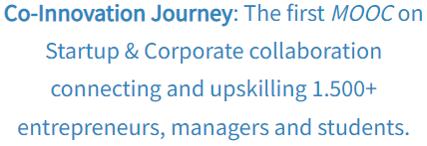
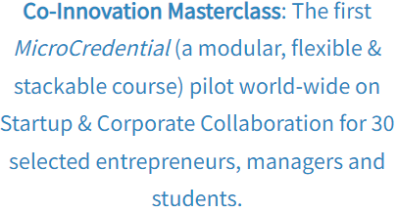
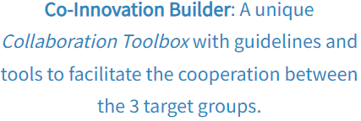
CORSHIP.eu - corporate edupreneurship
The results of corship
https://www.corship.eu/mooc/
https://www.corship.eu/microcredential/
https://www.corship.eu/toolbox/

Slide 5
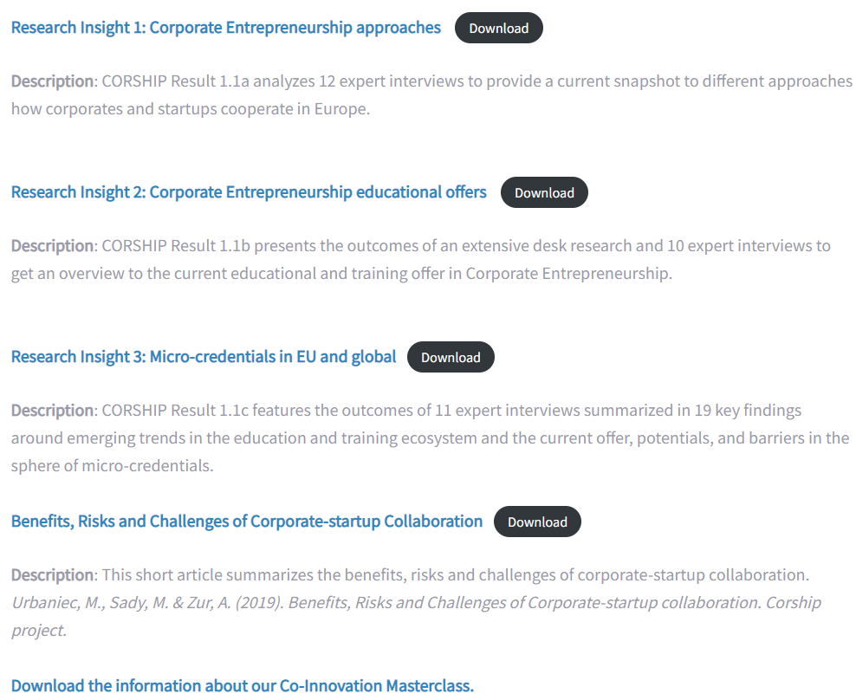
CORSHIP.eu - corporate edupreneurship
The research results of corship
https://www.corship.eu/research-insights/

Slide 6
CORSHIP.eu - corporate edupreneurship
The research insight 3: Micro-credentials in EU and global
TABLE OF CONTENT Executive summary ........................................................ 3
1. Introduction ................................................................................................ 5
2. Methodology ............................................................................................... 7
3. The Rise of Micro-credentials ...................................................................... 8
3.1 Definitions and Micro-credential overview ............................................... 8
3.2 Existing Projects and Initiatives ................................................................11
MicroHE & OEPASS ..............................................................................11
European Short Learning Programmes (E-SLP) project .......................11
Common Microcredential Framework (CMF) by EMC .... ...................12
Digital Credentials collaboration .........................................................12
4. Key Findings from Expert Interviews ..........................................................13
4.1 Emerging Trends & Framework Conditions ..............................................13
4.2 Perception of Status Quo ..........................................................................15
4.3 Barriers & Challenges ................................................................................17
4.4 Potentials & Opportunities .......................................................................20
5. Summary and Recommendations ...............................................................24
References .......................................................................................................26
Appendix ..........................................................................................................27

Slide 7
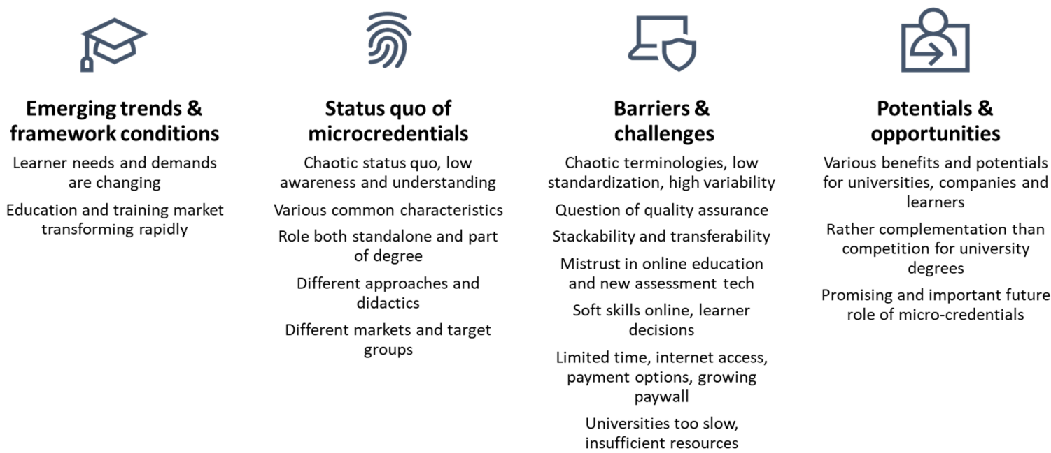
CORSHIP.eu - corporate edupreneurship
The research insight 4: KEY FINDINGS FROM EXPERT INTERVIEWS (overview)
source: Corship RESULT 1.1c MICRO-CREDENTIALS IN EU AND GLOBAL, p.13

Slide 8
CORSHIP.eu - corporate edupreneurship
The obvious challenges & learnings
© Christian Friedl

Slide 9
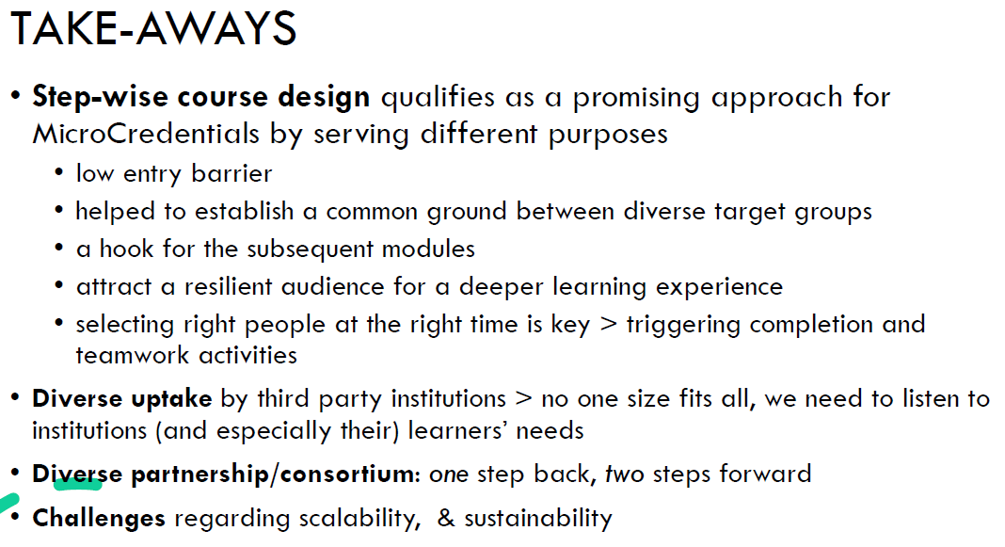
CORSHIP.eu - corporate edupreneurship
The „Take aways“ out of research
© Christian Friedl

Slide 10
CORSHIP.eu - corporate edupreneurship
Appendix
© Christian Friedl

