Slide 1
Project acronym: MICROGUIDE Project full title: DEVELOPING GUIDELINES FOR THE IMPLEMENTATION OF MICRO-CREDENTIALS IN HIGHER EDUCATION Project No. 2021-1-ProjectRS01-KA220-HED-000027585 Funding Scheme: Erasmus+
Analysis of the micro-credential implementation practice in Serbia Graz, 07 – 11. October 2022
Prof. Dr. Sinisa Djurasevic
University of Belgrade

Slide 2
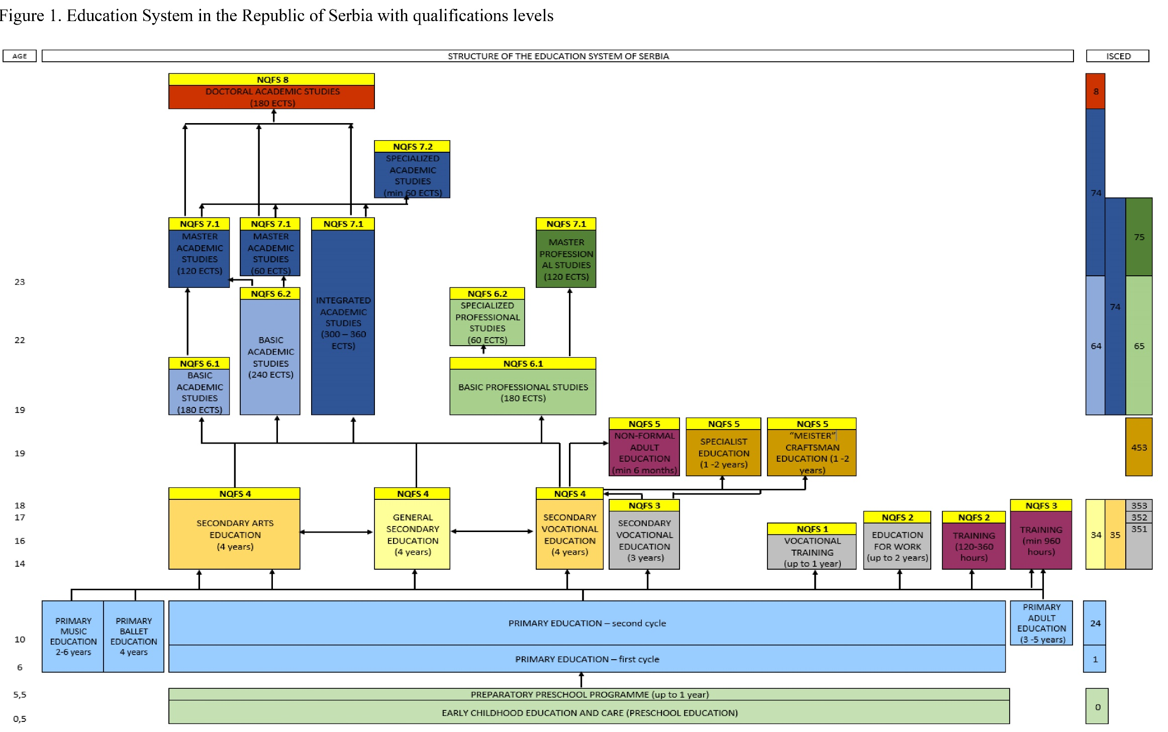

Slide 3
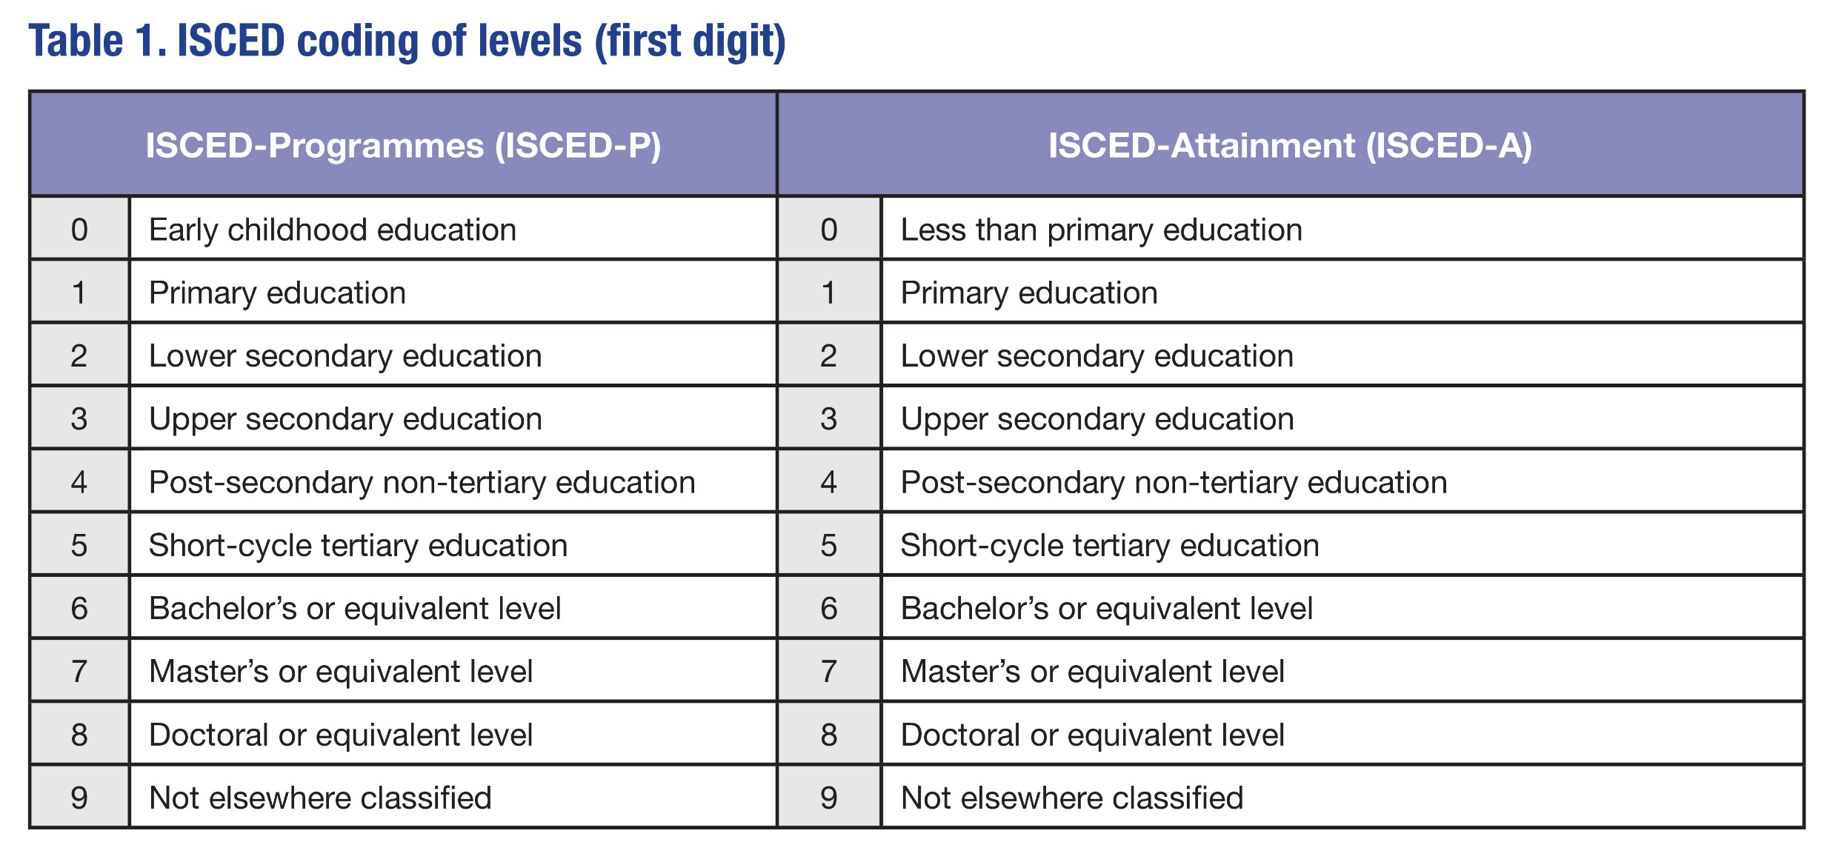
ISCED

Slide 4
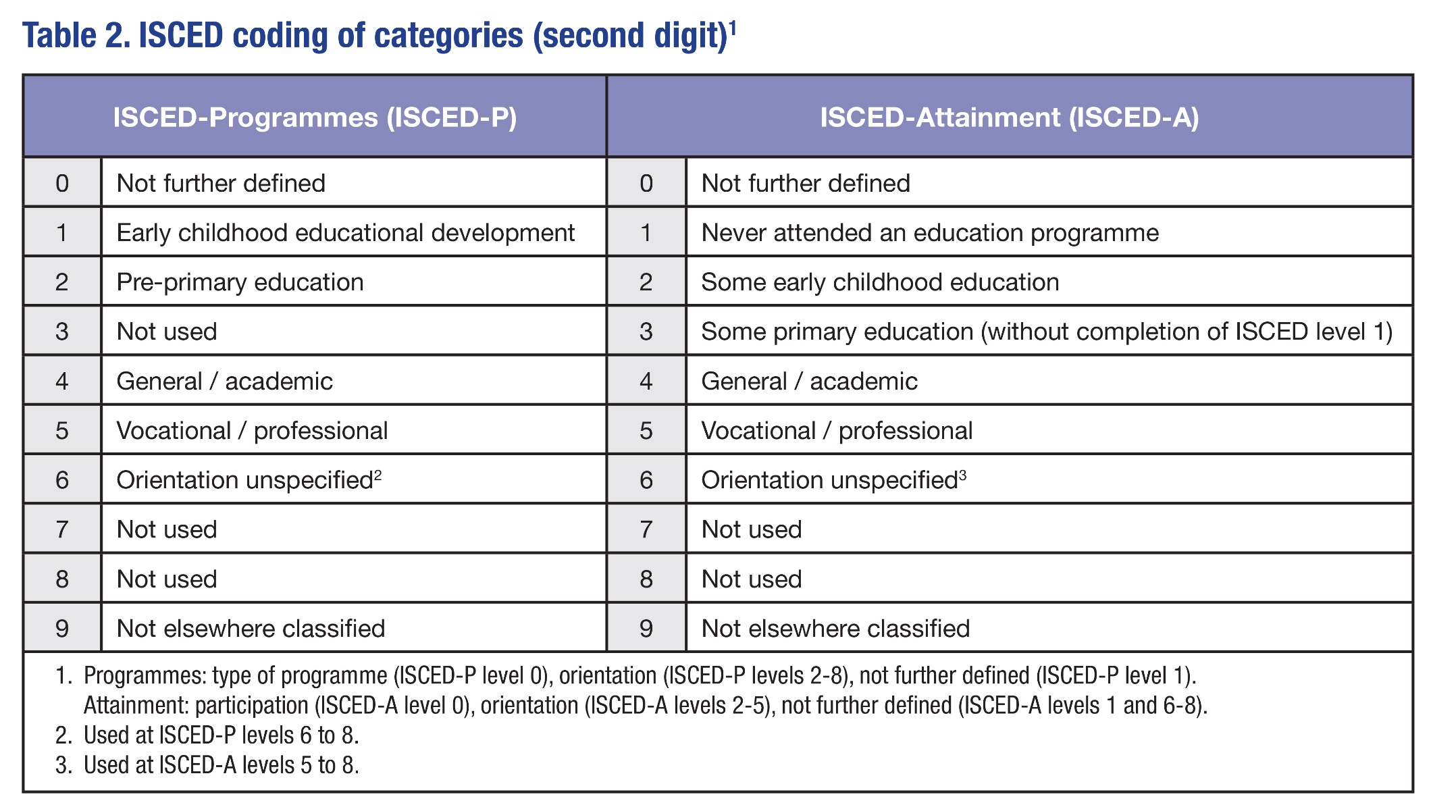
ISCED

Slide 5
Institutional framework
The Ministry of Education, Science and Technological Development (The Ministry of Education, from 2022):
is competent for planning and ensuring the functioning of the education system in accordance with the general principles and education system goals. The main tasks of the Ministry are: planning and monitoring the development and improvement of the quality of preschool education and upbringing, primary, secondary and higher education; evaluation of the quality of education and achievement of education system goals based on the data from the integrated education information system, researches and analysis; supervision of preschool institutions, primary and secondary schools and higher education institutions; licensing teachers and coordinating their professional development. In addition, it ensures participation in international studies and activities related to education policies within EU programmes and projects and continuously monitors and implements measures to increase the coverage of children, students and adults at all levels of education and prevent their dropout.

Slide 6
Institutional framework
The National Education Council:
is an advisory body competent for the development and improvement of the quality of preschool education and upbringing, primary and secondary general and arts education, especially in the way of providing opinion on standards of achievement in general education, preschool education and upbringing and general primary and secondary education programmes, competency standards for teachers and headmasters, quality standards for institutional operations. The National Education Council has 35 members appointed by the Government of the Republic of Serbia from the Serbian Academy of Sciences and Arts, Matica Srpska, Conference of Universities of Serbia, national councils of national minorities, Serbian Orthodox Church, Commission for Religious Education, professional associations, professional societies and representatives of trade unions.

Slide 7
Institutional framework
The Council for Vocational Education and Adult Education:
is an advisory body competent for the development and improvement of the quality of secondary vocational education and training and adult education. The Council gives opinions on the qualification standards for vocational qualifications, specific standards of achievement for secondary vocational education, the vocational part of the curricula and exams in vocational education. The Council monitors, encourages and instructs activities that link education and employment and their impact on economic development and meeting labour market needs and participates in the preparation of strategic documents in the area of vocational and adult education. The Council for Vocational Education and Adult Education consists of 17 members appointed by the Government from: the rank of members of the Chamber of Commerce and Industry, artisans, associations of employers, experts in the area of vocational education and adult education, industry, employment, labour, social and youth policy, representatives of the associations of vocational schools and two members of representative trade unions.

Slide 8
Institutional framework
The National Council for Higher Education:
is an advisory body competent for monitoring the development of higher education and its compliance with European and international standards, proposing the enrolment policy to the Ministry, adopting standards and procedures for accreditation and quality control and standards for quality assessment and self-evaluation of higher education institutions and study programmes, establishing scientific fields and areas within the field as well as the list of professional, academic and scientific titles; it proposes to the Government norms and standards for higher education institutions’ operations, as well as material resources for their implementation, upon obtaining an opinion from the Conference of Universities of Serbia and the Conference of Academies of Applied Studies, deciding in the second instance on the complaints in the accreditation process, establishing minimum criteria for the appointment to the rank of professor, and adopting the Foundations of the Code of Academic Integrity and the Conflict of Interest when Appointing to the Rank of Professor or Associate and Employing Staff in Higher Education Institutions in the Republic of Serbia and establishes a list of study programme reviewers in the accreditation process.

Slide 9
Institutional framework
National Entity for Accreditation and Quality Assurance in Higher Education:
is an independent body established by the Government, which has competence in quality assurance in higher education through the implementation of the accreditation process and external quality control of higher education institutions and study programmes. The expert body of the National Entity participating in the accreditation process and quality control of higher education institutions and study programmes is the Commission for Accreditation and Quality Assurance, which has 17 members selected at the proposal of the National Council for Higher Education.

Slide 10
Institutional framework
The Qualifications Agency:
is a Government’s professional organization established by the Law on the National Qualifications Framework of the Republic of Serbia11, competent for developing qualification standards, recognition of foreign school and higher education documents, accreditation of organizations in the area of adult education – Publicly Recognized Organizers of Adult Education Activities. It provides support to the Council for the National Qualifications Framework and proposes quality assurance measures throughout the entire education system. The most important tasks of the Qualifications Agency in the implementation of the NQFS relate to reviewing initiatives for the introduction of new qualifications, providing professional support to the Sector Skills Councils and preparing proposals for qualification standards, maintaining the NQFS Register, external quality control of the PROAEA, monitoring and measuring the effects of the qualification implementation on employment and lifelong learning. The Agency submits an annual report to the Government of the Republic of Serbia and on request periodic reports to the Ministry of Education, Science and Technological Development.

Slide 11
Institutional framework
Sector Skills Council:
is an expert and advisory body established on the principle of social partnership, whose main role is to carry out activities relevant to concrete qualifications within a certain sector, acquired in secondary, vocational, higher education and adult education. The Government of the Republic of Serbia issued decisions on the establishment of 12 Sector Skills Councils covering the sectors of education and economy 12. Mandatory institutionally delegated members of the Sector Skills Councils are the representatives of the Chamber of Commerce and Industry and representative associations of employers (representatives of entrepreneurs), Council for Vocational Education and Adult Education, National Employment Service, Conference of Universities of Serbia and Conference of Academies of Applied Studies, associations of vocational schools, the Ministry of Education, Science and Technological Development, the ministry responsible for the area of work covered by the Sector Skills Council, trade unions, Institute for the Improvement of Education. Sector Skills Council reports annually to the Qualifications Agency, the Ministry of Education, Science and Technological Development and the Government of the Republic of Serbia.

Slide 12
The regulatory and strategic framework
1) The Law on the Foundations of the Education System;
2) The Law on Preschool Education;
3) The Law on Primary Education;
4) The Law on Secondary Education;
5) The Law on Dual Education;
6) The Law on Adult Education;
7) The Law on Higher Education;
8) The Law on the Dual Model of Studies in Higher Education;
9) The Law on Regulated Professions and the Recognition of Professional Qualifications
10) The Law on the National Qualifications Framework;
11) The Law on Education Inspectorate

Slide 13
The regulatory and strategic framework
Higher education is regulated by the Law on Higher Education, which incorporates the principles of the Bologna Declaration and the Lisbon Convention.
The Law on the Dual Model of Studies was adopted in September 2019 creating a legal basis for the introduction of a dual study model in which part of the study programme is implemented through work-based learning with an employer.
By adopting the Law on Regulated Professions and the Recognition of Professional Qualifications, the Directive 2005/36/EC (OG 124/09, 45/11) on the recognition of professional qualifications was integrated in the legal system of the Republic of Serbia. In the process of drafting this law, which will enter into force after the accession of the Republic of Serbia to the EU, the need to regulate the fulfilment of the requirements for performing professions regulated by individual laws in almost identical way in order to timely prepare the system for the implementation of the Directive.

Slide 14
Higher education institutions
Higher education is carried out by following higher education institutions:
1) University;
2) Faculty, or Art academy within a University;
3) Academy of applied studies;
4) College;
5) College of applied studies.
A university, academy of applied studies, college and college of applied studies are independent higher education institutions.
Depending on their founder, they can be state or private.

Slide 15
Higher education institutions
University is an independent higher education institution which, in the implementation of its activities, integrates educational, scientific and research, professional, artistic and innovation activities, as components of a single higher education process. University may realise all types and study cycles. In order for a higher education institution to qualify for the status of a university, it must implement academic study programmes at all study levels, within at least three educational-scientific, i.e. educational-artistic fields and three scientific, artistic or professional areas. Exceptionally, a university may be established in the field of arts if it has all three study cycles in at least three areas of arts and art sciences.
Universities carry out their educational, scientific and artistic activity through the faculties and art academies which are their part, and which do not have the status of an independent higher education institution.

Slide 16
Higher education institutions
Academy of applied studies is an independent higher education institution which, in the performing its activities, integrates educational, applied research, professional and artistic activities as components of a single higher education process. An academy of applied studies may realise bachelor applied studies, master applied studies and specialised applied studies. A higher education institution has the status of an academy of applied studies if it realises at least five accredited applied study programmes in at least two educational-scientific, or educational-artistic fields.

Slide 17
Higher education institutions
College is an independent higher education institution implementing bachelor (undergraduate) academic studies, master academic studies and specialised academic studies in one or more scientific, artistic or professional areas.
College of applied studies is an independent higher education institution that realises bachelor applied studies, specialised applied studies and master applied studies in one or more scientific, artistic or professional area.

Slide 18
Studies
According to the type, studies are divided into academic and applied:
academic studies train students to develop and apply scientific, artistic and professional achievements;
applied studies to apply and develop professional knowledge and skills required in order to enter the labour market.
By cycle, studies are divided in first, second and third cycle of studies. First cycle studies:
bachelor academic studies of three and four-year duration (180-240 ECTS);
bachelor applied studies of three-year duration (180 ECTS);
specialised applied studies of one-year duration (60 ECTS) after applied or academic studies of three-year duration (180 ECTS).

Slide 19
Studies
Second cycle studies:
integrated academic studies of five and six-year duration (300-360 ECTS);
master academic studies of one-year duration (60 ECTS) after bachelor academic studies of four-year duration (240 ECTS), or master academic studies of two-year duration (120 ECTS) after bachelor academic studies of three-year duration (180 ECTS);
master applied studies of two-year duration (120 ECTS) after bachelor academic or bachelor applied studies of three-year duration (180 ECTS);
specialised academic studies of one-year duration (60 ECTS) after master academic studies.
Third cycle studies are doctoral academic studies of three-year duration (180 ECTS) after integrated academic studies of at least five-year duration (300 ECTS) or master academic studies.

Slide 20
Studies
In addition to academic and applied studies, higher education institution may also organize a Short study programme of the scope from 30 to 60 ECTS credits.
These programs are organized for the professional training of persons with at least secondary education and for the purpose of entering the labour market.
Short study programmes have a clearly defined structure, purpose and learning outcomes and upon completion, a certificate with obtained competencies is issued.
Short study programmes defined in this way are different from Short-cycle study programmes in the European Higher Education Area, since there is no level or descriptor for them in the National Qualifications Framework.
Also, these programs are not subject to accreditation as defined for the first, second and third cycle study programmes, but a decision of a higher education institution’ professional body is sufficient.

Slide 21
Study programmes
The scope of a study programme is expressed through ECTS credits, which define the workload of students while mastering the foreseen learning outcomes.
A sum of 60 ECTS credits corresponds to the average total student engagement over a 40-hour workweek during one school year. Total student engagement consists of active learning activities (lectures, exercises, practicums, seminars, etc.), individual work, colloquiums, exams, final thesis, student internships, voluntary work in the local community and other forms of engagement.
The total number of active learning hours cannot be less than 600 hours during one school year.
The total workload of 30 hours of an averagely successful student equal to 1 ECTS.

Slide 22
Study programmes
For the purposes of accreditation, a study programme defines:
the name and study programme objectives;
the type of study;
the outcomes of the learning process in accordance with the law that establishes the national qualifications framework;
professional, academic, scientific or artistic title (i.e. qualification);
enrolment requirements for a study programme;
the list of mandatory and elective study areas or subjects, with indicative content;
the credit value of each subject;
the credit value of the final thesis in bachelor, specialised and master studies and doctoral dissertation or doctoral artistic project, expressed in ECTS credits;
preconditions for enrolment related to individual subjects or group of subjects.

Slide 23
Study programmes
The bachelor and specialised study programmes may foresee a final thesis. The master study programme includes the obligatory final thesis.
A doctoral dissertation is the final part of a doctoral study programme, except for a doctoral study programme in arts for which an art project represents the final part. Exceptionally, a doctorate may also be awarded to a person with completed medical studies and appropriate specialization in accordance with the law regulating health care, and on the basis of a successfully defended dissertation based on papers published in top world journals, in accordance with standards set by the National Council for Higher Education. The number of credits of the final thesis, that is, the final part of a study programme, is included in the total number of credits required for the completion of studies.
ECTS credits can be transferred between different study programmes, within the same cycle and type of studies.
For students participating in international mobility programmes, ECTS credits can be transferred between different study programmes within all cycles and types of studies.

Slide 24
Students
All persons who have completed secondary education, that is who have passed the Matura exam – have the right to higher education. From the school year 2021/2022, students with the completed General and Vocational Matura will be eligible to enrol in higher education.
Upon completing a study programme, the person obtains an appropriate professional, academic or scientific title (qualification), namely:
the person who completes bachelor academic studies of the scope of 180 ECTS credits obtains the qualification “bachelor” in an appropriate area, and the person who completes bachelor academic studies of the scope of 240 ECTS credits qualification „bachelor with honours“;
the person who completes bachelor applied studies of the scope of 180 ECTS credits obtains the qualification “bachelor (appl.)“ in an appropriate area, and the person who completes specialised applied studies of the scope of 60 ECTS (in total 240 ECTS throughout the entire studies) the qualification “bachelor specialist (appl.)“;

Slide 25
Students
the person who completes master academic studies obtains the qualification “master“ in an appropriate area, and the person who completes master applied studies the qualification “master (appl.)“;
the person who completes specialised academic studies (at least 360 ECTS throughout the entire studies) obtains the qualification “master specialist“ in an appropriate area;
the person who completes doctoral academic studies obtains the qualification doctor of sciences (Ph.D.), or doctor of arts (D.A.), with the indication of the field, or area.
Public documents obtained upon completing a study programme are the Diploma and the Diploma Supplement. The diploma supplement must also contain the description of the higher education system in the Republic of Serbia.

Slide 26
Quality assurance in higher education
National Council for Higher Education
monitor the HE development and its compliance with European and international standards and propose higher education policy to the Ministry;
propose to the Government norms and standards for the operations of higher education institutions, as well as material resources for their implementation, upon obtaining an opinion from the Conference of Universities of Serbia and the Conference of Academies of Applied Studies;
at the proposal of the National Entity for Accreditation and Quality Assurance in Higher Education establish standards for initial accreditation of higher education institutions and study programmes, standards and procedures for accreditation of higher education institutions and study programmes, standards for self-evaluation and quality assessment of higher education institutions, and standards for external quality assessment of higher education institutions;
at the proposal of the Conference of Universities of Serbia and the Conference of Academies of Applied Studies establish minimum criteria for appointment to the rank of professor, adopts the Foundations of the Code of Academic Integrity and the Conflict of Interest when Appointing to the Rank of Professor or Associate and Employing Staff in Higher Education Institutions in the Republic of Serbia.

Slide 27
Quality assurance in higher education
National Entity for Accreditation and Quality Assurance in Higher Education
The role of performing the activities related to the accreditation, quality assurance of higher education institutions and their units, evaluation of study programmes and quality assurance in higher education in Serbia belongs to the National Entity for Accreditation and Quality Assurance in Higher Education.
It is financed by the revenues acquired through the accreditation and quality assurance of higher education institutions and their units fees, evaluation of study programmes fees and quality assurance in higher education fees, as well as from other incomes in accordance with the law

Slide 28
Quality assurance in higher education
Commission for Accreditation and Quality Assurance
The Commission for Accreditation and Quality Assurance is an expert body of Entity, which conducts the procedure of accreditation of higher education institutions and study programmes and the procedure of external quality assurance of higher education institutions, in accordance with the law and prescribed procedures and standards for accreditation and external quality control
The competencies of the Commission for Accreditation and Quality Assurance
decide on the application for accreditation and conduct the procedure of accreditation of institutions and study programmes in the field of higher education;
prepare a report on the initial accreditation in the procedure for issuing a work permit;
conduct the external quality control procedure;
ensure the harmonisation of the implementation of standards and procedures in the field of accreditation, within the European Higher Education Area;
propose to the Entity Director reviewers from the list established by the National Council for Higher Education

Slide 29
Quality assurance in higher education
Conference of Universities
The Conference of Universities was established to coordinate work, establish common policies, pursue common interests and carry out the tasks established by the law.
All accredited universities are the members of the Conference of Universities, represented by Rector.
The University is entitled to delegate one additional representative to the Conference of Universities for every 1,000 teachers and associates, and also to delegate another representative to the Conference of Universities for every 5,000 students.
Competences of the Conference of Universities are to:
consider issues of common interest for the advancement of educational – scientific and educational – artistic activities at universities, harmonise attitudes and coordinate the activities of universities, especially in the field of enrolment policy, and propose measures to improve the financial position of universities and student standards;
give opinion on quality standards for educational, scientific research, artistic and professional work;
propose candidates for members of the National Council for Higher Education and the Managing Board of Entity;
propose a list of professional, academic, scientific or artistic titles in the relevant fields, abbreviations and a description of the qualifications of those titles.

Slide 30
Quality assurance in higher education
Conference of Academies of Applied Studies in Serbia
The Conference of Academies of Applied Studies was established to coordinate work, establish common policies, pursue common interests and carry out tasks established by the law.
The Conference of Academies of Applied Studies consists of accredited College, Academies of Applied Studies and Colleges of Applied Studies. Academies of Applied Studies, and Colleges of Applied Studies are represented in the Conference of Academies of Applied Studies by the President or Director.
Competences of the Conference of Universities are to:
to discuss issues of common interest for the advancement of educational – professional and educational-artistic activities, harmonise attitudes and coordinate activities of academies of applied studies and colleges, especially in the field of enrolment policy, and propose measures to improve the material position of academies of applied studies and colleges and students’ standard;
to give an opinion on quality standards of educational, research, artistic and professional work;
to propose a list of professional titles in the relevant fields, abbreviations and a description of the qualification of those names;
to propose candidates for members of the National Council for Higher Education and the Managing Board of Entity

Slide 31
Quality assurance in higher education
Students Conferences
The Students Conference of Universities and the Students Conference of Academies of Applied Studies were established to pursue the common interests of students as partners in the process of implementation of higher education.
The Students Conference of Serbian Universities is composed of representatives of university's student parliaments. The Students Conference of Academies of Applied Studies is composed of the representatives of student parliaments of academies of applied studies, colleges and colleges of applied studies.
Student conferences have the right to give an opinion on the standards for self- evaluation and quality assessment of higher education institutions, proposed by Entity and established by the National Council for Higher Education

Slide 32
Recognition of foreign HE documents
ENIC/NARIC Centre, as an internal organisational unit of the Qualifications Agency, evaluates the foreign study programme, or a part of the study programme for the purpose of employment. Based on the evaluation, the ENIC/NARIC Centre issues a decision on professional recognition.
The decision on professional recognition contains the name, type, degree and duration (scope) of the study programme, the scientific, artistic or professional field within which the study programme was completed, the qualification as it is stated in the foreign higher education document – in the original language and translated into Serbian, as well as the NQFS level to which the qualification corresponds

Slide 33
Recognition of foreign HE documents
The evaluation of a foreign study programme in order to continue the education is carried out by the professional body of an independent higher education institution to which an application for academic recognition has been submitted.
Based on the evaluation, the independent higher education institution issues a decision on academic recognition.
if it is determined that there is a substantial difference between the knowledge and skills achieved in relation to the conditions for enrolment in a particular study programme, further education or enrolment in higher education cycle may be either denied or conditioned by the obligation to obtain additional learning outcomes.
Criteria for determining the existence of a significant difference between the type and level of acquired knowledge and skills in relation to the conditions for enrolment in a particular study programme are prescribed by an independent higher education institution.

Slide 34
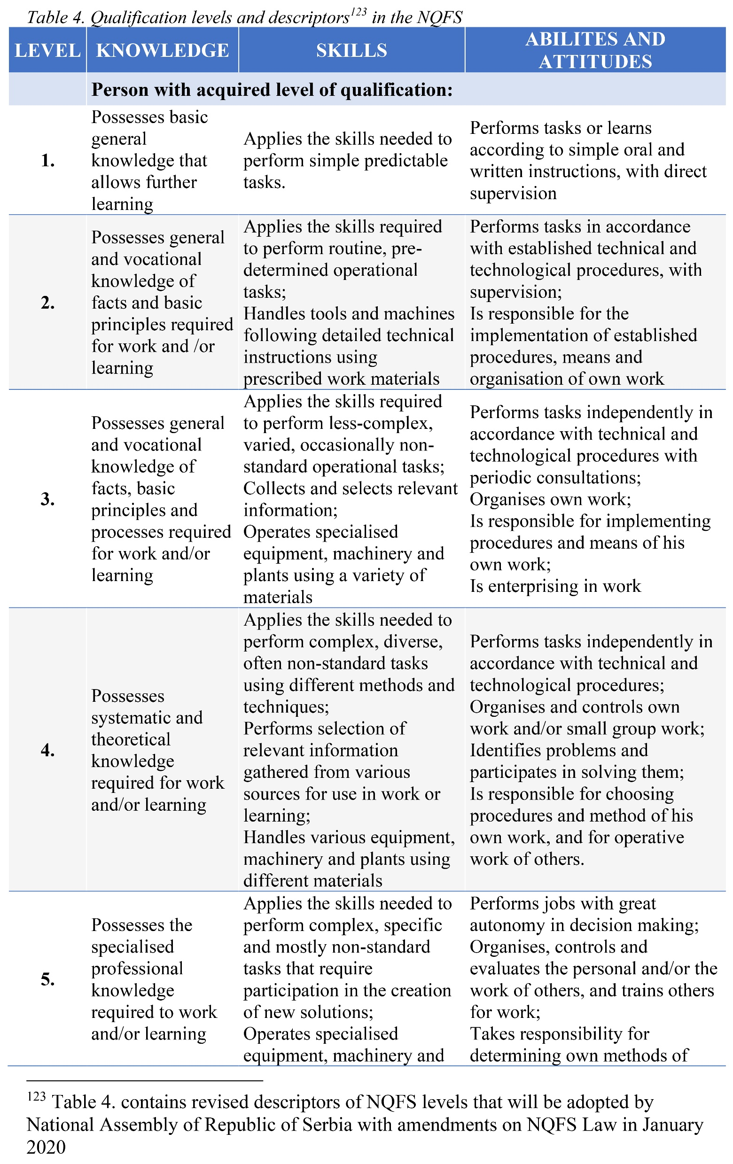
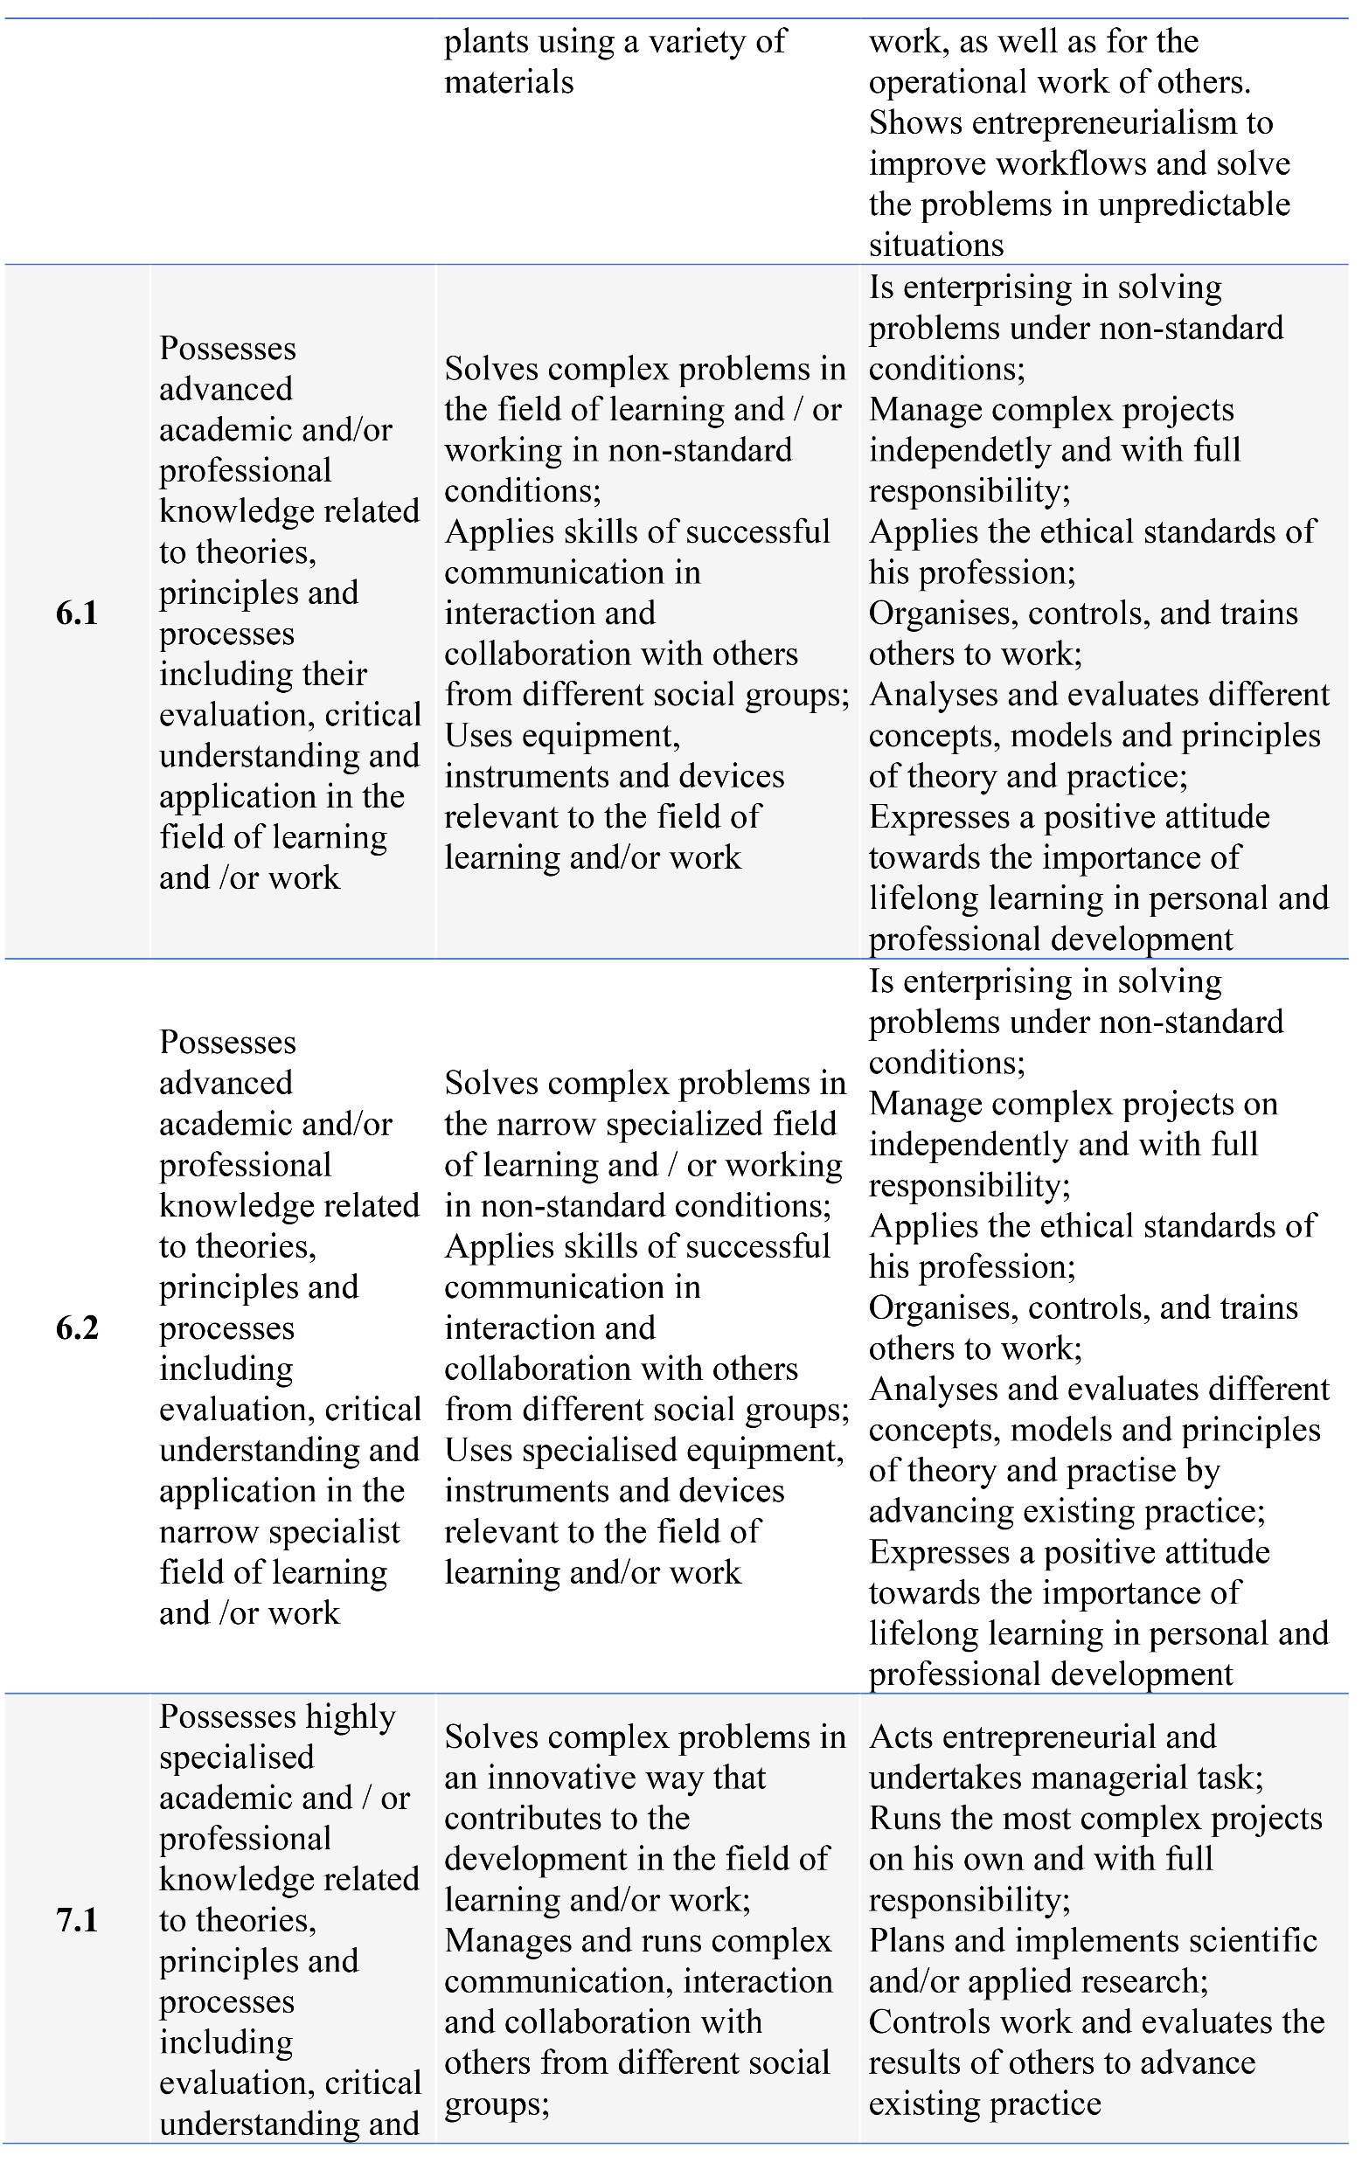
National Qualification Framework

Slide 35
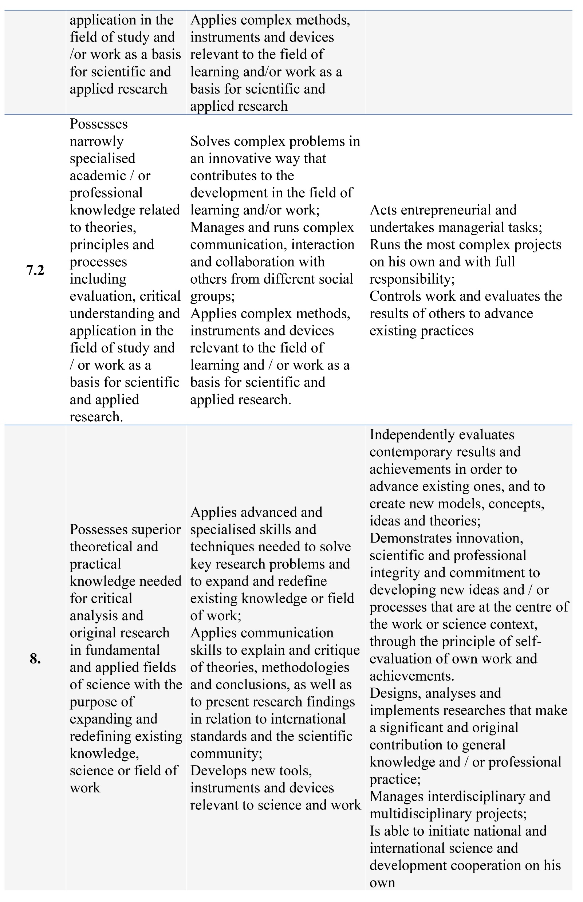
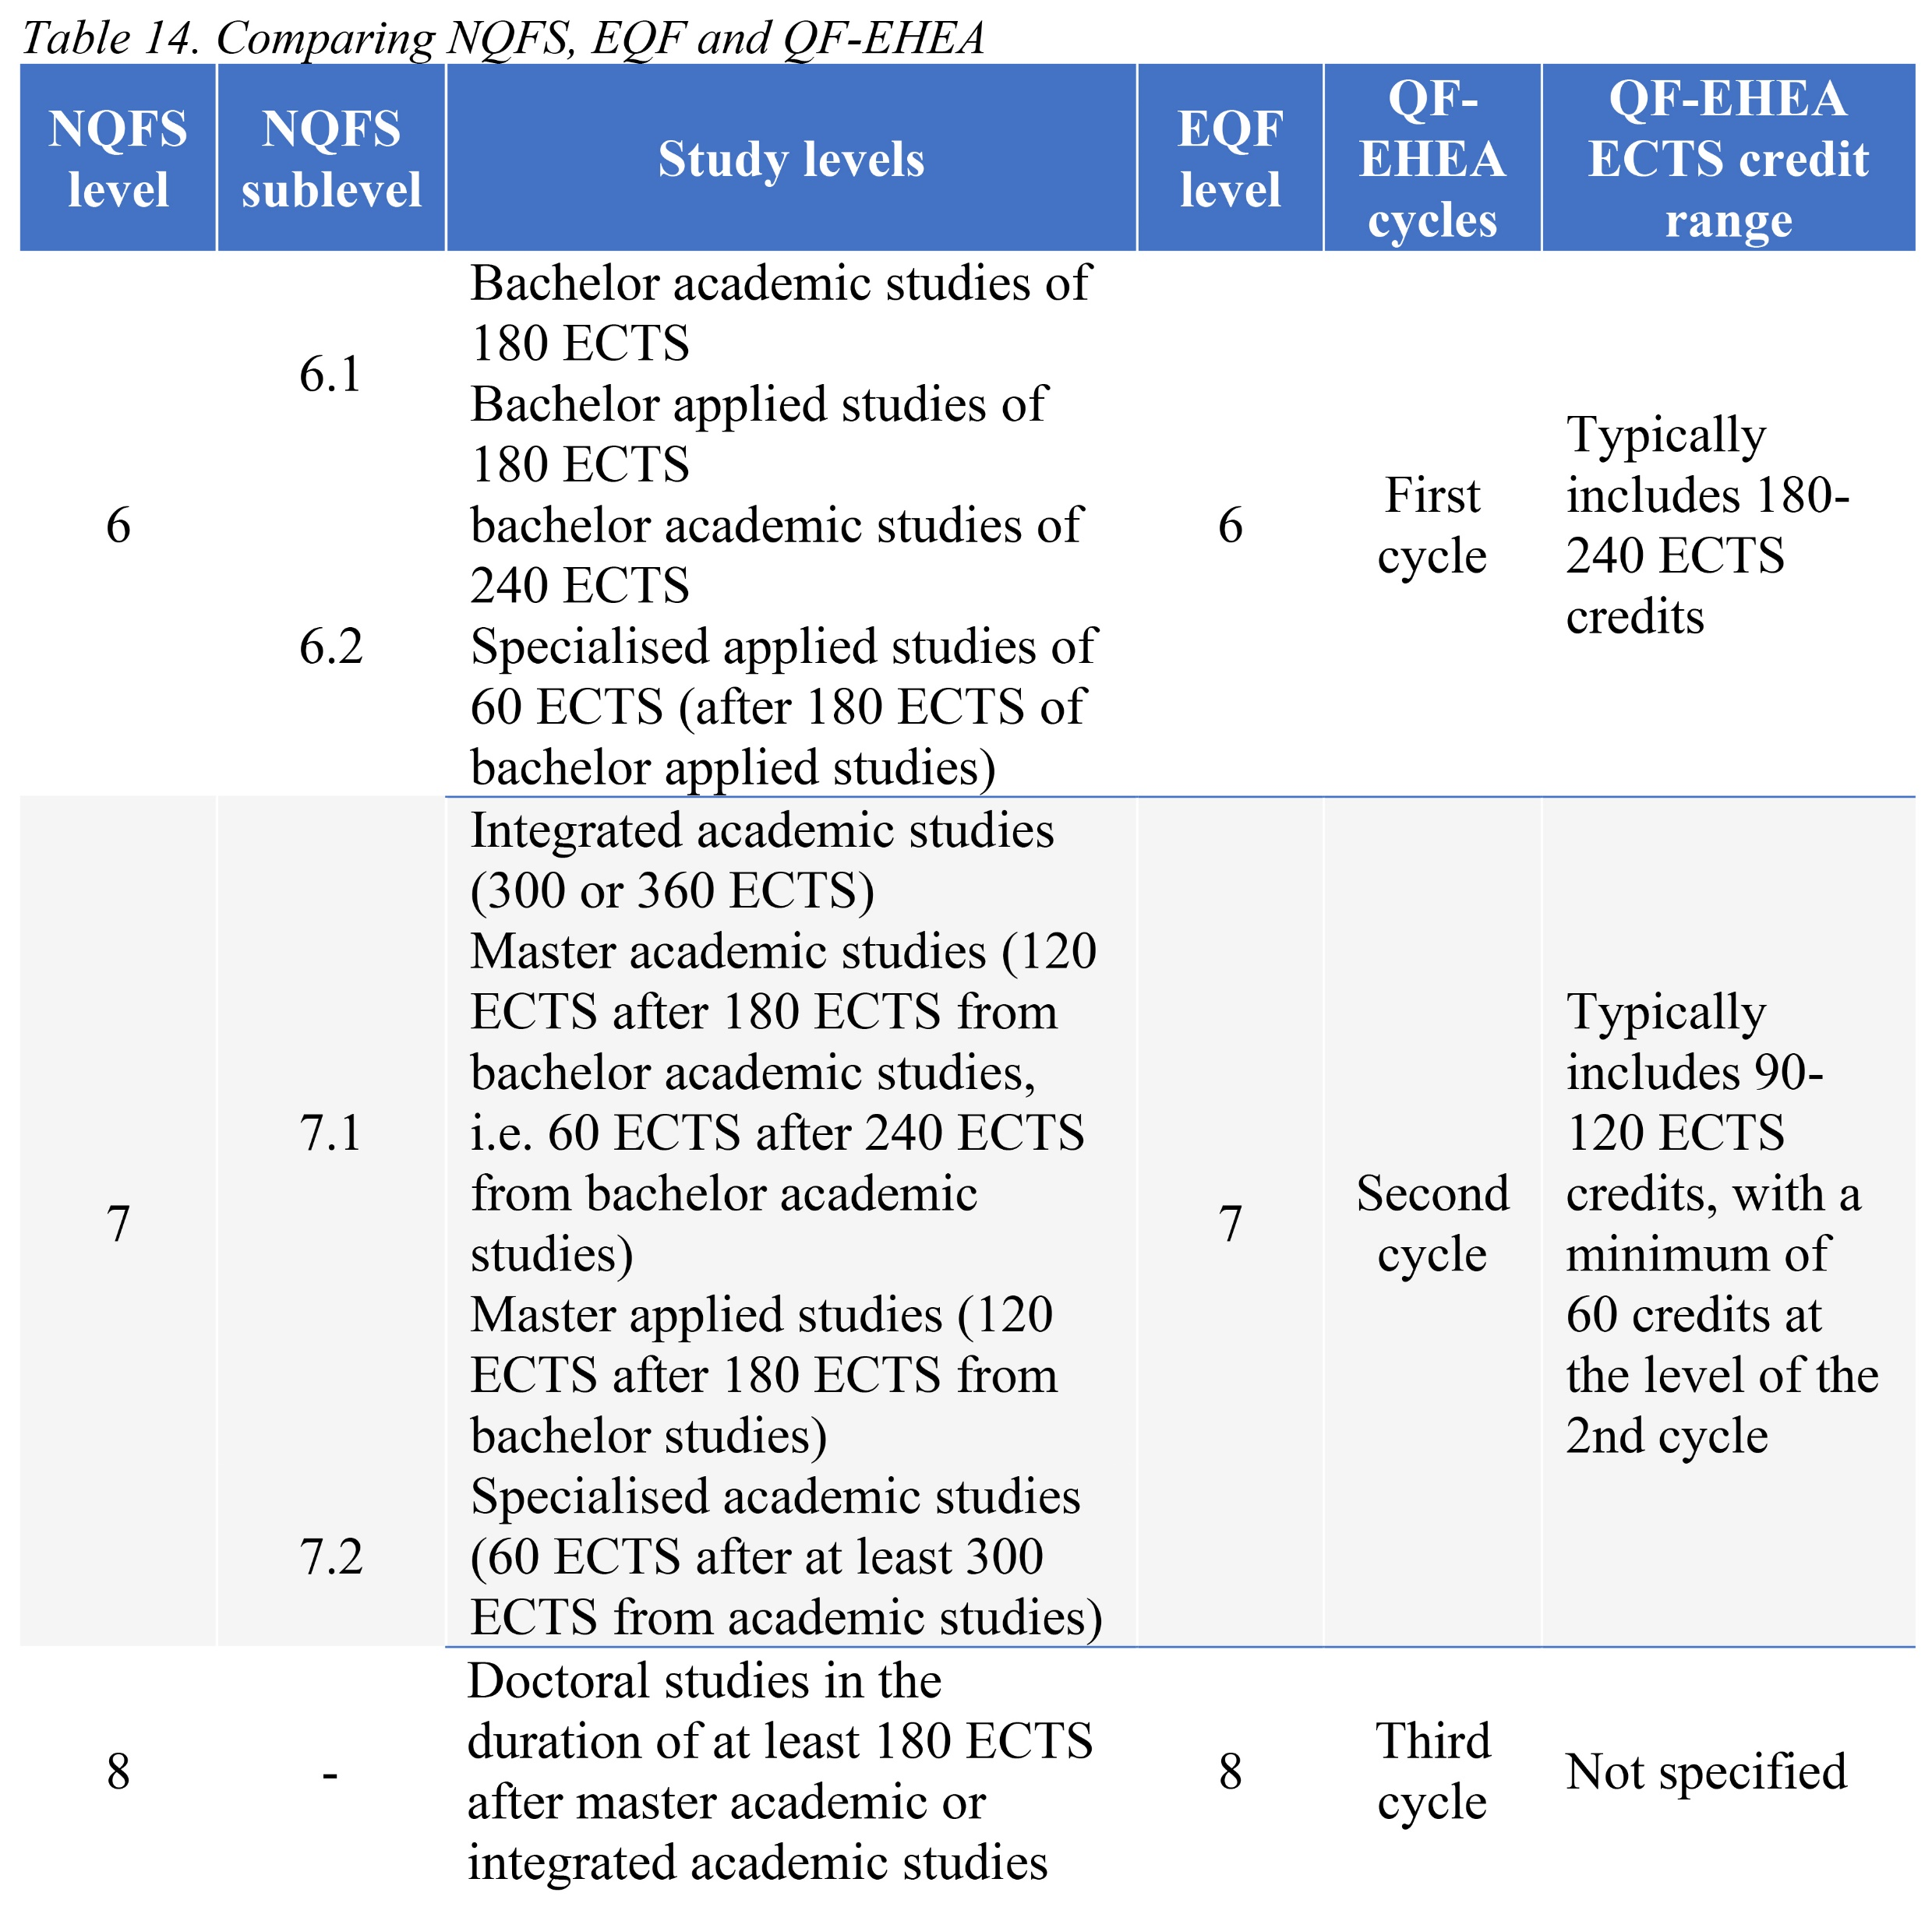
National Qualification Framework

Slide 36
Thank you for your attention
Vielen Dank für Ihre Aufmerksamkeit
Gracias por su atención
sine@bio.bg.ac.rs
www.bio.bg.ac.rs

