Slide 1
Project acronym: MICROGUIDE Project full title: DEVELOPING GUIDELINES FOR THE IMPLEMENTATION OF MICRO-CREDENTIALS IN HIGHER EDUCATION Project No. 2021-1-ProjectRS01-KA220-HED-000027585 Funding Scheme: Erasmus+
Analysis of the MCs implementation practice in Spain Graz, 8 november 2022
Speaker: Ferran Badia
Institution: University of Lleida

Slide 2
Higher Education Quality Agencies in Spain
Agencia Andaluza del Conocimiento (AAC)
Agencia Canaria de Calidad Universitaria y Evaluación Educativa (ACCUEE)
Agencia de Calidad y Prospectiva Universitaria de Aragón (ACPUA)
Agencia de Calidad, Acreditación y Prospectiva de las Universidades de Madrid (ACAP)
Agència de Qualitat Universitària de les Illes Balears (AQUIB)
Agència per a la Qualitat del Sistema Universitari de Catalunya (AQU)
Axencia para a Calidade do Sistema Universitario de Galicia (ACSUG)
Agencia Valenciana d´Avaluació i Prospectiva (AVAP)
Agencia Nacional de Evaluación de la Calidad y Acreditación (ANECA)
Euskal Unibertsitate Sistemaren Kalitatea Ebaluatu eta Egiaztatzeko Agentzia (UNIBASQ)

Slide 3
AQU Catalunya has develop a guide for developing and assessing SLP and microcredentials
Short learning programmes - Micro-credentials
Short learning programmes (SLPs) are a type of course (unit, module, etc.) in a particular subject area that focus on specific societal needs which can be a part of larger degree programmes.
SLPs have evolved into an opportunity not only to establish bridges between the academic system and the professional world but also to promote lifelong learning.
A micro-credential is proof of the learning outcomes acquired by students on an SLP.

Slide 4
The SLPs assessed by AQU Catalunya can be characterised as follows:
Levels 2 and 3 under the Catalan Higher Education Qualifications Framework, and levels 4 and 5 of the National Catalogue of Professional Qualifications.
Programmes linked to the Catalan Public Employment Service's Catalogue of Training in Specialised Fields.
Credit load: between 4 and 30 ECTS credits.
ECTS credits earned are recognisable in official qualifications.
They are taught by Catalan universities.
They are in line with labour market needs.
They are targeted at non-traditional students.

Slide 5
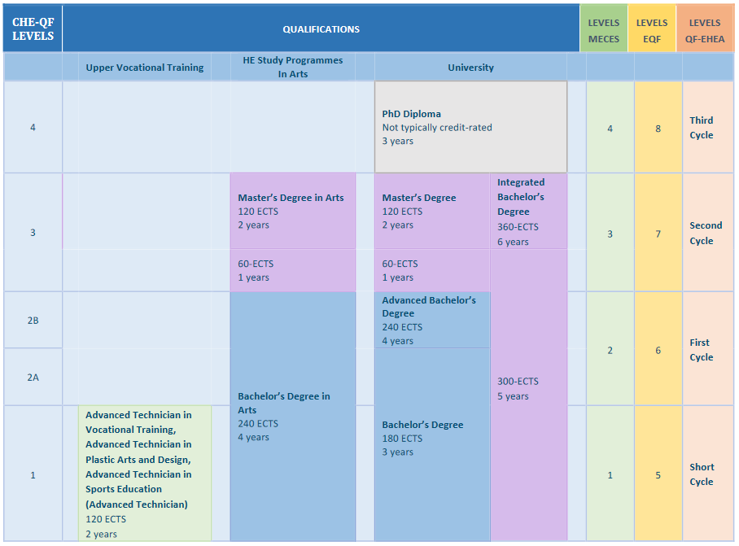
Catalan Higher Education Qualifications Framework (CHE-QF)
Qualification frameworks enable comparability and transparency within the EHEA, and identification of the ways in which students can move from one level to another within a higher education system and between different education systems. In addition, they describe what students need to know, understand, and be able to do from a given qualification
Level.
Notes:
https://www.aqu.cat/en/Universities/Methodology/Catalan-Higher-Education-Qualifications-Framework-CHE-QF
https://www.aqu.cat/en/doc/doc_54247988_1.pdf

Slide 6
Design of short learning or micro-credential programmes
The Ex ante accreditation of Short Learning Programmes linked to the Catalan Public Employment Service's Catalogue of Training in Specialised Fields guides the proposals drawn up in connection with the same catalogue.
When designing these programmes, the following must be taken into account:
The description of the programme
The justification for its creation
The internal quality assurance system (IQAS)
The objective and learning outcomes
Student access and admission, and student support
Planning
Teaching and support staff
Material resources and services
Expected outcomes

Slide 7
Assessment process
The assessment process consists of a prior evaluation by an ad hoc committee, which submits a proposal for an assessment report to the specific assessment committee of the corresponding area of the Institutional and Programme Assessment Committee.
This Specific Committee is the one that issues an initial report (preliminary report), regarding which the university may submit allegations. After having analysed the allegations made, the Specific Committee issues the final report in terms of a favourable or unfavourable ex ante assessment.
The university may lodge an appeal against this decision before the AQU Catalunya Appeals Committee within a maximum period of one month from its notification.

Slide 8
Methodology
The assessment methodology is based on the following guide:
Ex ante accreditation of Short Learning Programmes,
which follows:
Standards and Guidelines for Quality Assurance in the European Higher Education Area
References
European Approach to micro-credentials, European Commission
Notes:
https://www.aqu.cat/en/doc/doc_54247988_1.pdf

Slide 9
Results
Degree programmes that receive a favourable assessment are awarded a quality label which is valid for six years:
The final report from the assessment process is sent to the Catalan Public Employment Service (SOC) so that they might begin registration of the training in a specialised field in the Catalan Public Employment Service's Catalogue of Training in Specialised Fields (SEPE).
The assessment reports issued are made public on the AQU Catalunya website. They are also made public on the EQAR Database of External Quality Assurance Results.
Notes:
https://education.ec.europa.eu/education-levels/higher-education/micro-credentials

Slide 10
Assessment 2020
Collaborating in the 2020 project to assess short learning programmes were the Secretariat for Universities and Research, the Catalan Public Employment Service (SOC)and the Consortium for Lifelong Learning in Catalonia. It also received support from the Barcelona Digital Talent alliance, which includes, among others, Mobile World Capital - Barcelona.
The project assessed seven short learning programmes linked to the field of information and communication technologies taught in different Catalan universities.
Assessment reports on the design of short learning or micro-credential programmes:
Android mobile developer
Cloud Deployer
Consultor CRM
Data Scientist
Frontal developer
Java Back-end web developer
Open Source Back end web developer
Notes:
https://ec.europa.eu/info/law/better-regulation/have-your-say/initiatives/12858-Micro-credentials/public-consultation_en
https://education.ec.europa.eu/sites/default/files/document-library-docs/european-approach-micro-credentials-higher-education-consultation-group-output-executive-summary.pdf

Slide 12
Vielen danke
Хвала Вам много
Gràcies
ferran.badia@udl.cat
www.udl.cat

