Slide 1
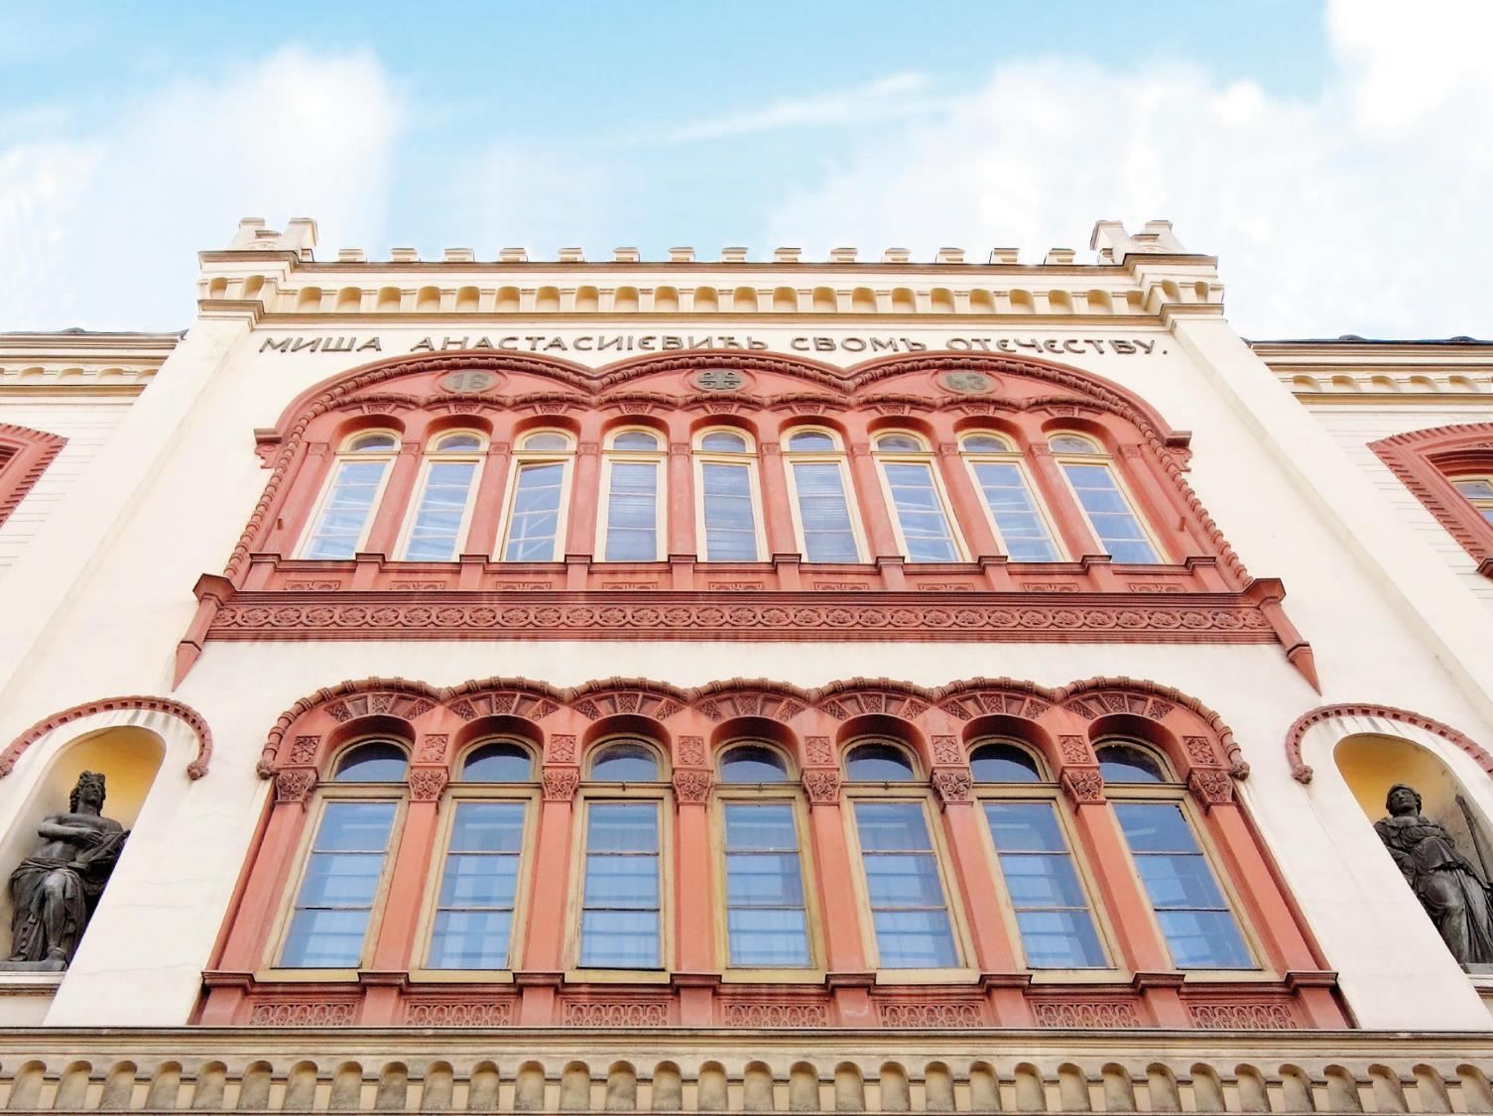
University of Belgrade
Prof. Dr. Nenad Zrnić
Project Microguide, Belgrade 11-12 July
Ivanka Popović

Slide 2
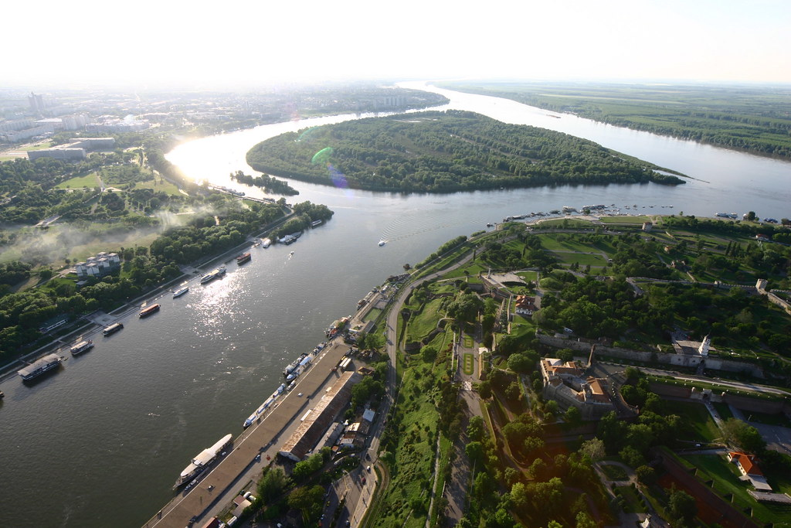
Belgrade

Slide 3

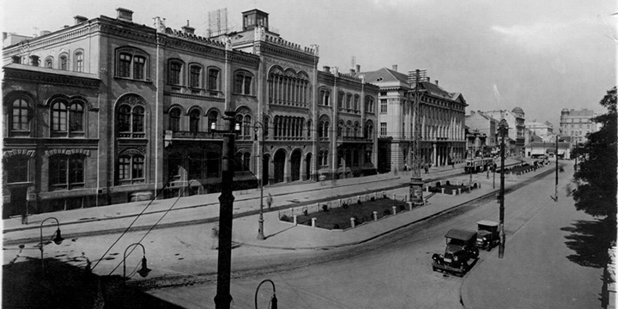
Founded in 1808
Comprehensive research-intensive university
Committed to academic excellence
Devoted to incorporating SDGs in all aspects of UB life

Slide 4

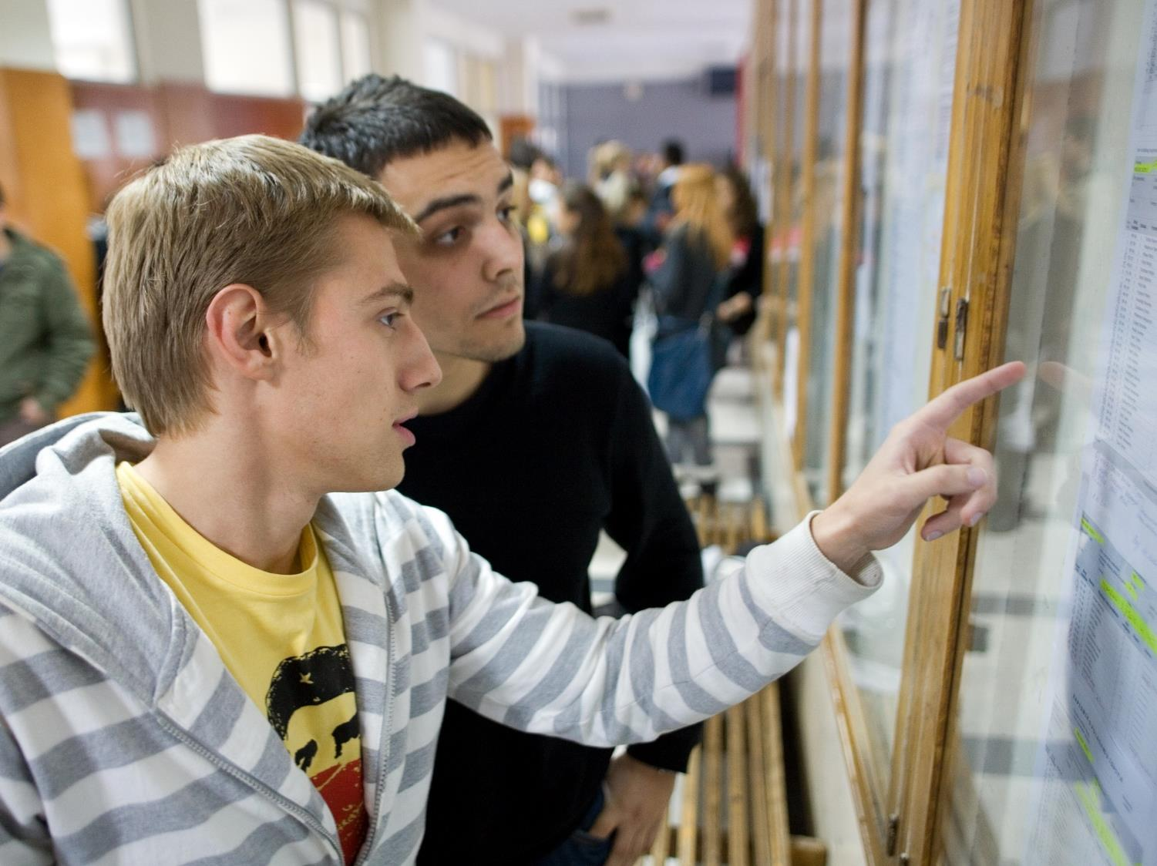
Facts & Figures
31 Faculties
11 Research Institutes
Central Administration
University Library
340 Study Programs
100,000 Students

Slide 5
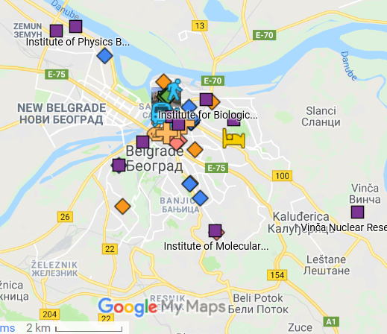

Slide 6
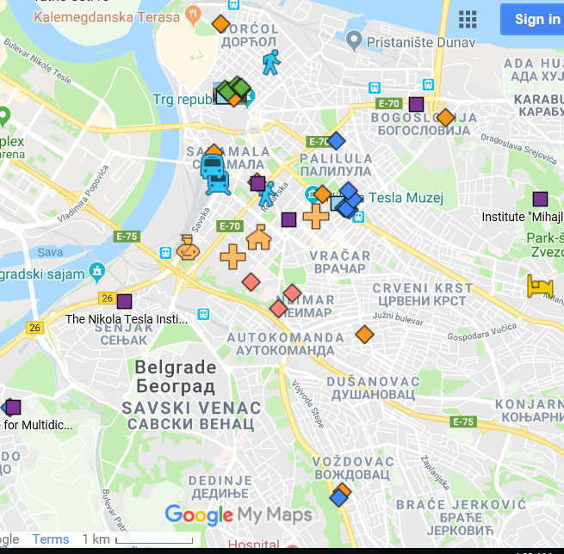

Slide 7

31 FACULTIES divided in
4 divisions
+
INSTITUTES
as 5th division
+
library

Slide 8
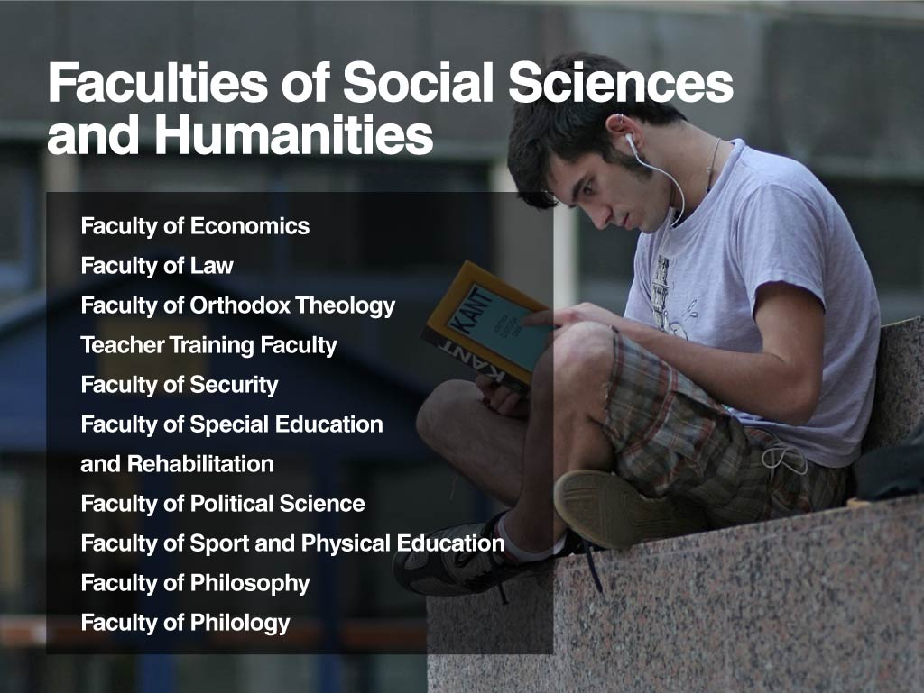

Slide 9
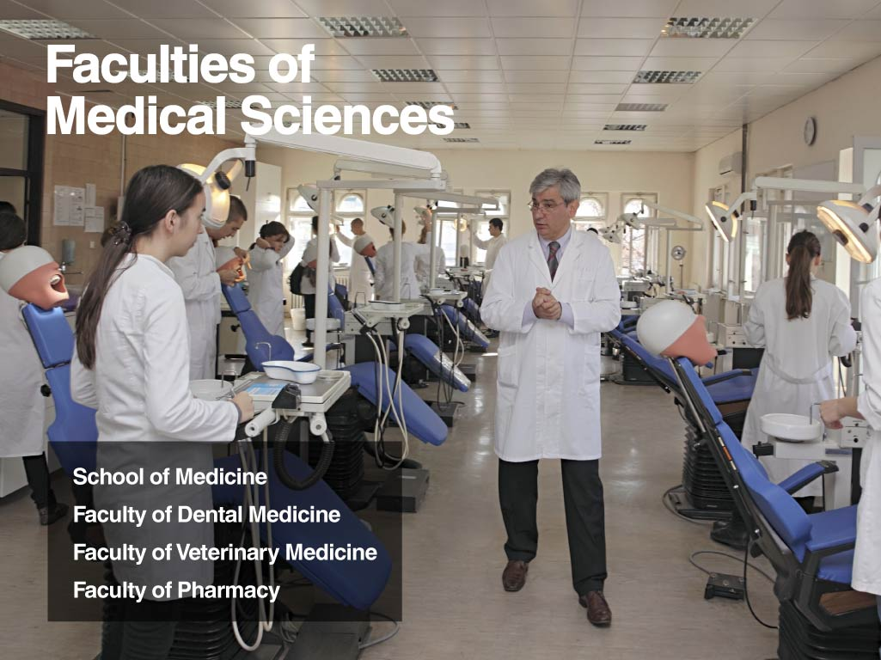

Slide 10
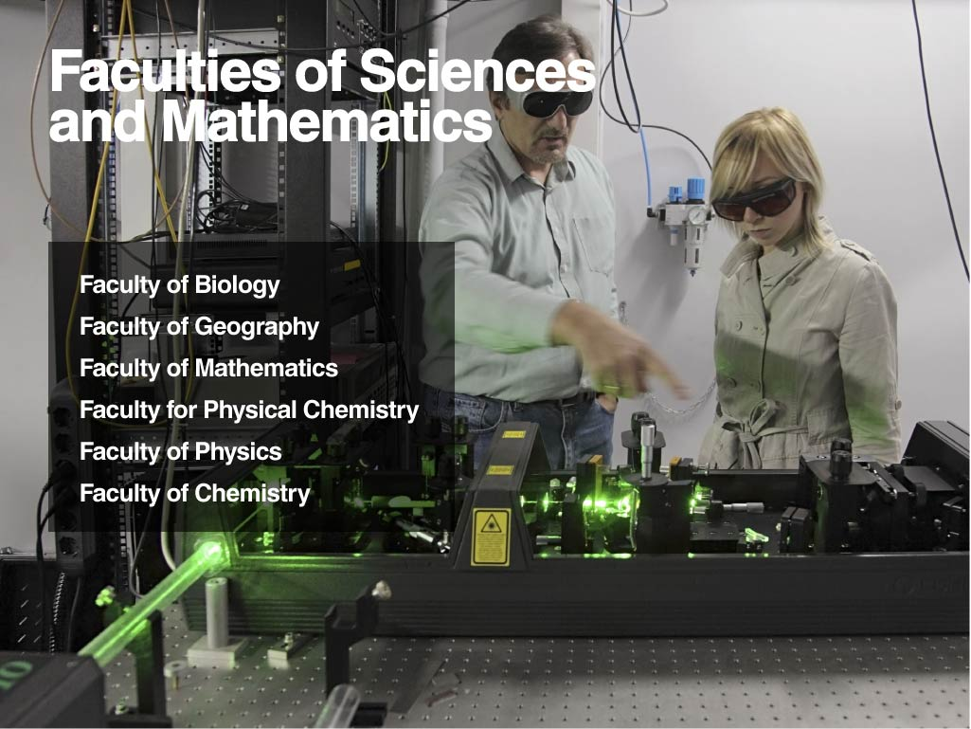

Slide 11


Slide 12


Slide 13


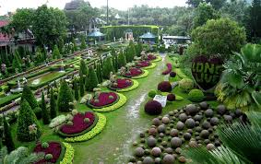

Slide 14
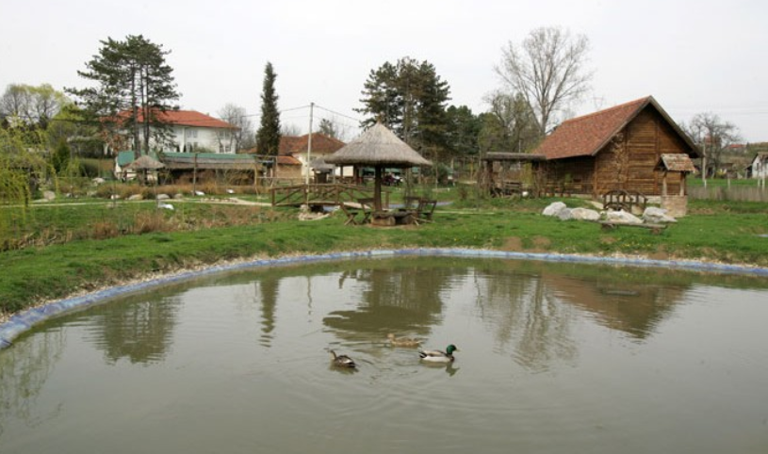
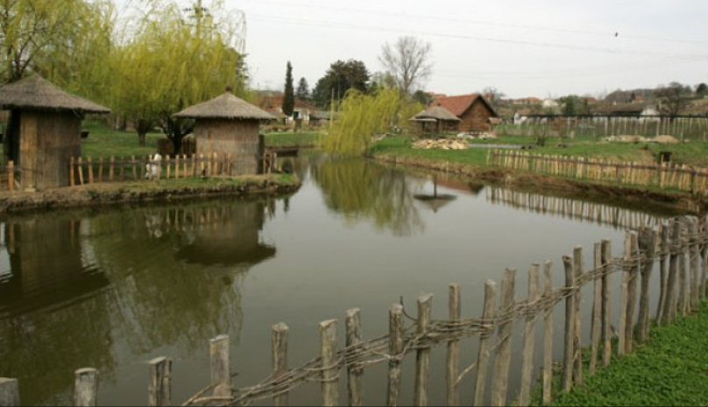
Faculty of Agriculture Experimental Farm

Slide 15
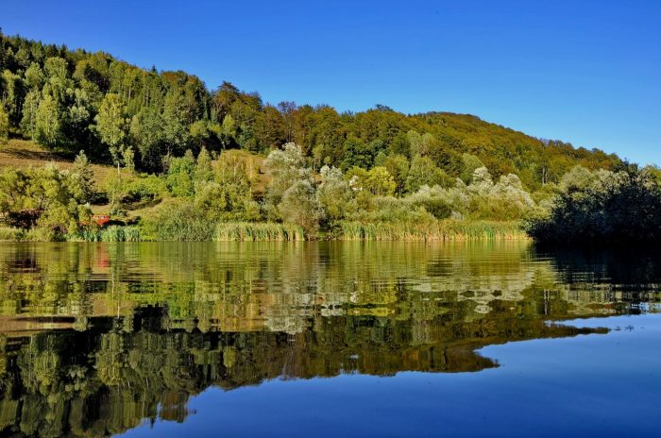

Faculty of Forestry – Special Nature Reserve

Slide 19
Scientific Excellence

Slide 20
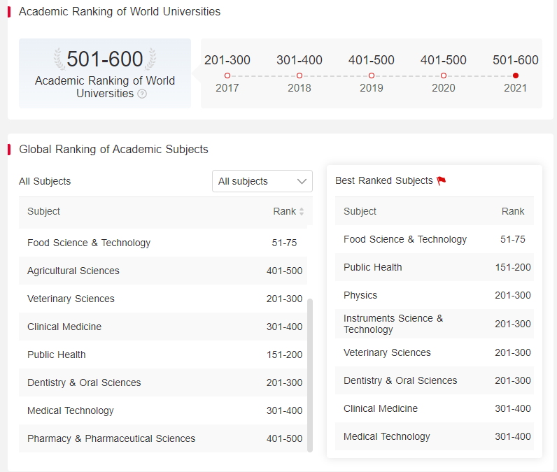

Slide 21


Slide 23
University of Belgrade
International Collaboration
Ongoing projects
Erasmus+ KA1 | - 202 - 39 neg.
Erasmus+ KA2 | 23
Strategic partnerships | 6
Sports | 1
Jean Monnet | 8
AUF | 5
HERD | 1
King Baudouin | 1
CEEPUS | 32 networks
Over 200 bilateral agreements of cooperation with universities from more than 60 countries.
Networks and Associations:
EUA, UNICA, UNIADRION, AUF, AARC Danube Rectors Conference (DRC) Black Sea University Network (BSUN)
CERN, CNR, INFN

Slide 24
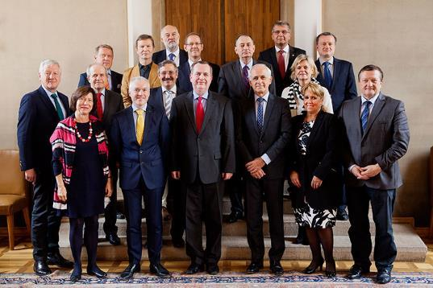
LERU-CE7 Meeting
Prague, Czech Republic, October 8, 2016
University of Belgrade, Serbia
Eötvös Loránd University, Budapest, Hungary
University of Ljubljana, Slovenia,
Charles University, Prague, Czech Republic
University of Tartu, Estonia
University of Warsaw, Poland
University of Zagreb, Croatia

Slide 25
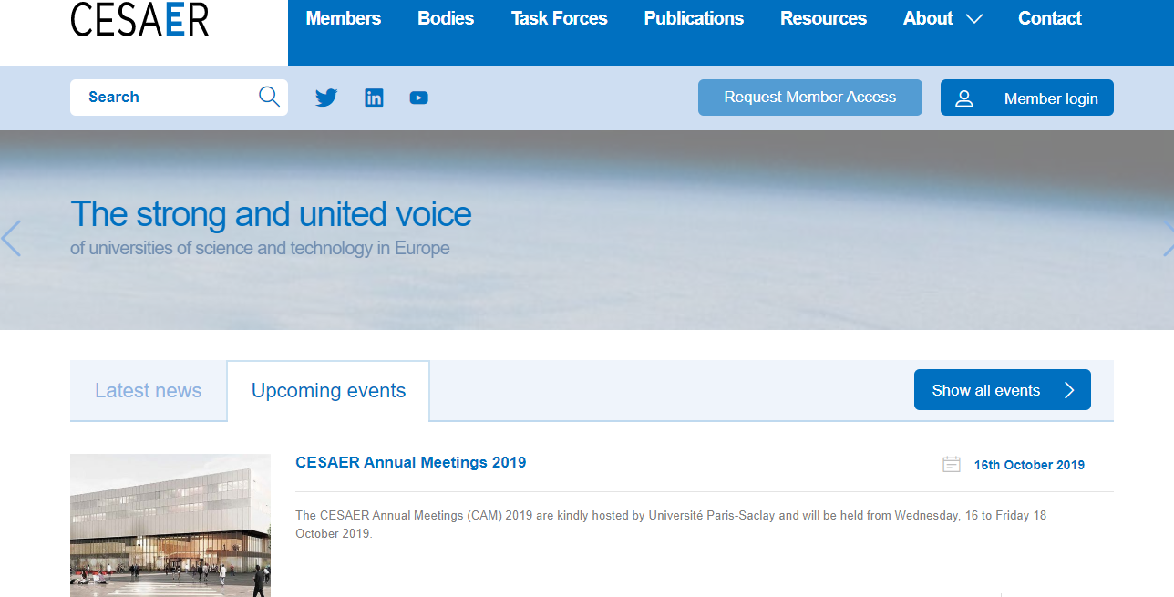

Slide 26


Slide 27
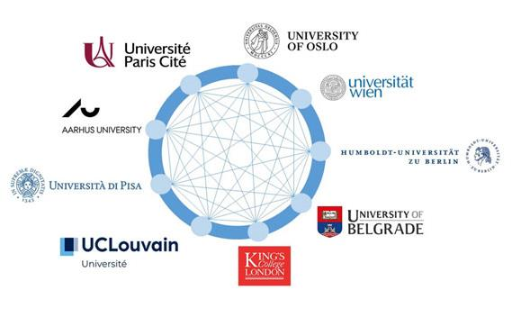
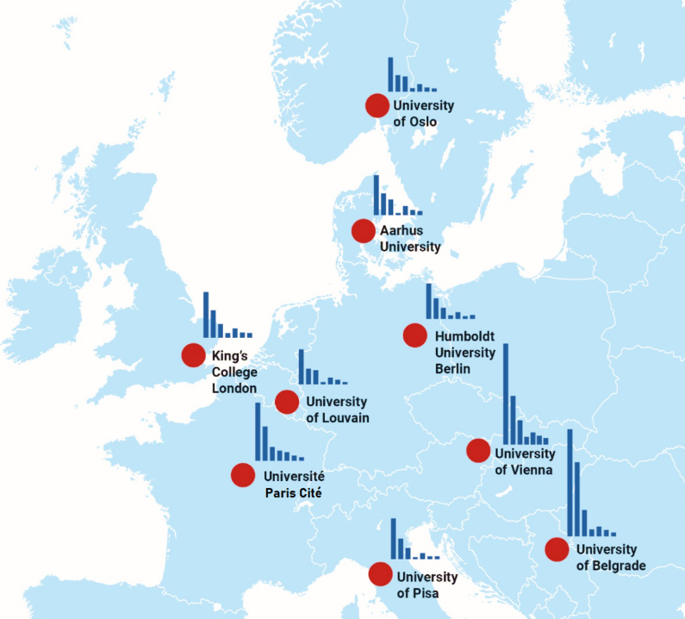

2019
2022

Slide 28
All 42 members of the University of Belgrade + the Rector's Office/Central Administration are separate legal entities with independent funding.

Slide 29
UB Team, MICROGUIDE project
Prof. Dr. Siniša Đurašević, UB, Faculty of Biology
Prof. Dr. Nenad Zrnić, UB Faculty of Mech. Eng.
Prof. Dr. Petar Bulat, UB Faculty of Medicine
Assoc. Prof. Dr. Nebojša Jasnić, UB, Faculty of Biology

Slide 30

THANK YOU...
Contact persons:
Coordinator
Prof. Dr. Siniša Đurašević
sine@bio.bg.ac.rs
Administration
Assoc. Prof.Dr. Nebojša Jasnić
jasnicn@bio.bg.ac.rs

Slide 31
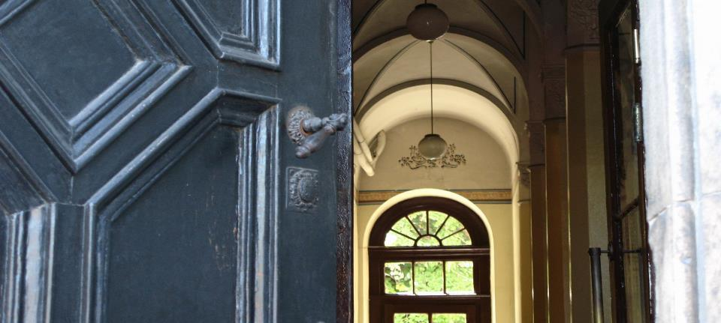
University of Belgrade
Studentski trg 1, 11000 Belgrade, Serbia
www.bg.ac.rs

