Slide 1
UNIVERSITY OF LLEIDA Kick-Off Meeting Belgrade, 11 – 12 July 2022
Speaker: Ferran Badia
Institution: University of Lleida
Notes:
Sobre comunicació i logos UE
http://sepie.es/comunicacion/imagen.html
Identitat comunicativa Gencat
https://identitatcorporativa.gencat.cat/ca/descarregues/identificacio-basica/cat/

Slide 2
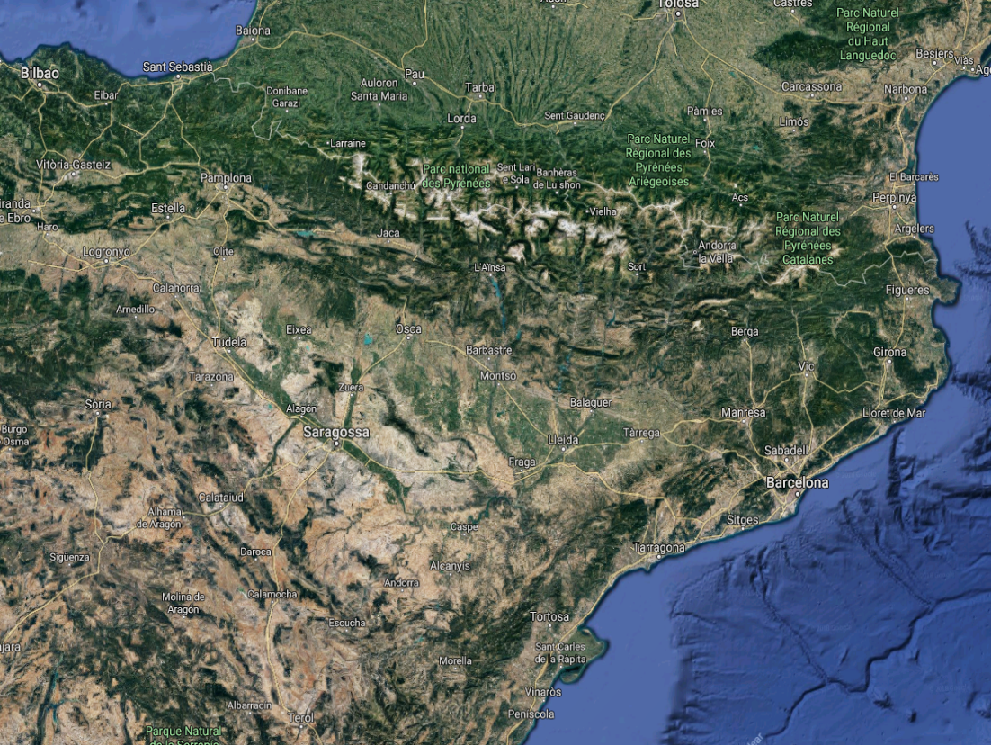
Where is Lleida?
Population: 140.000 (2020)
Location: 41º37’00’’ N
0º38’00’’ E

Slide 3
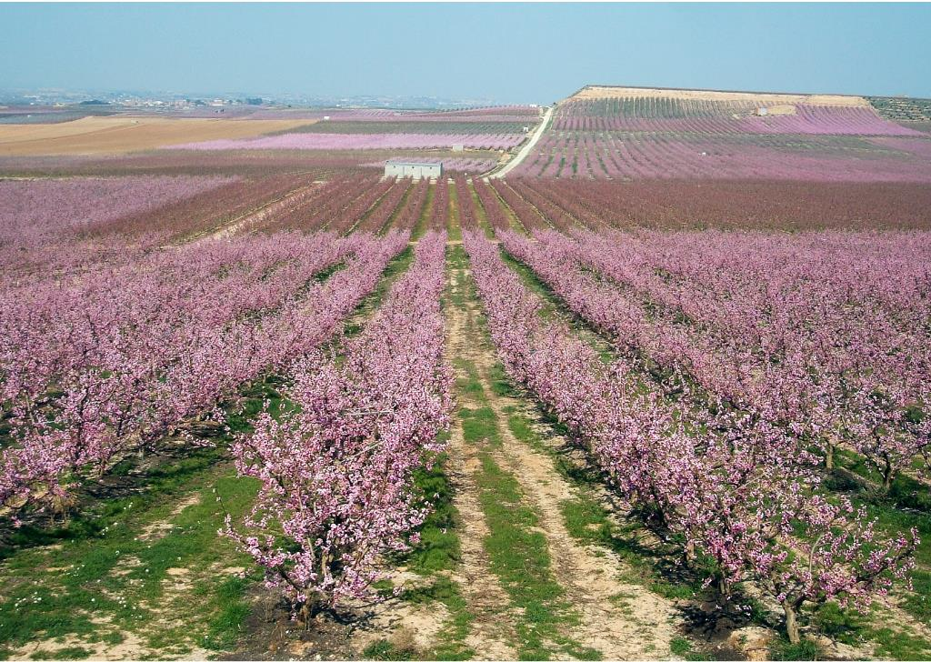
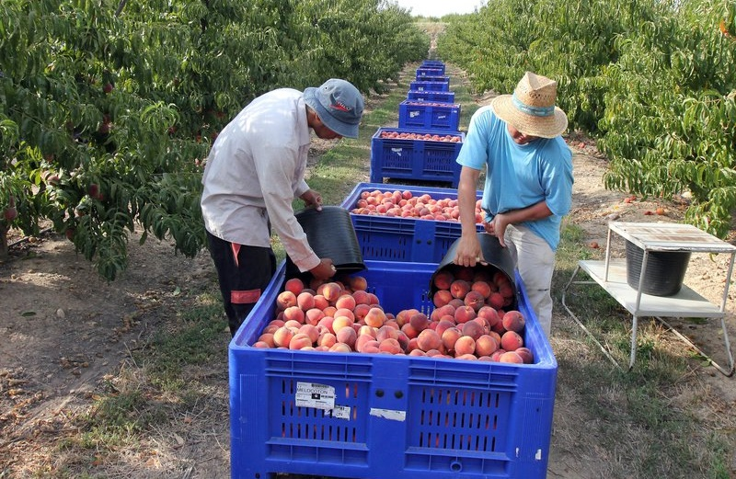
Lleida Region Economical Activity

Slide 4
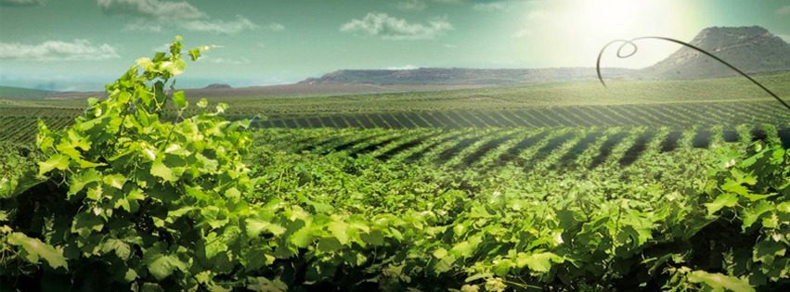
Lleida Region Economical Activity

Slide 5
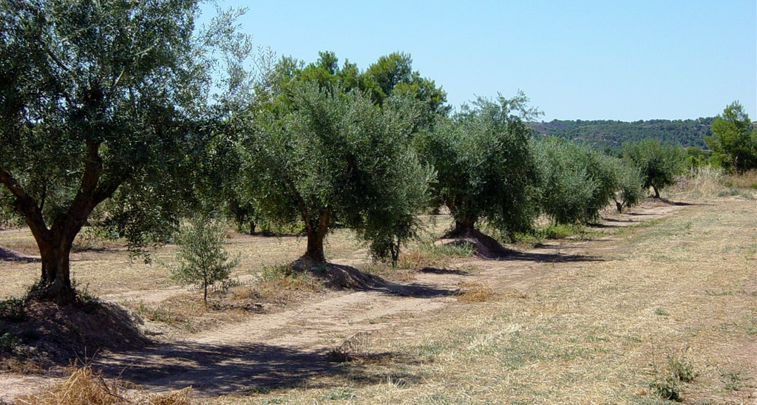
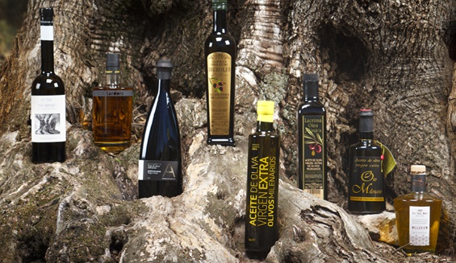
Lleida Region Economical Activity

Slide 6
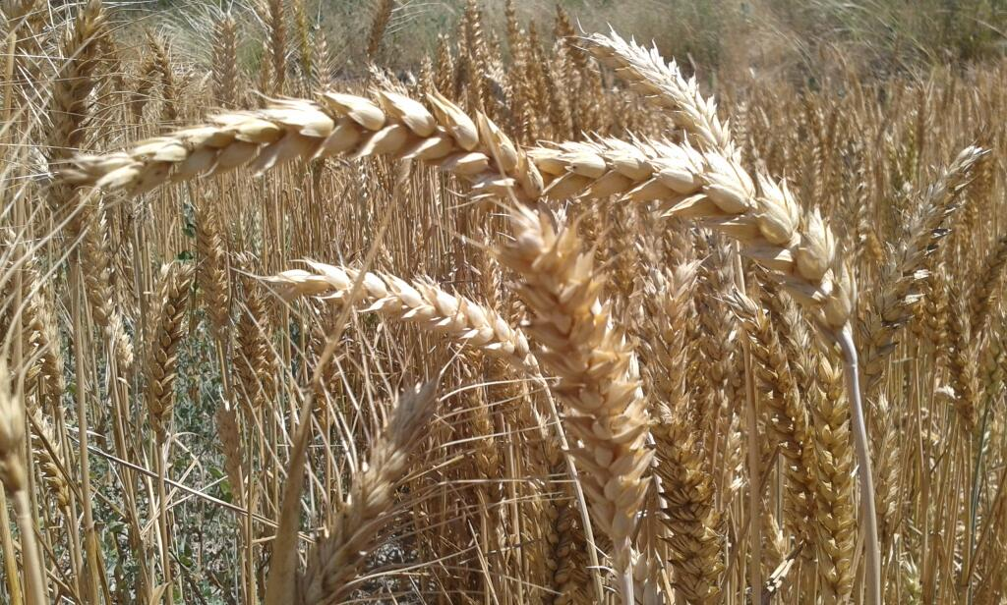
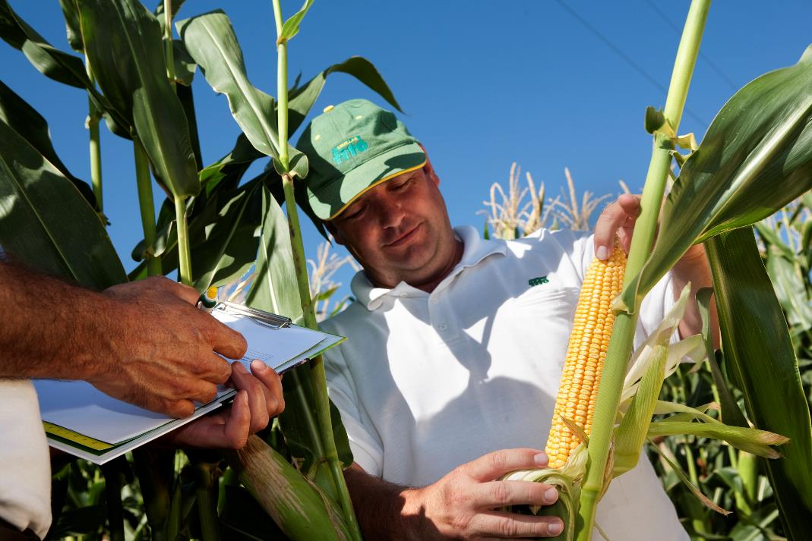
Lleida Region Economical Activity

Slide 7
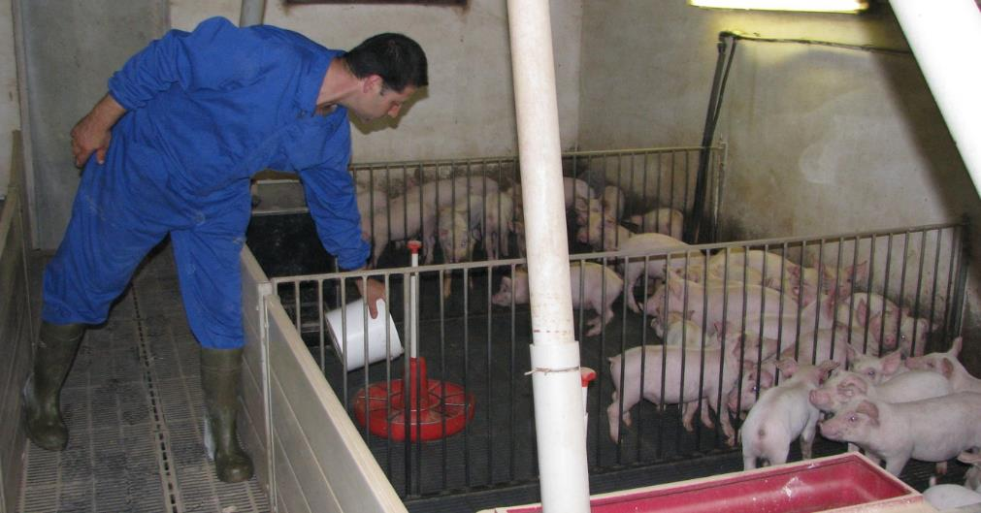
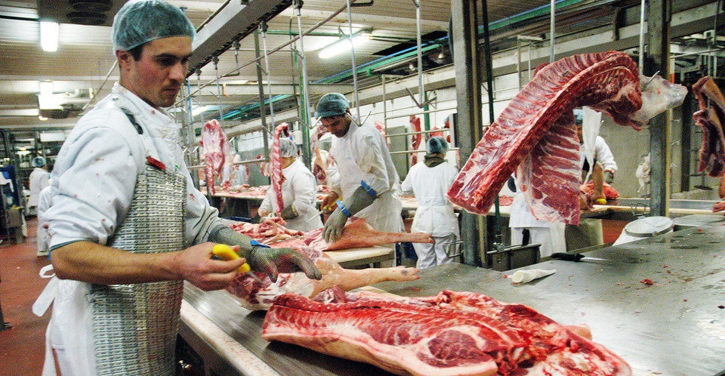
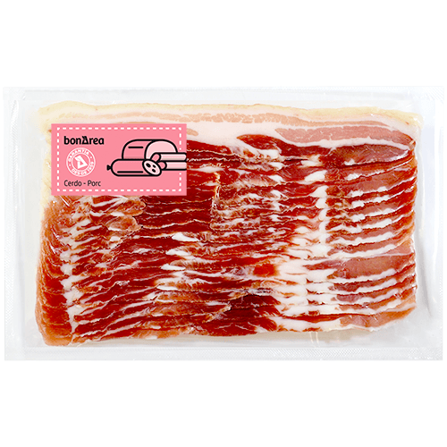
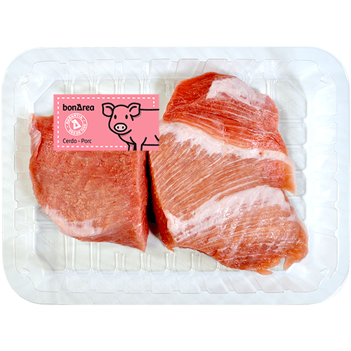
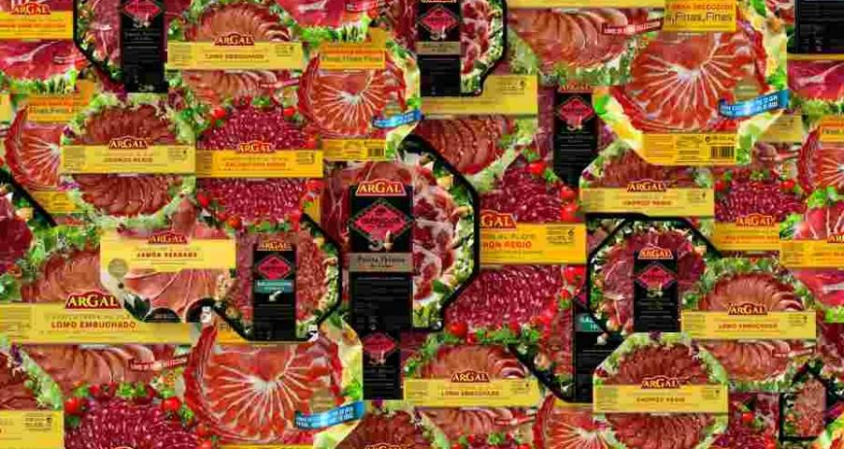
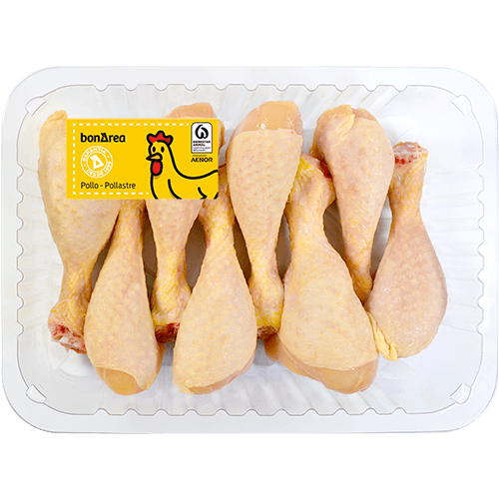
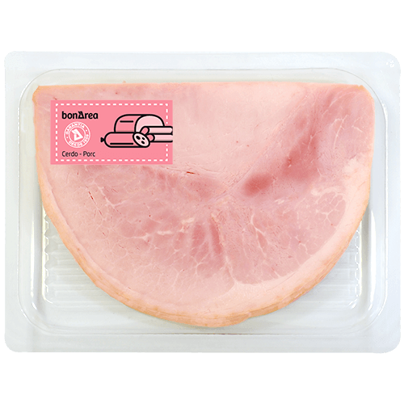
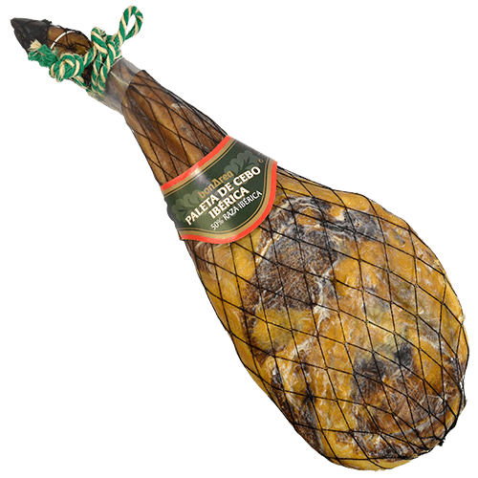
Lleida Region Economical Activity

Slide 8
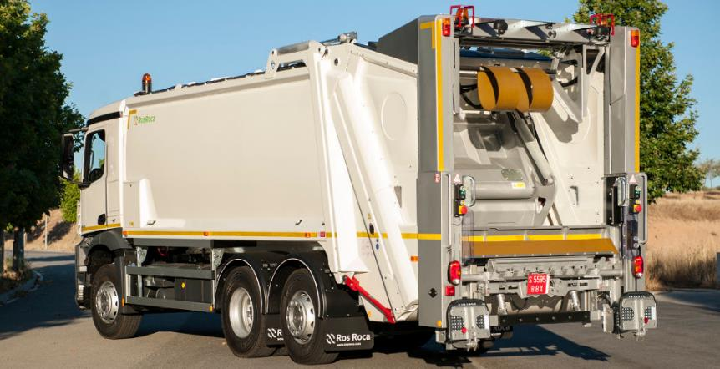
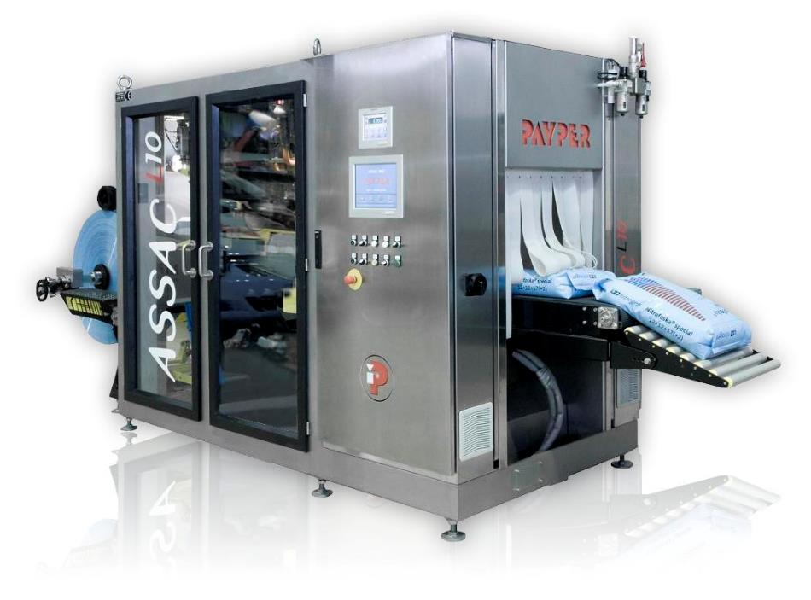
Lleida Region Economical Activity

Slide 9
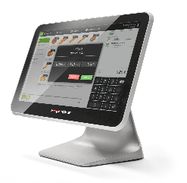
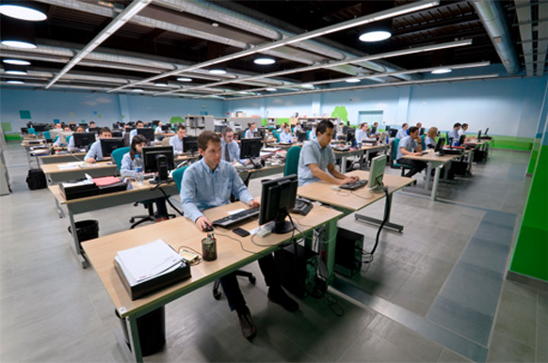
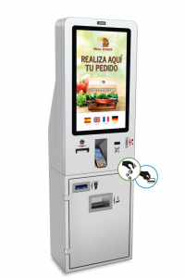
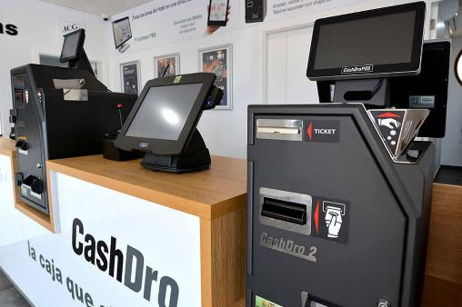
Lleida Region Economical Activity

Slide 10
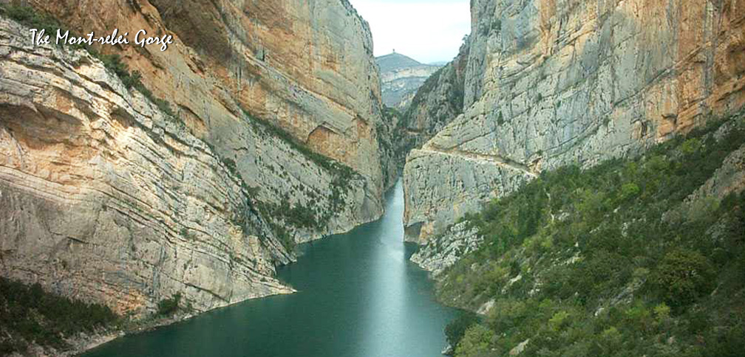
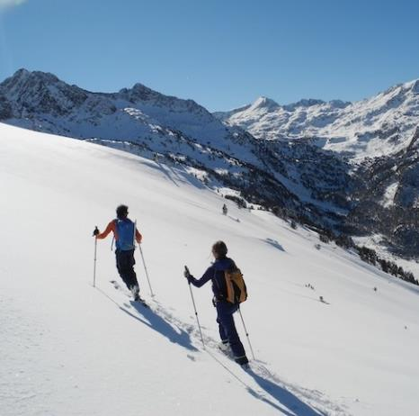

Slide 11
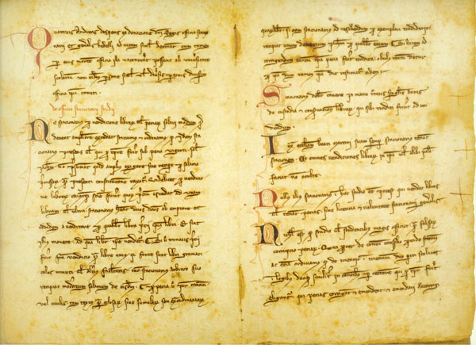
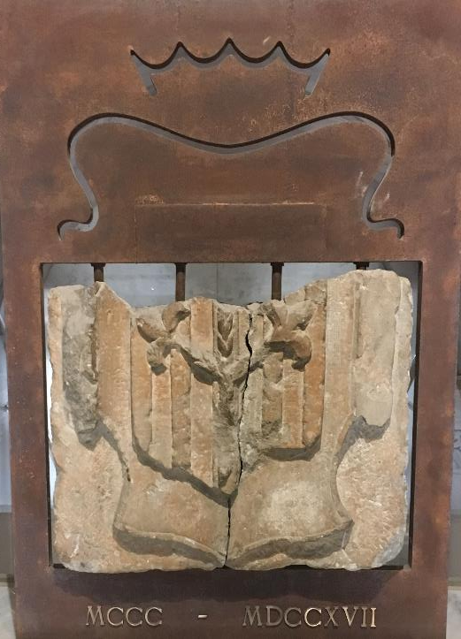
University of Lleida Founded on September the 1st of 1300

Slide 12
Lleida – Medieval University

Slide 13
Lleida – Succession War, 1707

Slide 14
Lleida – Present

Slide 15
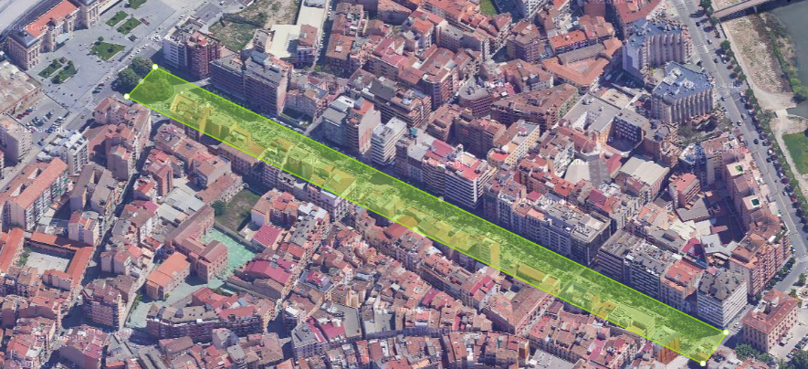
THE UNIVERSITY OF LLEIDA IN NUMBERS
8
centers
27
departments
Did you know that...
Our undergraduate and graduate students add up to the population of a city like Mollerussa?
The UdL community would fill Lleida’s Rambla Ferran from the train station to the old bridge?
Our undergraduate, graduate and PhD students equal the population of Terra Alta region?
The UdL yearly budget is 0.8% of Lleida province’s GDP?
2.556
lifelong learning students
9.883
bachelor’s degree, master’s degree and PhD students
1.199
professors and
researchers
531
administration and services staff
93,17
MEUR budget

Slide 16
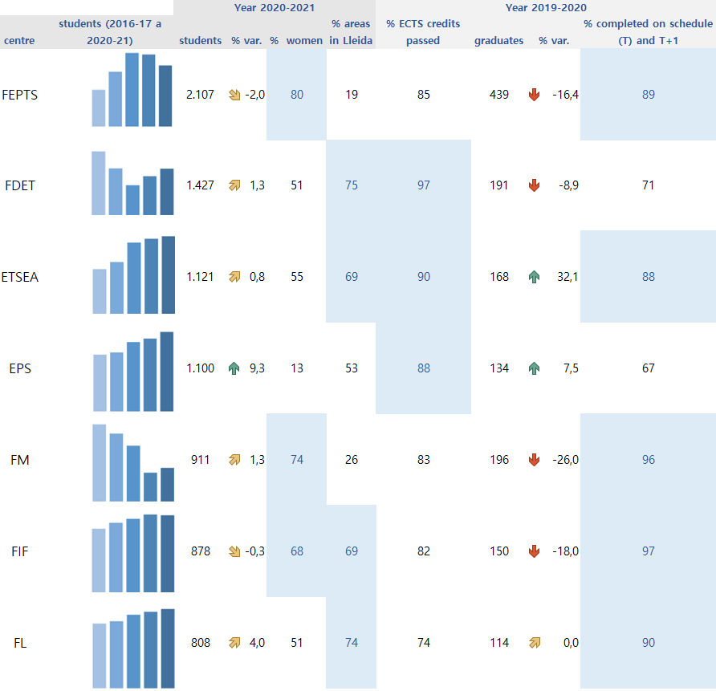
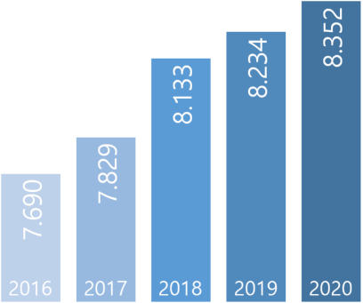
UNDERGRADUATE STUDIES
Offer
Students enrolled
UdL centres
46 bachelor’s
degrees
8.352
( 1,4 %)
2.215university places
59% from Lleida Region
60% women
Academic results (year 2019-2020)
85% of ECTS credits passed
1.392 graduates
( 10,7%)
86% completed on schedule (T) and T+1
The UdL is above the average

Slide 17
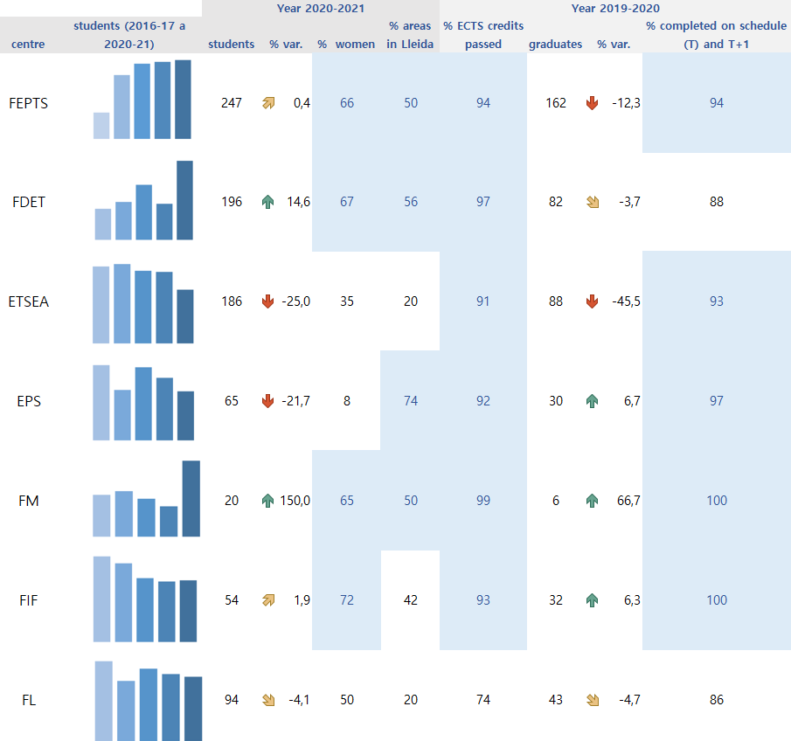
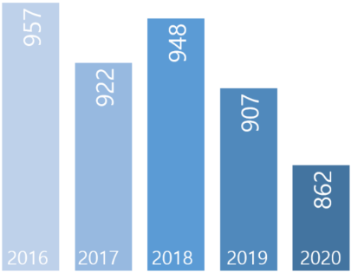
MASTER’S DEGREE STUDIES
Offer
Students enrolled
UdL centres
31 master’s degrees
862
( -5 %)
664 university places
42% from Lleida Region
54% women
Academic results (year 2019-2020)
91% of ECTS credits passed
443 graduates
( 14,8%)
92% completed on schedule (T) and T+1
The UdL is above the average

Slide 18
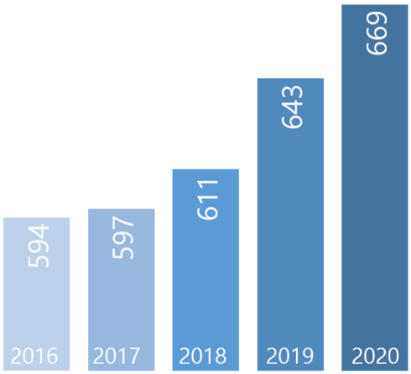
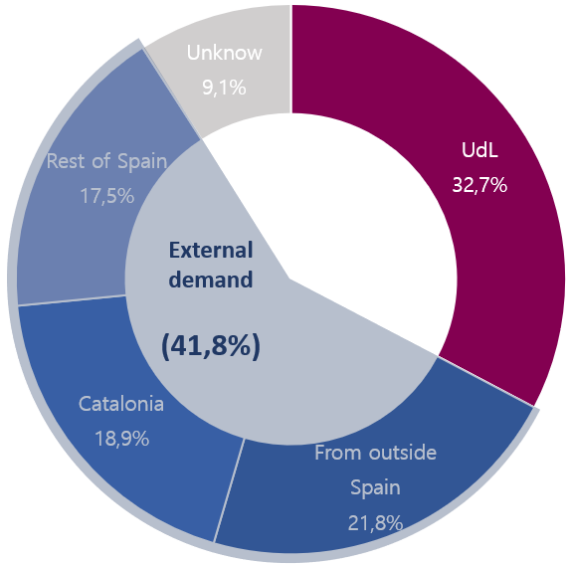
DOCTORATE STUDIES
Offer
Students enrolled
14 programmes
669
According to the university of origin
( 4 %)
5 interuniversity programmes
13% foreign students
56% women
31%
under contract or have grants
28 industrial doctorates
(period 2015-2020)
PhD theses (year 2019-20)
By means of industrial doctorates, the UdL transfers knowledge and cooperates with the business sector in research training and talent recruitment
72 theses
( 14,8%)
36% with international recognition
50% women

Slide 19
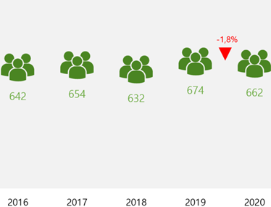
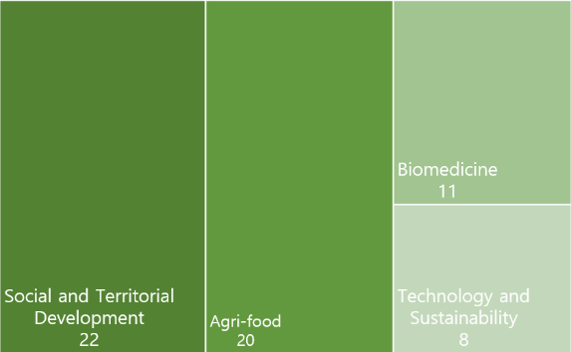
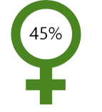
RDI
People
UdL Network
61
research groups
Research centres
Human resources strategy for research
3
TECNIO
centers
15
university-company chairs
35
scientific and technical services

Slide 20
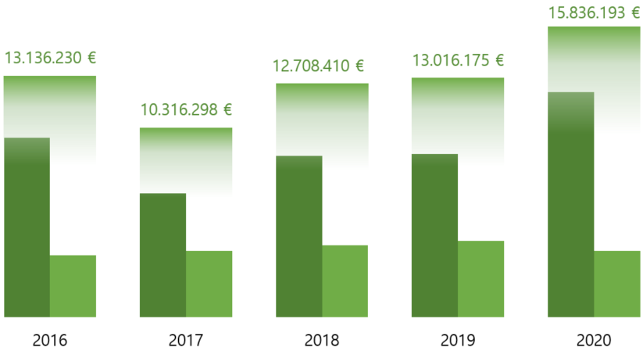
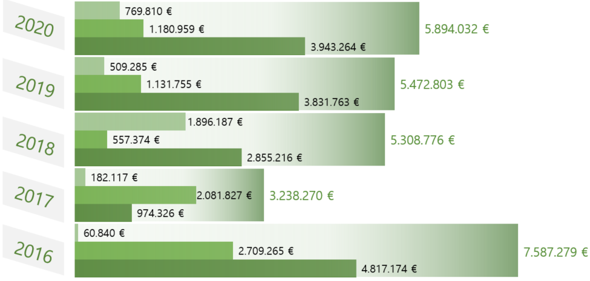
RDI
Financing
Resources mobilized for R+D+I activities (*)
Origin of public funding for R+D+I projects (*)
public funding
transfer contracts
total
(*) Source: GREC i UNEIX
105 ( 1,9%)
transfer contracts
14,45 MEUR
(15,5% budget)
Programme budget
“Research and knowledge transfer”
3,59 MEUR ( 13%)
the economic value of contracts and services (2020)

Slide 21
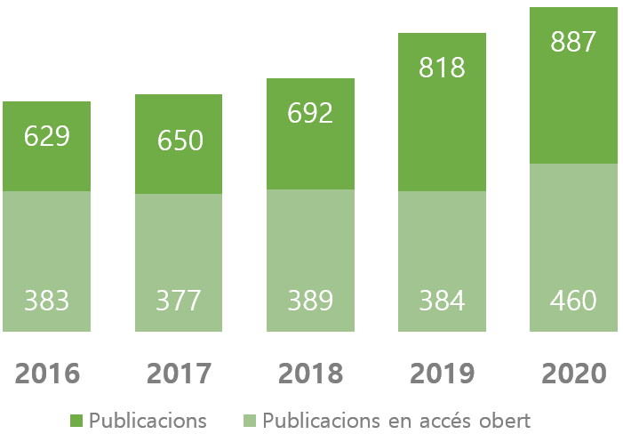
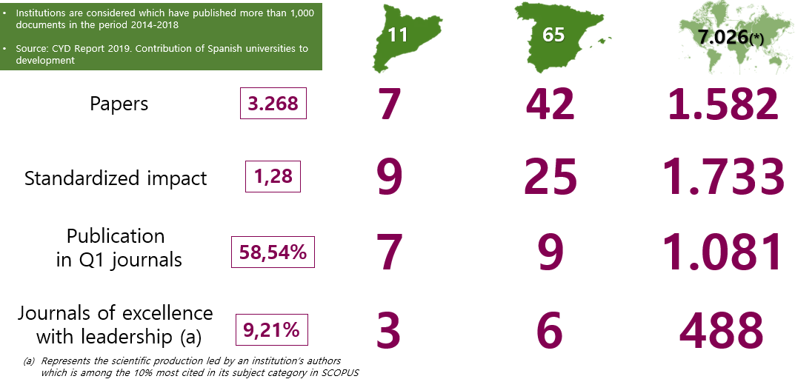
RDI
Visibility of scientific production
887
papers
52%
open access papers
2.234
citations
47%
papers with
International collaboration
72
highly cited papers (*)
17
Researchers among the most cited ones in the world (*)
57%
Papers in first-quartil journals
(*) Highly Cited Papers: number of papers found among the top cited 1% cited papers in the world, by category and year, taking into consideration the citation in the last 10 years
(*) According to the database developed by Stanford University (USA), SciTech Strategies Inc. and ELSEVIER (year 2020)

Slide 22
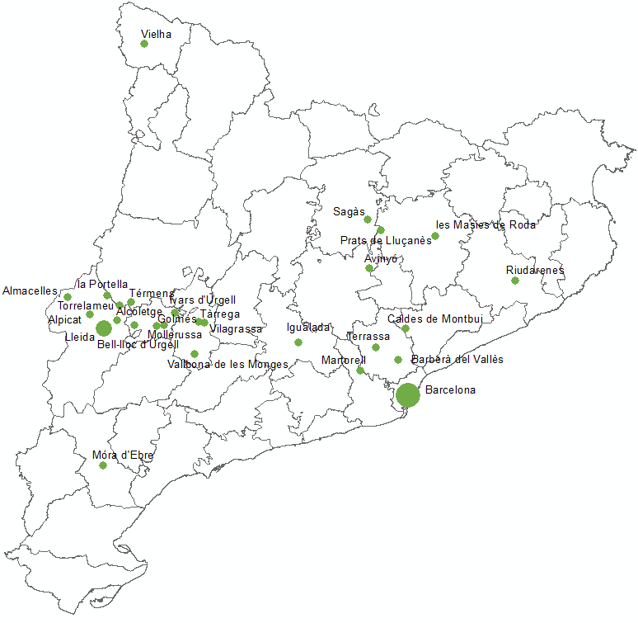
RDI
Transfer of knowledge to the territory
PECTs
Projects of specialization and territorial competitiveness
RIS3CAT communities
A2
Transfer contracts signed with Catalan companies in each municipality (2020)

Slide 23
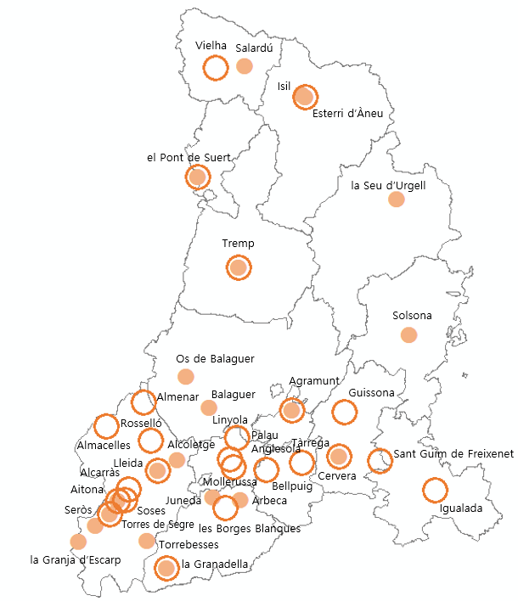
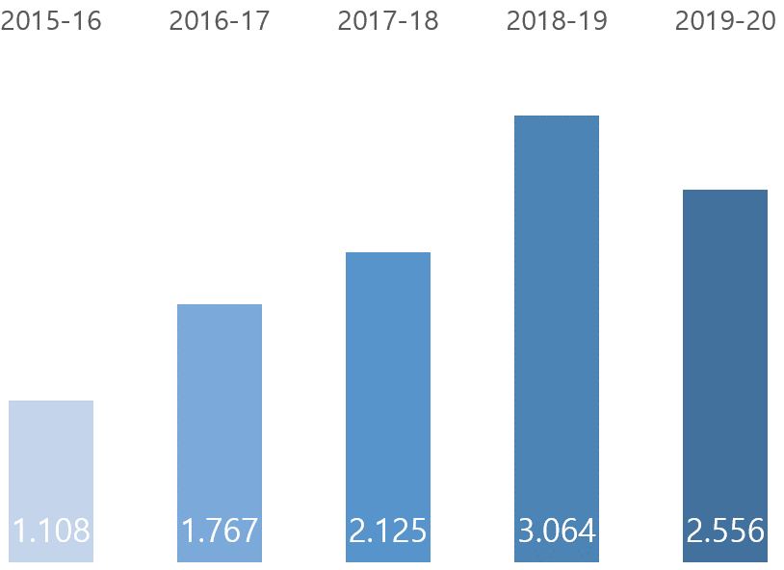
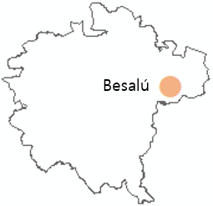
COMMITMENT TO SOCIETY, CULTURE, EQUALITY AND COOPERATION
Extension programs and venues of the Summer University
Continuous learning students
Programs
24
venues
5.500
students
Extension programs and Summer University courses, based on the expertise of the staff, are a tool for culture dissemination and lifelong learning in the vicinity of the University
The University of Lleida develops a specialized offering, to meet the needs of the society and companies in its vicinity
Summer University(*)
22
venues
+3.600
students
699 students enrolled in the School of Languages
Extension programs
(*) Venues in the period 2017-2021
Summer University venue

Slide 24
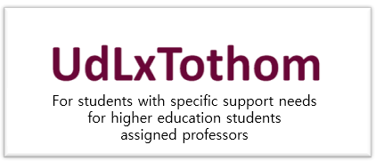
COMMITMENT TO SOCIETY, CULTURE, EQUALITY AND COOPERATION
Promoting social engagement and equal opportunities
Cooperation for development and social change
141
students assigned
1.957 participants in programs against poverty
(period 2020-21)
61 cooperation development projects in empoverished countries (period 2017-2021)
11 active cooperation projects
(2018-2021)
8
professors
Centre for Equal Opportunities and Promotion of Women - Dolors Piera Centre

Slide 25
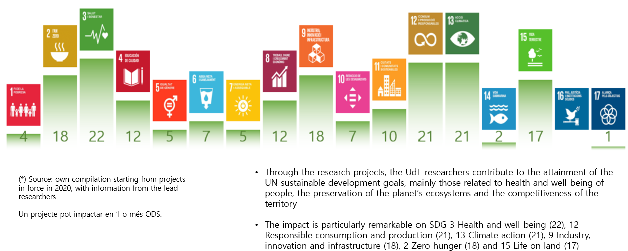
COMMITMENT TO SOCIETY, CULTURE, EQUALITY AND COOPERATION
Connection between the research projects and the SDG (*)
2030 Agenda at the UdL
Electric power from 100% renewable sources
Deployment of photovoltaic panels for self-consumption, with an active surface of 4,530 m²
Grants for international cooperation, solidary mobility and research on the fourth world projects
Participation in the UdL Shelter Programme, to accommodate people from countries in conflict to restart studies in Catalonia
By means of the research projects carried out by the researchers, the University contributes to attainment of the Sustainable Development Goals (SDG)
201-300 (1.115)

Slide 26
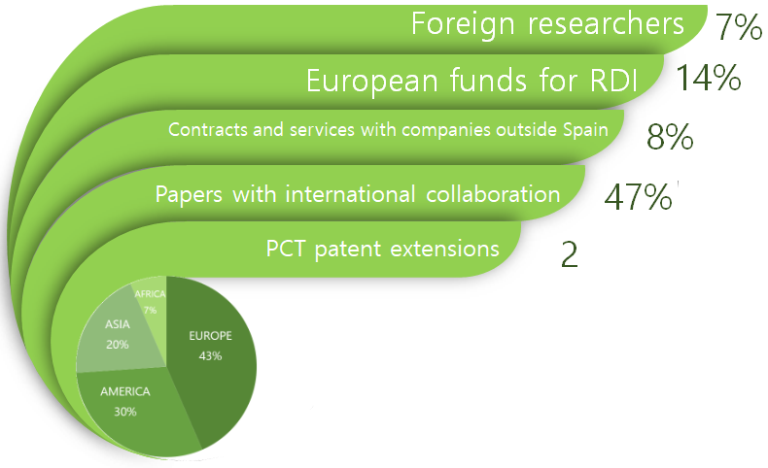
INTERNATIONAL OUTLOOK
Academic programs (year 2020-2021)
Participation in international university networks
14 international double degrees and 5 master’s degrees
8% foreign students on master’s degrees and 13% doctorate studies
RDI (2020)
381incoming mobility students (year 2019-2020), 41% from European countries
Foreign RDI staff by continent (2020)

Slide 27
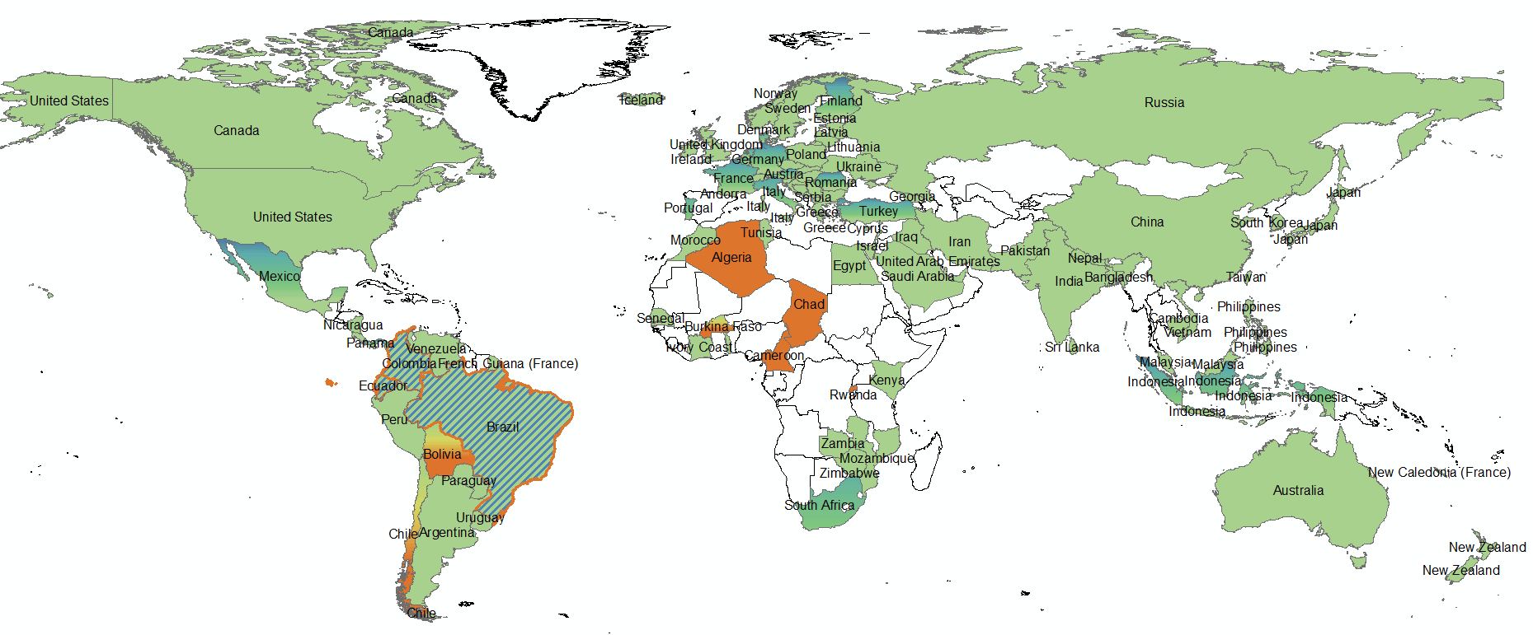
INTERNATIONAL OUTLOOK
Studies offered – scientific papers – cooperation projects
Through academic research and commitment to improving people’s well-being, the UdL projects its staff talent and is present in most countries around the world, especially those of Europe and America
International bachelor’s and master’s degrees / joint scientific papers
Joint scientific papers
Active cooperation projects
Joint scientific papers / active cooperation projects
International bachelor’s and master’s degrees / joint scientific papers / active cooperation projects

Slide 28
INTERNATIONAL OUTLOOK
Position of the UdL in rankings
Position by areas
(X): number of universities

Slide 29
Хвала вам пуно
Хвала Вам много
Gràcies
ferran.badia@udl.cat
www.udl.cat

