Slide 1



Project acronym: MICROGUIDE
Project full title: DEVELOPING GUIDELINES FOR THE IMPLEMENTATION OF MICRO-CREDENTIALS IN HIGHER EDUCATION
Project No. 2021-1-ProjectRS01-KA220-HED-000027585
Funding Scheme: Erasmus+
Training on the linking MCs to NQF practice in Project Partner HE
Lleida, 28 – 30. June 2023
Adisa Ejubovic and Adekola Ashonibare
Institution: Accreditation Council for Entrepreneurial and Engaged Universities

Slide 2
Agenda
1. Task information
2. Scope of the study
3. Methodology
4. Overview of German NQF and European QF
4. Key findings
  Landscape of micro-credentials (MCs) in Germany
  Models of MCs
  Weaknesses or challenges of linking MCs to DQR
  Prerequisites for linking MCs to DQR
  Recommendations for linking MCs to DQR
5. Limitations of the study and need for further research

Slide 3
Task information
Task: Analyse the linking of micro-credentials to the National Qualification Framework in Germany, making a proposal for the best model of linking
Task description: Identify the qualities and weaknesses of linking micro-credentials to Germany’s NQF and measures of improvement

Slide 4
Scope
It was not feasible to analyse all existing micro-credentials given their diversity, so what?
This study conducted analysed all relevant and available data providing information about linking MCs to qualification frameworks, particularly, the German NQF.

Slide 5
Methodology
1. Desk research
  Books, reports, articles, websites, and databases.
2. Literature review
  Academic and scholarly literature

Slide 6
German National Qualification Framework
Officially launched in May 2013
It aims to:
  enhance transparency, comparability and recognition of German qualifications
  facilitate mobility of learners and workers
  promote lifelong learning (Cedefop, 2021)
Structured on eight (8) levels just like the EQF
So far, it mainly represents formally acquired qualifications from general, vocational and higher education, leaving out non-formal & informal education
Emphasis on competence, indicating development of an ability to apply knowledge and act reasonably within an academic field or occupational activity (BMBF, 2019)
Each level is divided into (I) Professional and (II) Personal competence
One important principle of DQR is that each qualification level should always be accessible via various education pathways, e.g. allocation of bachelor and master craftsman qualification to level 6

Slide 7
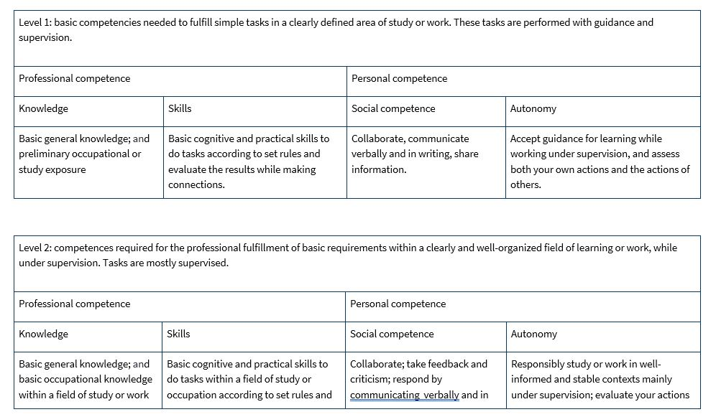
German National Qualification Framework (graphical example)

Slide 8
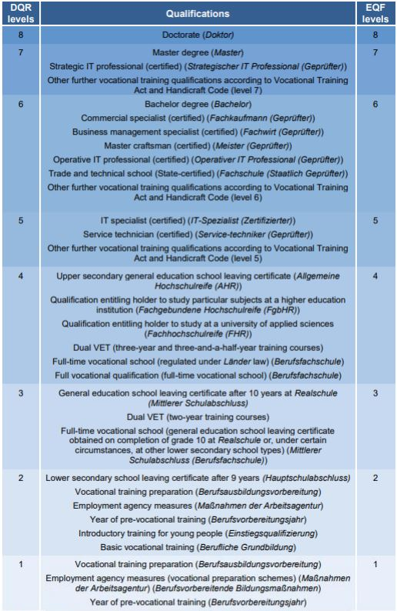
Correspondence between the DQR and EQF

Slide 9
Key findings
Landscape of MCs in Germany
  MCs are offered by both formal as well as non-formal and informal education providers (training providers, industry organisations).
  Only about one in five universities offer MCs for the year 2022. (DAAD, 2022)
  Based on the DAAD survey across 160 German HEIs, 20% are using MCs, 23% are considering potential implementation, and 37% have not considered its use.
  Considering the emerging shortage of skilled workers, it makes sense to

Slide 10
Models of MCs
Independent model: stand-alone MCs; can be earned through online courses, workshops, or other forms of training
Integrated model: MCs with stackability options (including into other formal qualification)
Embedded: deliberate incorporation of MCs into a qualification program, substituting local content and assessments with their own course material and evaluation methods.
RPL: HEIs have the option to consider micro-credentials retrospectively. For example, Kiron-and Kiron’s 32 partner universities (Kiron, 2019)
Modular: learners can undertake MCs in the form of modules, which can function as stand-alone qualifications. Upon successful completion of the multiple micro-credentials, learners receive another qualification.
Models of MCs
Independent model
Embedded model
Recognition of prior learning model
Integrated model
Modular model

Slide 11
Weaknesses or challenges of linking MCs to DQR
Recognition and crediting: there is a lack of consistent guidelines for evaluating competencies gained in micro-learning programs, presenting a challenge to recognizing the value of MCs, which are generally considered as non-formal education programs.
There has been a lack of a common understanding of quality, reinforcing the possible lack of transparency within the education market and making it difficult to evaluate respective programmes – both for the course offerings and learners.
Ensuring the validity of MCs and fostering its linkage to DQR is complicated as they vary in terms of course providers.
MCs vary in terms of learning outcomes, duration, costs, modes of assessment, whether they can lead to further qualifications or not (stackable), and whether they are credit-bearing or not. Therefore, linking MCs to DQR would depend on these factors.
Qualifications acquired in non-formal and informal learning processes do not fully reflect a DQR level, they are elements of a level

Slide 12
Prerequisites for linking MCs to the DQR
ECTS should be used for MCs offered by HEIs to support compatibility and stackability of MCs.
The design of micro-credentials follows agreed standards, for instance the European Common Micro-Credential Framework.
MCs need to be subject to regular quality assurance reviews by appropriate regulatory bodies to ensure they continue to meet intended needs.

Slide 13
Recommendations for linking MCs to DQR (pessimistic viewpoint)
Non-university MC providers need to partner with HEIs in ensuring correct allocation of ECTS, as well as verifying learning outcomes, and micro-credential workload. E.g. Northeastern University and IBM have a partnership that allows IBM-micro-credential holders to receive graduate credit from the university (Leaser et al., 2020).
The linking of MCs solely or jointly provided by HEIs to DQR must be done with caution since a single micro-credential may not equate to the rigour, learning outcomes, and complexity of the recommended DQR levels (level 6 to 8). Therefore, the alignment to DQR level 6 to 8 could serve as reference points for the stackability of MCs into existing qualification programmes, rather than an indication of equivalence to a specific level in the DQR.

Slide 14
Recommendations for linking MCs to DQR (optimistic viewpoint)
A coalition of all HEIs in Germany in designing a repository of partnership expectations could potentially provide necessary guidelines to other non-formal MC providers who might be interested in collaborating with a HEI.
There is need for HEIs to have discussion at the national level discussion regarding the recognition of competencies acquired through university-offered micro-credentials and crediting of competencies via non-university organisations since HEIs may have different legal frameworks and examination criteria (HRK, 2020).
Following the European CMF, MCs provided by HEIs could be linked to DQR by integrating the MCs into existing qualification programs between level 6 and 8 (Antonaci, 2021), since MCs provided by HEIs (universities, colleges and technical universities) have greater potential for improving clarity, transparency, and stackability by building on existing EHEA tools (ECTS, ISCED field, and other supplementary information).
Establishment of competent bodies to:
* develop Germany-wide comprehensible criteria
* define quality criteria
* accrediting informally and non-formally acquired MCs
Non-university MCs who meet stipulated criteria request for MCs accreditation and propose assignment to a specific DQR level, subject to the approval of the monitoring body

Slide 15
Recommendations for linking MCs to DQR (most likely)
Stacking micro-credentials into existing formal qualifications seem to be the most viable way of linking micro-credentials to DQR. Therefore, the design of micro-credentials needs to align with formal qualification outcomes and strategic purpose.
MCs earned in non-formal and informal learning could be linked to the DQR through the recognition of prior learning. The process of linking of micro-credentials issued by non-formal and informal learning organisations to the DQR, could be decided by the concerned HEIs.
The concept of external examinations according to § 45 BBIG and professional advancement training, could be used in identifying, certifying, as well as linking non-formally acquired MCs to the DQR

Slide 16
Limitations of the study and need for further research
Methodological limitation
Empirically investigate the perception of higher education institutions in Germany on the possibility of partnership with non-university providers of micro-credentials.
Examine possible means of enhancing acceptance of micro-credentials by HEIs in Germany.

Slide 17
Thank you for your attention
Vielen Dank für Ihre Aufmerksamkeit
Gracias por su atención

