Slide 1
Project acronym: MICROGUIDE Project full title: DEVELOPING GUIDELINES FOR THE IMPLEMENTATION OF MICRO-CREDENTIALS IN HIGHER EDUCATION Project No. 2021-1-ProjectRS01-KA220-HED-000027585 Funding Scheme: Erasmus+
Analysis of linking micro-credentials to National Qualification Framework in Serbia Lleida, 28h June – 30th June 2023
Prof. Dr. Sinisa Djurasevic
University of Belgrade

Slide 2
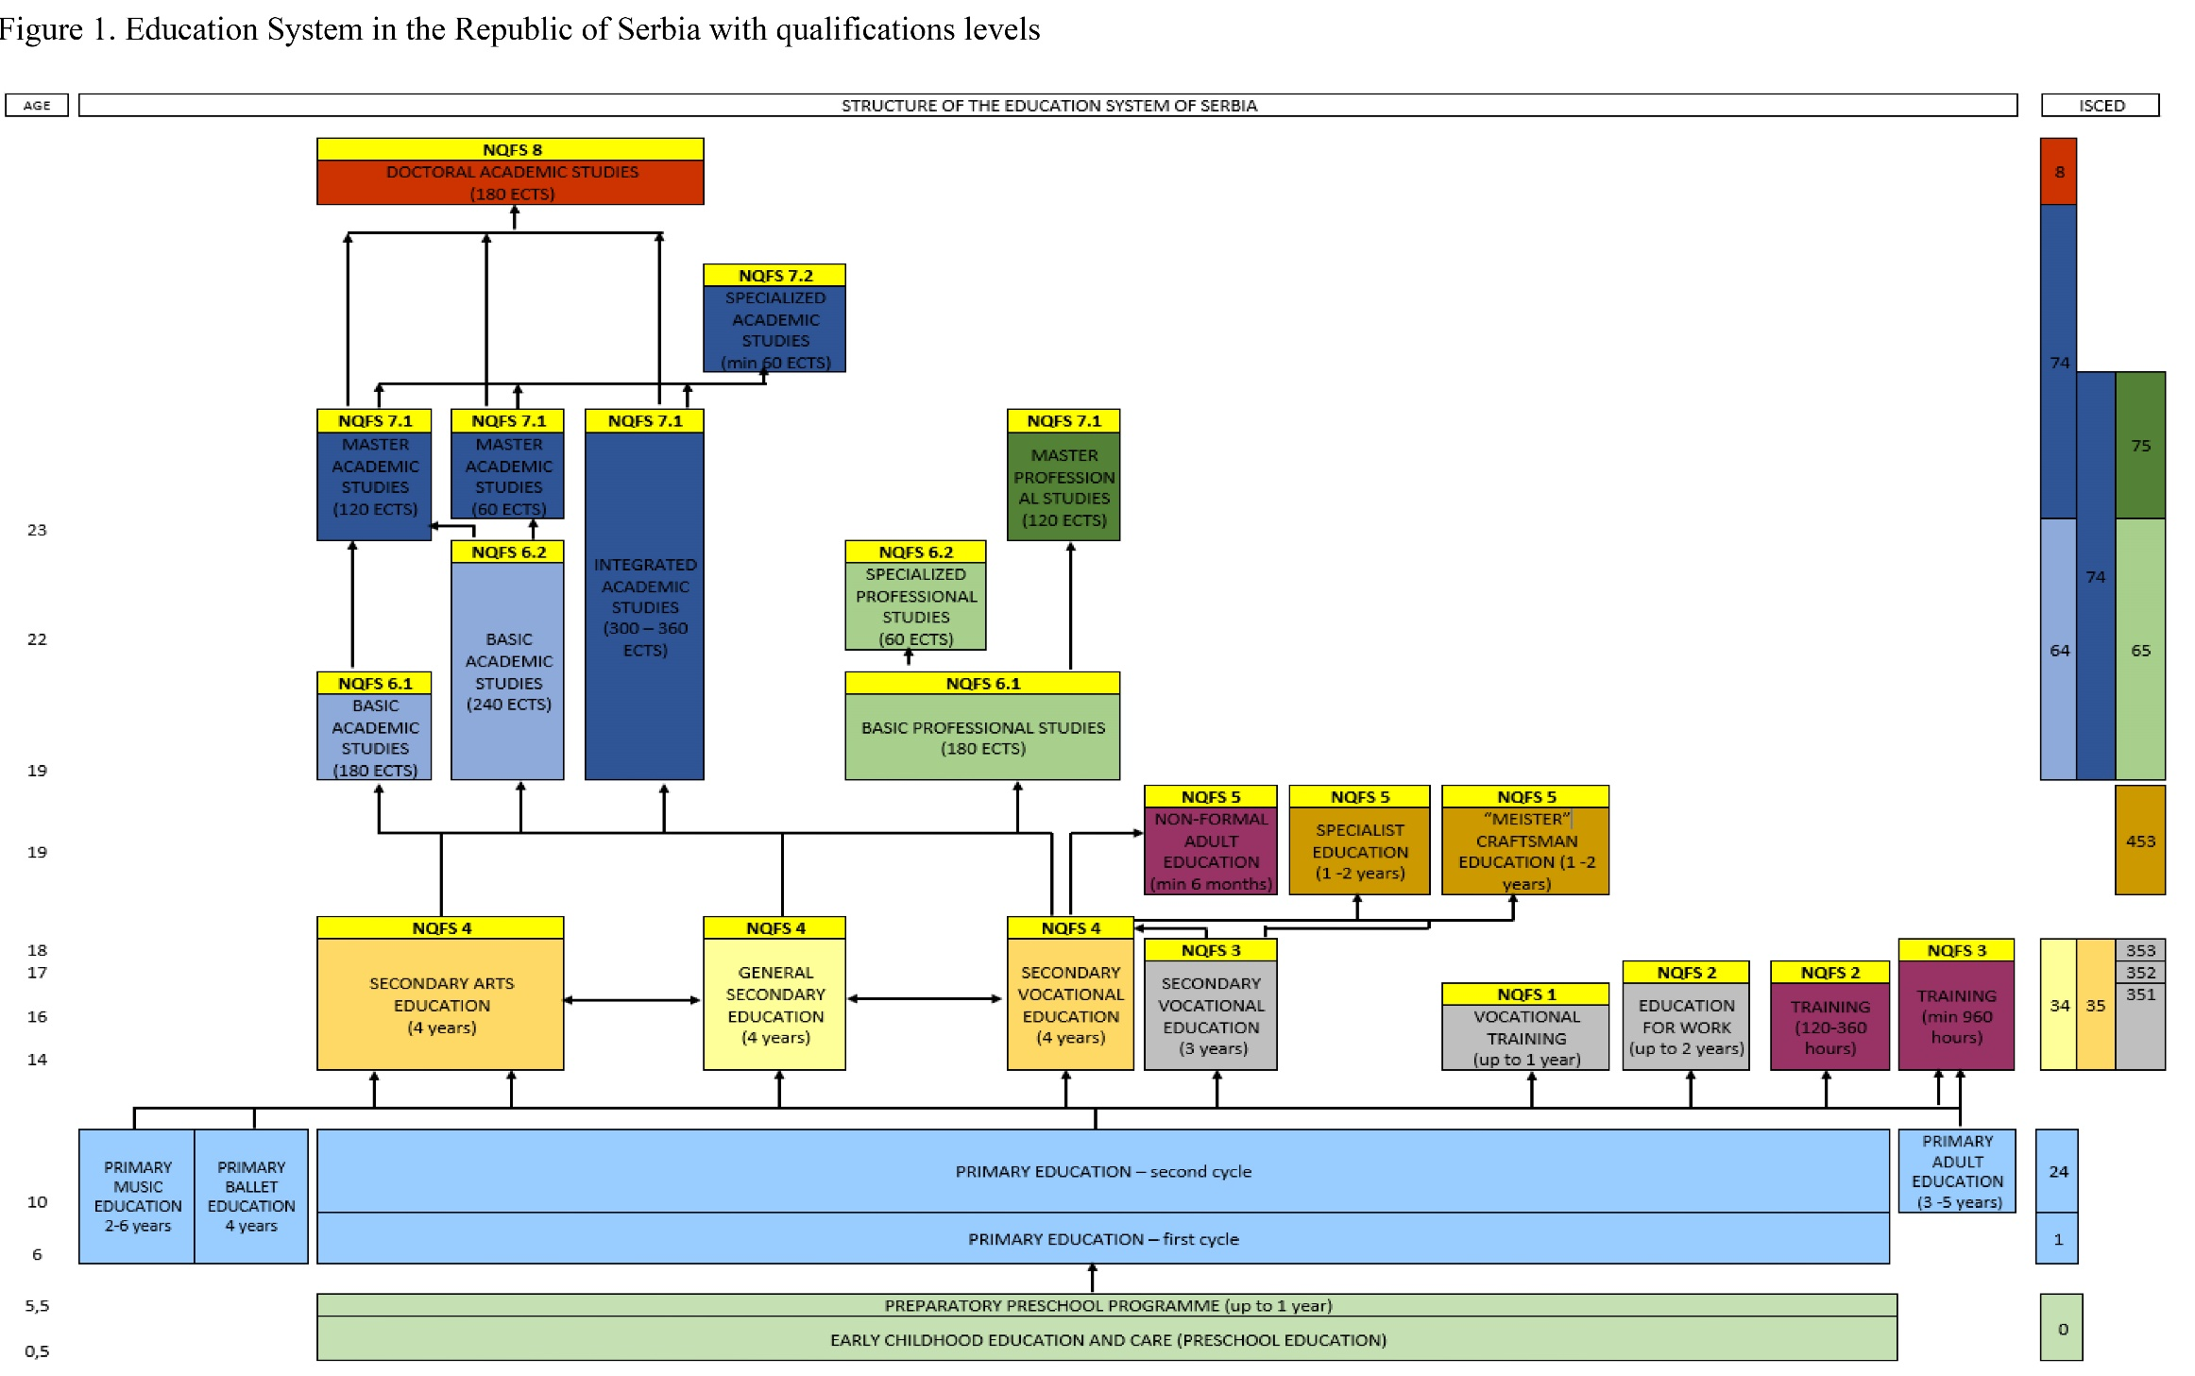

Slide 3
The regulatory and strategic framework
1) The Law on the Foundations of the Education System;
2) The Law on Preschool Education;
3) The Law on Primary Education;
4) The Law on Secondary Education;
5) The Law on Dual Education;
6) The Law on Adult Education;
7) The Law on Higher Education;
8) The Law on the Dual Model of Studies in Higher Education;
9) The Law on Regulated Professions and the Recognition of Professional Qualifications
10) The Law on the National Qualifications Framework;
11) The Law on Education Inspectorate

Slide 4
Institutional framework
The Qualifications Agency:
is a Government’s professional organization established by the Law on the National Qualifications Framework of the Republic of Serbia11, competent for developing qualification standards, recognition of foreign school and higher education documents, accreditation of organizations in the area of adult education – Publicly Recognized Organizers of Adult Education Activities. It provides support to the Council for the National Qualifications Framework and proposes quality assurance measures throughout the entire education system. The most important tasks of the Qualifications Agency in the implementation of the NQFS relate to reviewing initiatives for the introduction of new qualifications, providing professional support to the Sector Skills Councils and preparing proposals for qualification standards, maintaining the NQFS Register, external quality control of the PROAEA, monitoring and measuring the effects of the qualification implementation on employment and lifelong learning. The Agency submits an annual report to the Government of the Republic of Serbia and on request periodic reports to the Ministry of Education, Science and Technological Development.

Slide 5
Institutional framework
Sector Skills Council:
is an expert and advisory body established on the principle of social partnership, whose main role is to carry out activities relevant to concrete qualifications within a certain sector, acquired in secondary, vocational, higher education and adult education. The Government of the Republic of Serbia issued decisions on the establishment of 12 Sector Skills Councils covering the sectors of education and economy 12. Mandatory institutionally delegated members of the Sector Skills Councils are the representatives of the Chamber of Commerce and Industry and representative associations of employers (representatives of entrepreneurs), Council for Vocational Education and Adult Education, National Employment Service, Conference of Universities of Serbia and Conference of Academies of Applied Studies, associations of vocational schools, the Ministry of Education, Science and Technological Development, the ministry responsible for the area of work covered by the Sector Skills Council, trade unions, Institute for the Improvement of Education. Sector Skills Council reports annually to the Qualifications Agency, the Ministry of Education, Science and Technological Development and the Government of the Republic of Serbia.

Slide 6
Studies
According to the type, studies are divided into academic and applied:
academic studies train students to develop and apply scientific, artistic and professional achievements;
applied studies to apply and develop professional knowledge and skills required in order to enter the labour market.
By cycle, studies are divided in first, second and third cycle of studies. First cycle studies:
bachelor academic studies of three and four-year duration (180-240 ECTS);
bachelor applied studies of three-year duration (180 ECTS);
specialised applied studies of one-year duration (60 ECTS) after applied or academic studies of three-year duration (180 ECTS).

Slide 7
Studies
Second cycle studies:
integrated academic studies of five and six-year duration (300-360 ECTS);
master academic studies of one-year duration (60 ECTS) after bachelor academic studies of four-year duration (240 ECTS), or master academic studies of two-year duration (120 ECTS) after bachelor academic studies of three-year duration (180 ECTS);
master applied studies of two-year duration (120 ECTS) after bachelor academic or bachelor applied studies of three-year duration (180 ECTS);
specialised academic studies of one-year duration (60 ECTS) after master academic studies.
Third cycle studies are doctoral academic studies of three-year duration (180 ECTS) after integrated academic studies of at least five-year duration (300 ECTS) or master academic studies.

Slide 8
Studies
In addition to academic and applied studies, higher education institution may also organize a Short study programme of the scope from 30 to 60 ECTS credits.
These programs are organized for the professional training of persons with at least secondary education and for the purpose of entering the labour market.
Short study programmes have a clearly defined structure, purpose and learning outcomes and upon completion, a certificate with obtained competencies is issued.
Short study programmes defined in this way are different from Short-cycle study programmes in the European Higher Education Area, since there is no level or descriptor for them in the National Qualifications Framework.
Also, these programs are not subject to accreditation as defined for the first, second and third cycle study programmes, but a decision of a higher education institution’ professional body is sufficient.

Slide 9
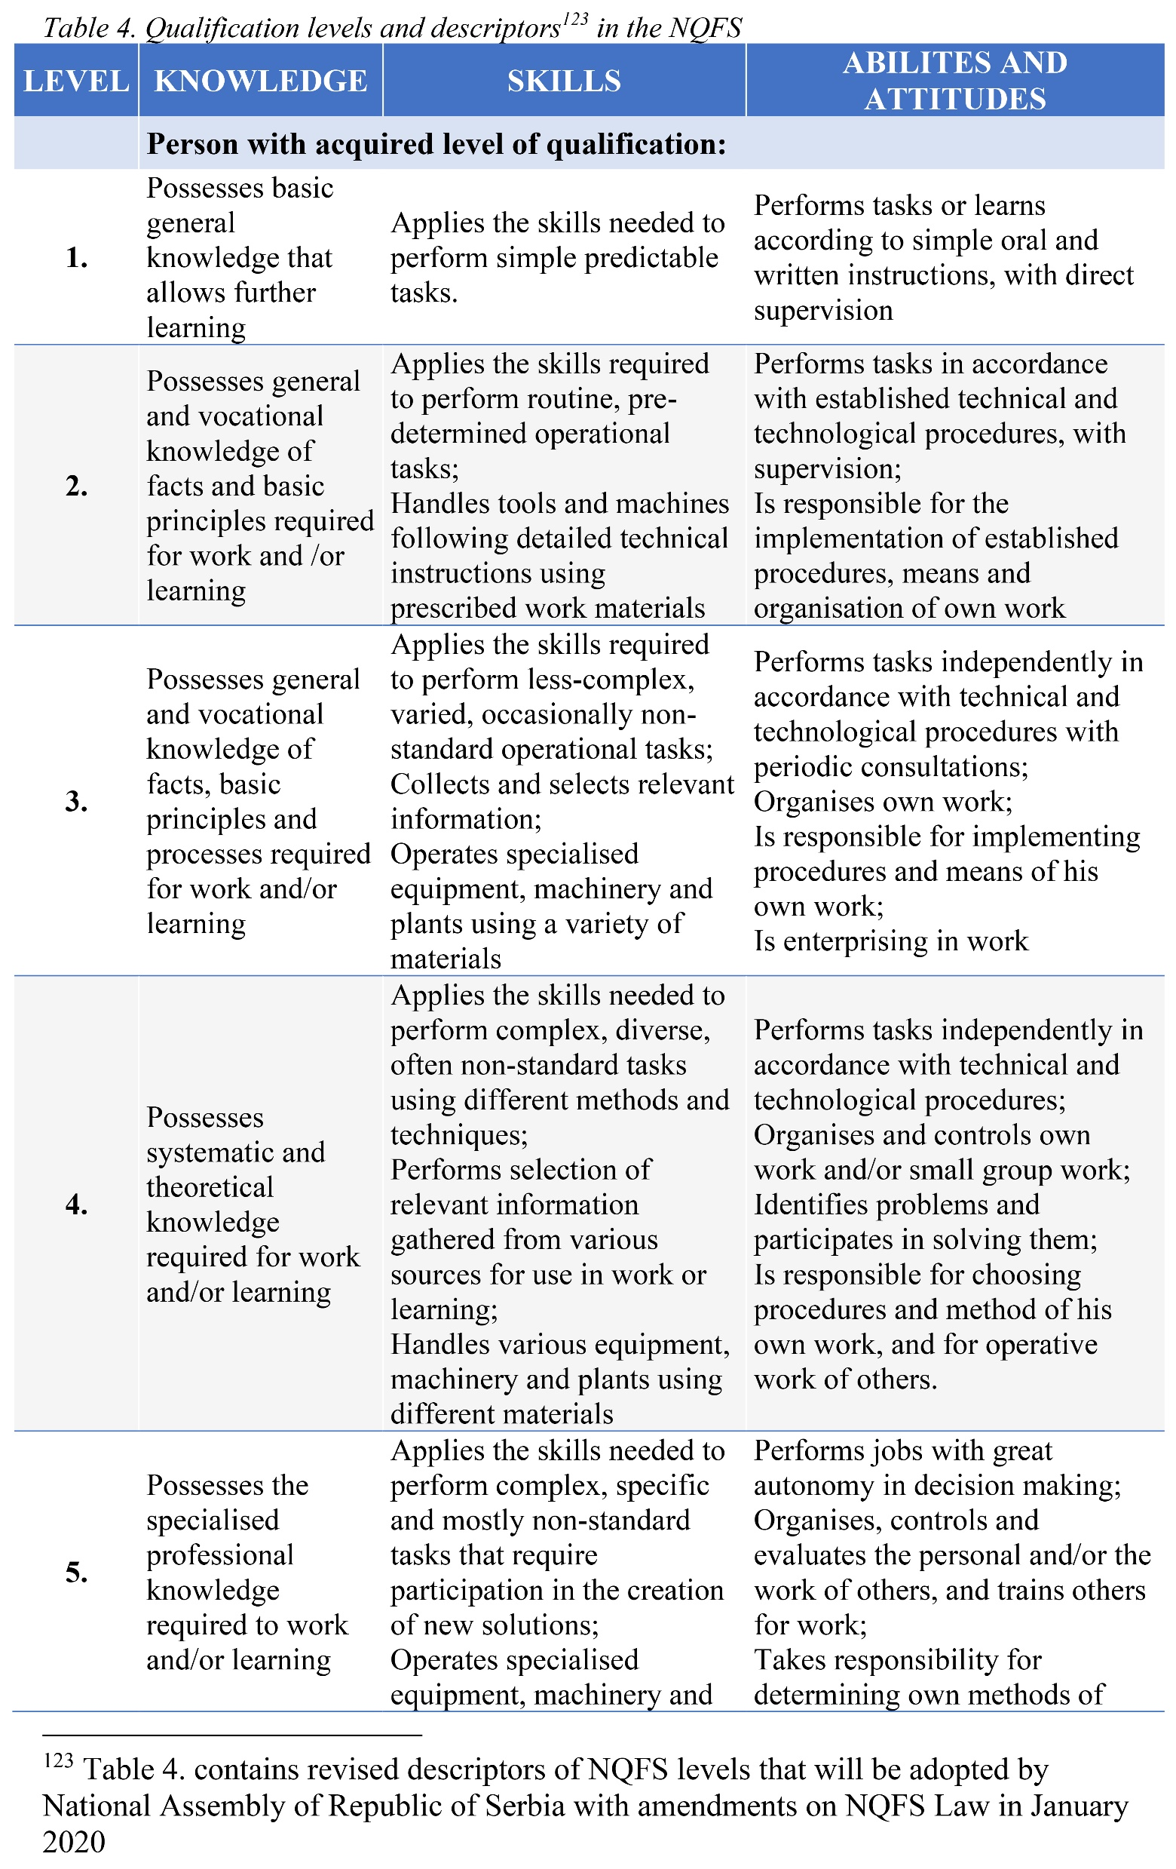
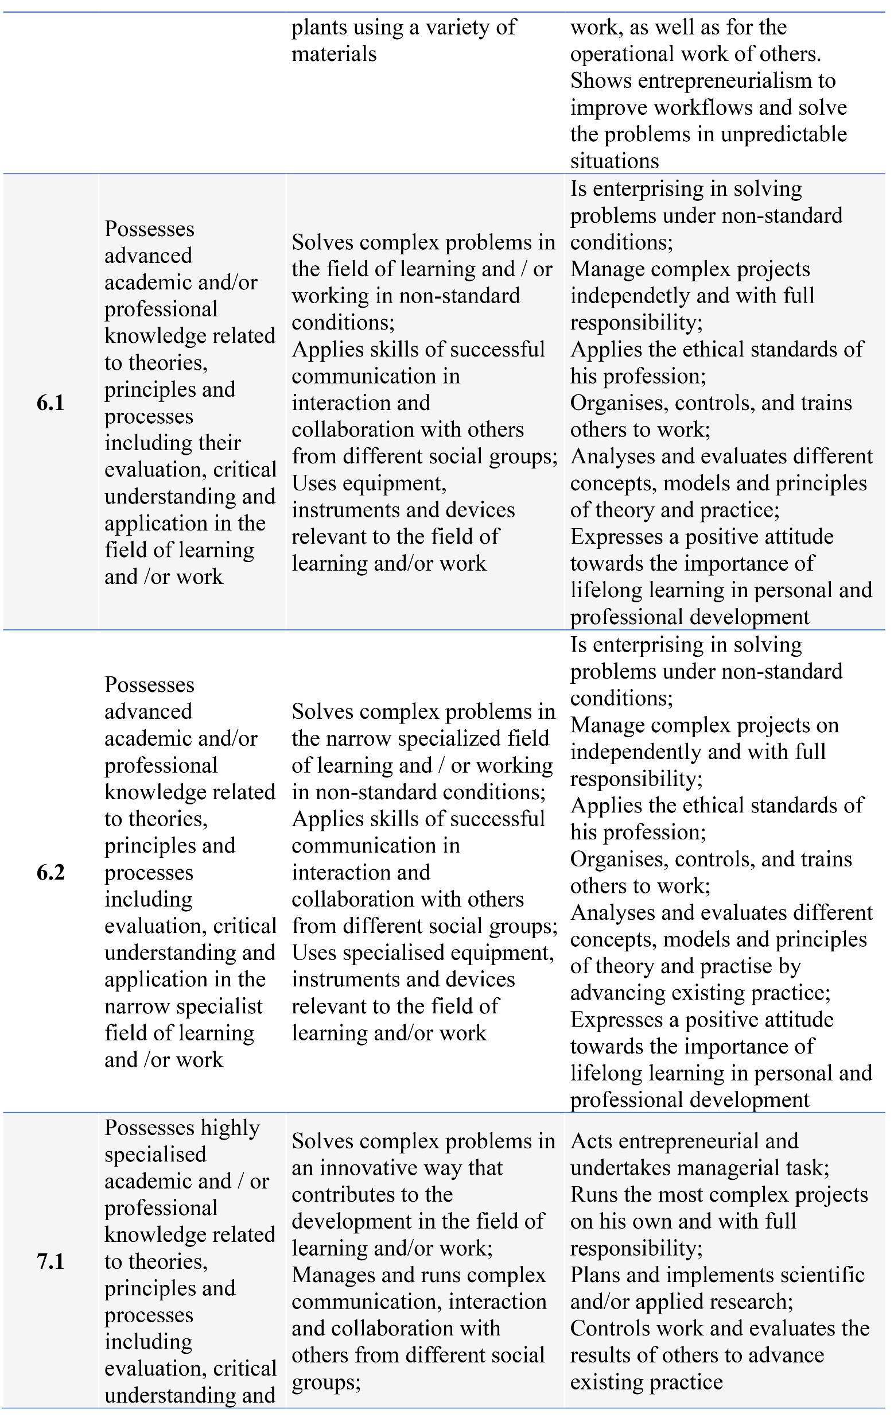
National Qualification Framework

Slide 10
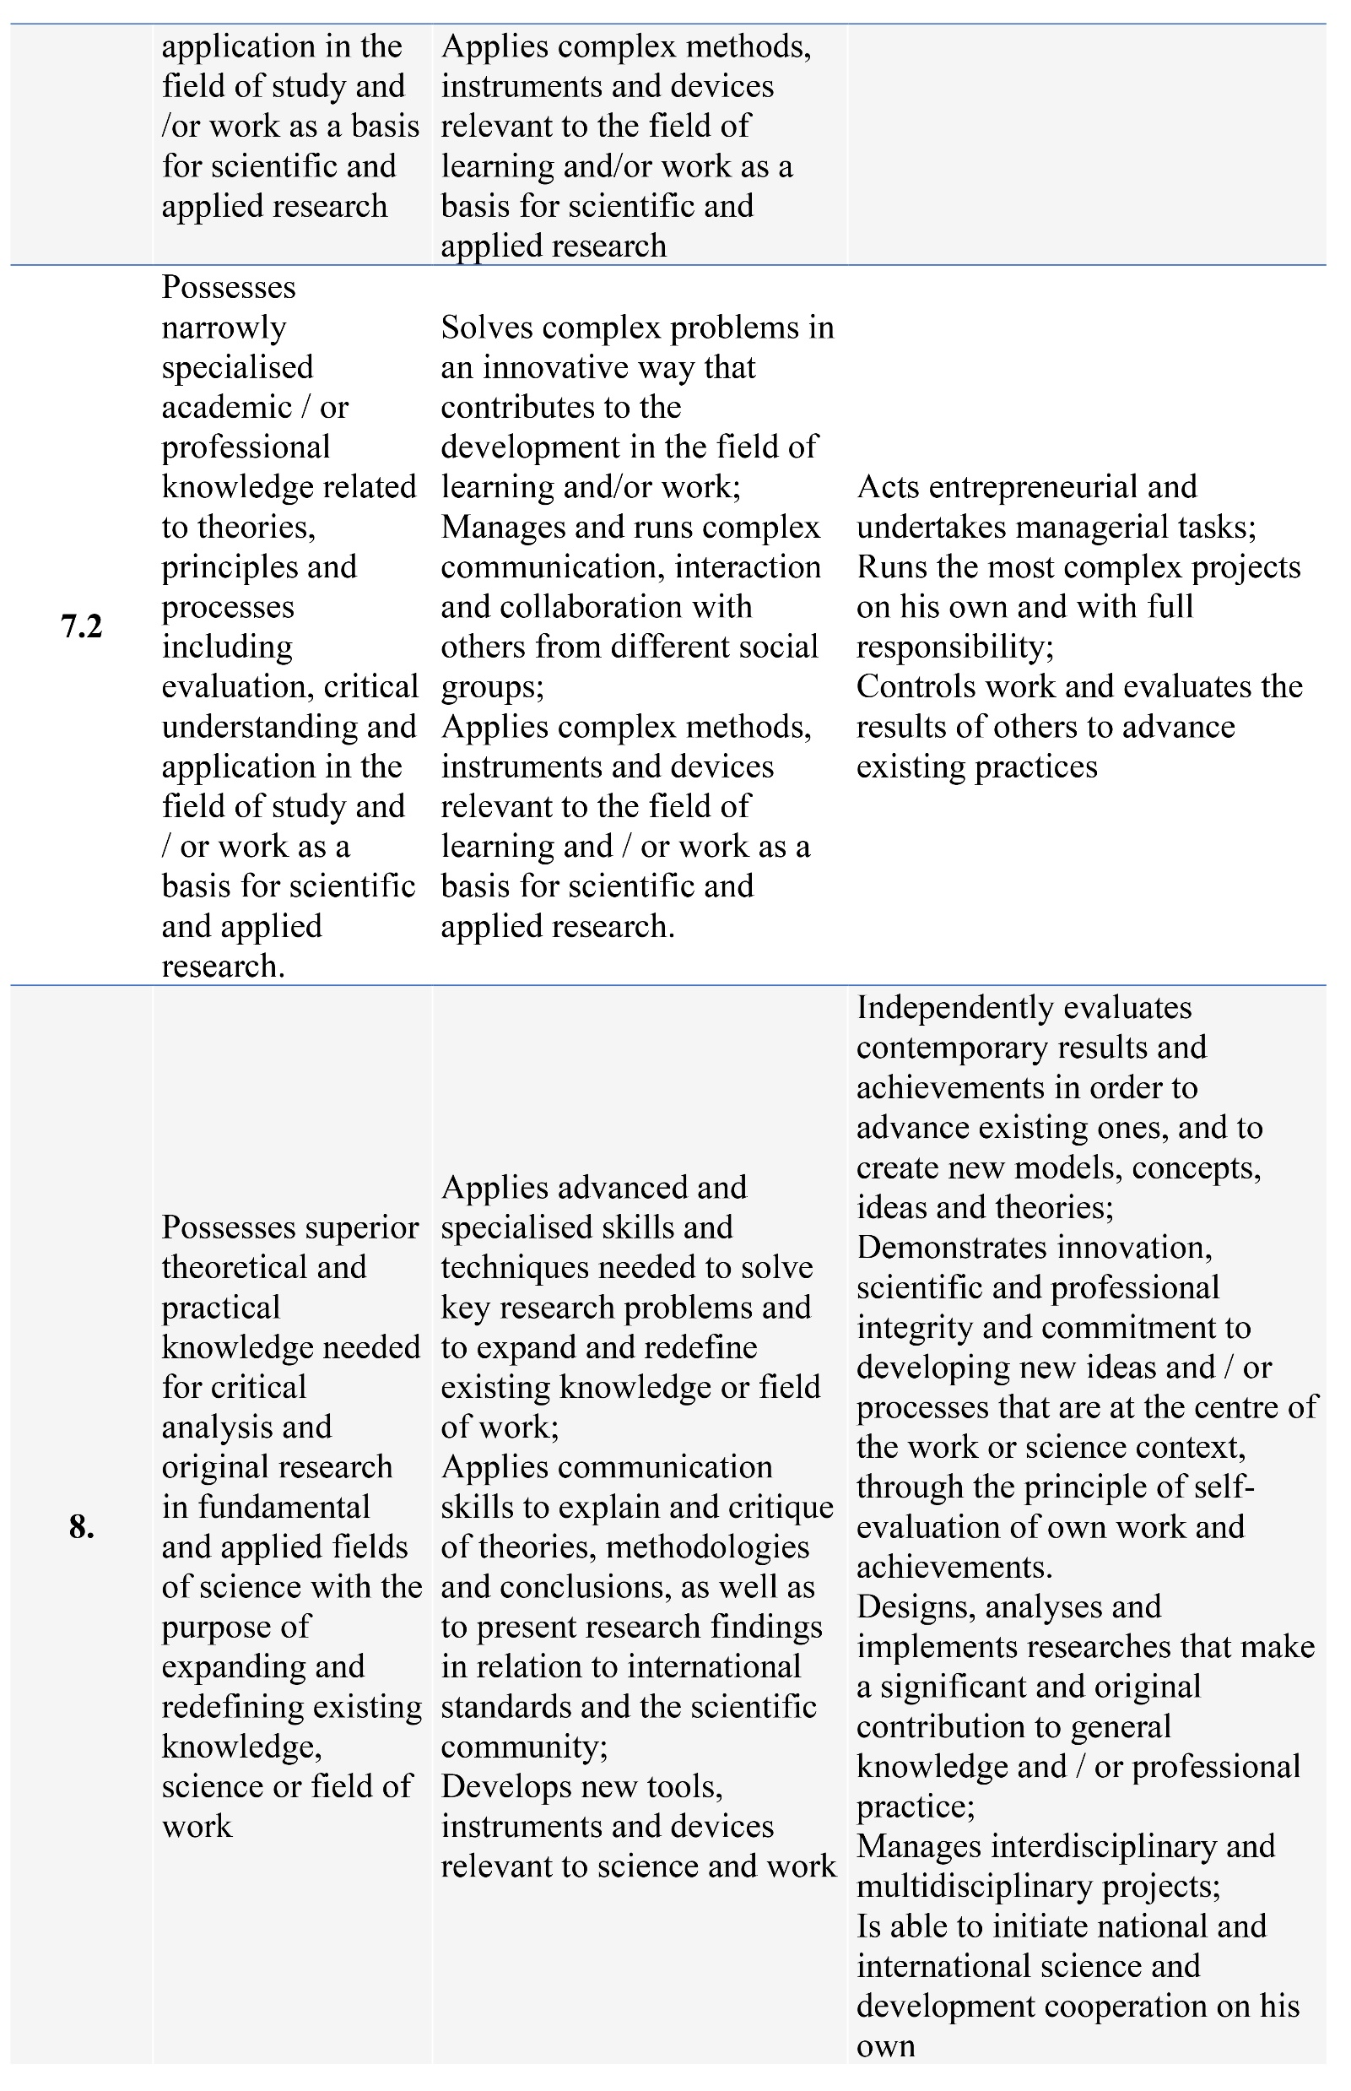
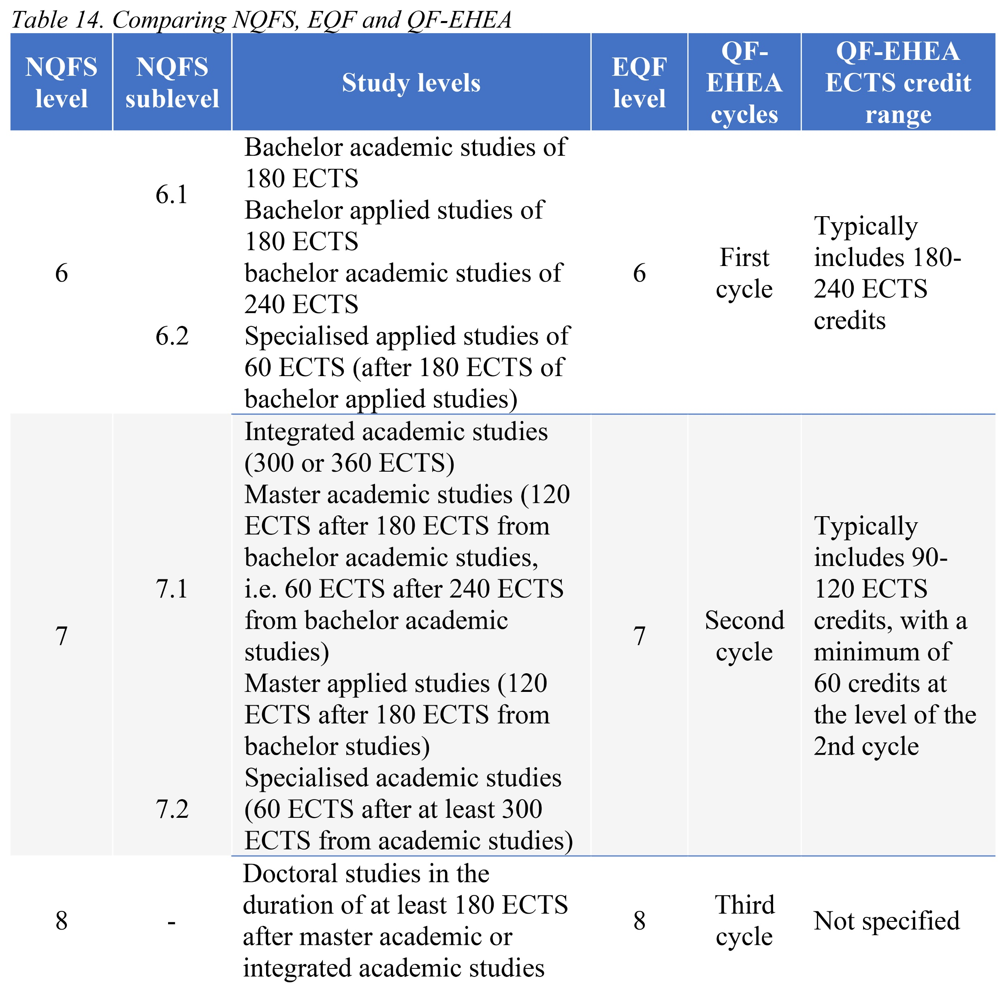
National Qualification Framework

Slide 11
Currently, in higher education, it is possible to connect NQF levels only with full qualifications (i.e., fully completed study cycle). A possible solution is to link micro-credentials to NQF based on MCs content (i.e., to answer the question “from which study cycle the MCs content predominantly belongs to).

Slide 12
Thank you for your attention
Vielen Dank für Ihre Aufmerksamkeit
Gracias por su atención
sine@bio.bg.ac.rs
www.bio.bg.ac.rs

