Slide 1
Project acronym: MICROGUIDE Project full title: DEVELOPING GUIDELINES FOR THE IMPLEMENTATION OF MICRO-CREDENTIALS IN HIGHER EDUCATION Project No. 2021-1-ProjectRS01-KA220-HED-000027585 Funding Scheme: Erasmus+ https://microguide.bio.bg.ac.rs/
EU4Green Workshop Sarajevo, 04. October 2023
Prof. Dr. Siniša Đurašević
University of Belgrade
sine@bio.bg.ac.rs

Slide 2
Definition(s)
Short courses that certify your knowledge in a particular area (Forbes Advisor)
Short, competency-based recognition (National Education Association)
Short certification courses that allow you to learn new professional skills very quickly (Assessment Systems)
Mini qualifications that can help individuals learn new skills, progress in their careers, or change careers entirely (Times Higher Education)

Slide 3
Framework for delivering competency-based qualifications that are shorter than a comprehensive certification (Accredible)
Short certification courses that allow you to learn new professional skills very quickly (Open Universities Australia)
Online credential programs where you can earn credits to apply towards a degree program (Pathways to Advancement)
Bite-sized qualifications that demonstrate skills, knowledge and/or experience in a specific subject area or capability (Wiley University Services)

Slide 4
Micro-credential properties
Micro-credentials come in various forms:
Badges: Digital badges earned for completing a course or project
Certificates: Short courses that lead to a certificate of completion
Nano-degrees: More extensive programs offered by organizations like Udacity or Coursera

Slide 5
They are offered by many reputable institutions or organizations:
Harvard University HarvardX Verified Certificate
Google Ads Certification, Google Analytics Certification, and Google Cloud Certification
Microsoft Certified Azure Fundamentals, Azure Developer Associate and Azure Solutions Architect Expert
IBM Digital Badge program
Coursera Specializations

Slide 6
edX Professional Certificate programs
Udacity nano-degrees
LinkedIn Learning Skills Assessments and LinkedIn Learning Certificates
Adobe Certified Badges
Salesforce Trailhead Badges and Superbadges (through its Trailhead platform)

Slide 7
Flexibility, both on the development and the way of delivery (blended learning, online learning…):
it allows learners to study at their own pace and can be completed in less time than traditional degrees, which makes them an attractive option for working professionals (no matter on previous education) looking to upskill or change careers

Slide 8
Targeted Skill Acquisition:
to enable individuals to acquire specific, in-demand skills in a life-long learning manner that can boost employability
Link to the labour market needs

Slide 9
Stackability:
Where multiple micro-credentials can be combined to form a comprehensive skillset. For example, someone interested in digital marketing might earn micro-credentials in SEO, social media, and analytics
Also a way to restrict MCs duration
And what about Certificates?
And what about a degree? (for example 180 micro-credential ECTS)

Slide 10
Assessments:
To earn a micro-credential, learners typically need to complete the required coursework or projects specified by the issuing institution or organization.
The specific requirements may vary depending on the micro-credential.
Some may require learners to pass quizzes, exams, or submit assignments, while others may involve practical projects or case studies

Slide 11
Issues (still) to be solved
Legal Framework:
Is it necessary, and if so, when
Formal vs Non-formal Learning
Quality vs Flexibility

Slide 12
ECTS range:
5?, 10? 30?
It must be something MICRO in it !
ECTS value based on purpose, having stackability in mind

Slide 13
Content:
Is it just a usual HE course or something other?
Quality assurance
Accreditation
Standards and Guidelines for Quality Assurance in the European Higher Education Area (ESG)

Slide 14
Certification:
Certificate and certificate supplement
According to the council recommendation, the mandatory elements for micro-credentials certification are the following:
Identification of the learner;
Title of the micro-credential;
Country(ies)/region(s) of the issuer;

Slide 15
Date of issuing;
Learning outcomes;
Workload needed to achieve the learning outcomes (in European Credit Transfer and Accumulation System – ECTS, wherever possible);
Type of assessment;
Level (and cycle, if applicable) of the learning experience leading to the micro-credential (European Qualifications Framework, Qualifications Frameworks in the European Higher Education Area), if applicable;

Slide 16
Form of participation in the learning activity;
Type of quality assurance used to underpin the micro-credential.
FH JOANNEUM (+):
Prerequisites: Admission requirements, Prior knowledge, Prior experience;
Description of the grading scheme;
Supervision and identity verification during assessment.

Slide 17
Link to the NQFs/EQF:
European Common Micro-credential Framework recommends linking micro-credentials issued by HEIs to NQF by integrating or stacking into qualification programs between level 6 to 8
It is noteworthy to mention that linking micro-credentials to NQFs levels does not equivalence with qualifications in the levels. Instead, it should serve as a reference point for stacking micro-credentials into existing formal qualifications

Slide 18
One (simple) approach could be content-based:
If some MCs is already a part of level 6 study curricula, either at the home HEI, or the HEI to whose students it is offered
Or if majority of its content belongs to the material that is normally offered at level 6 studies at home HEI
then that MCs should be linked to the level 6

Slide 19
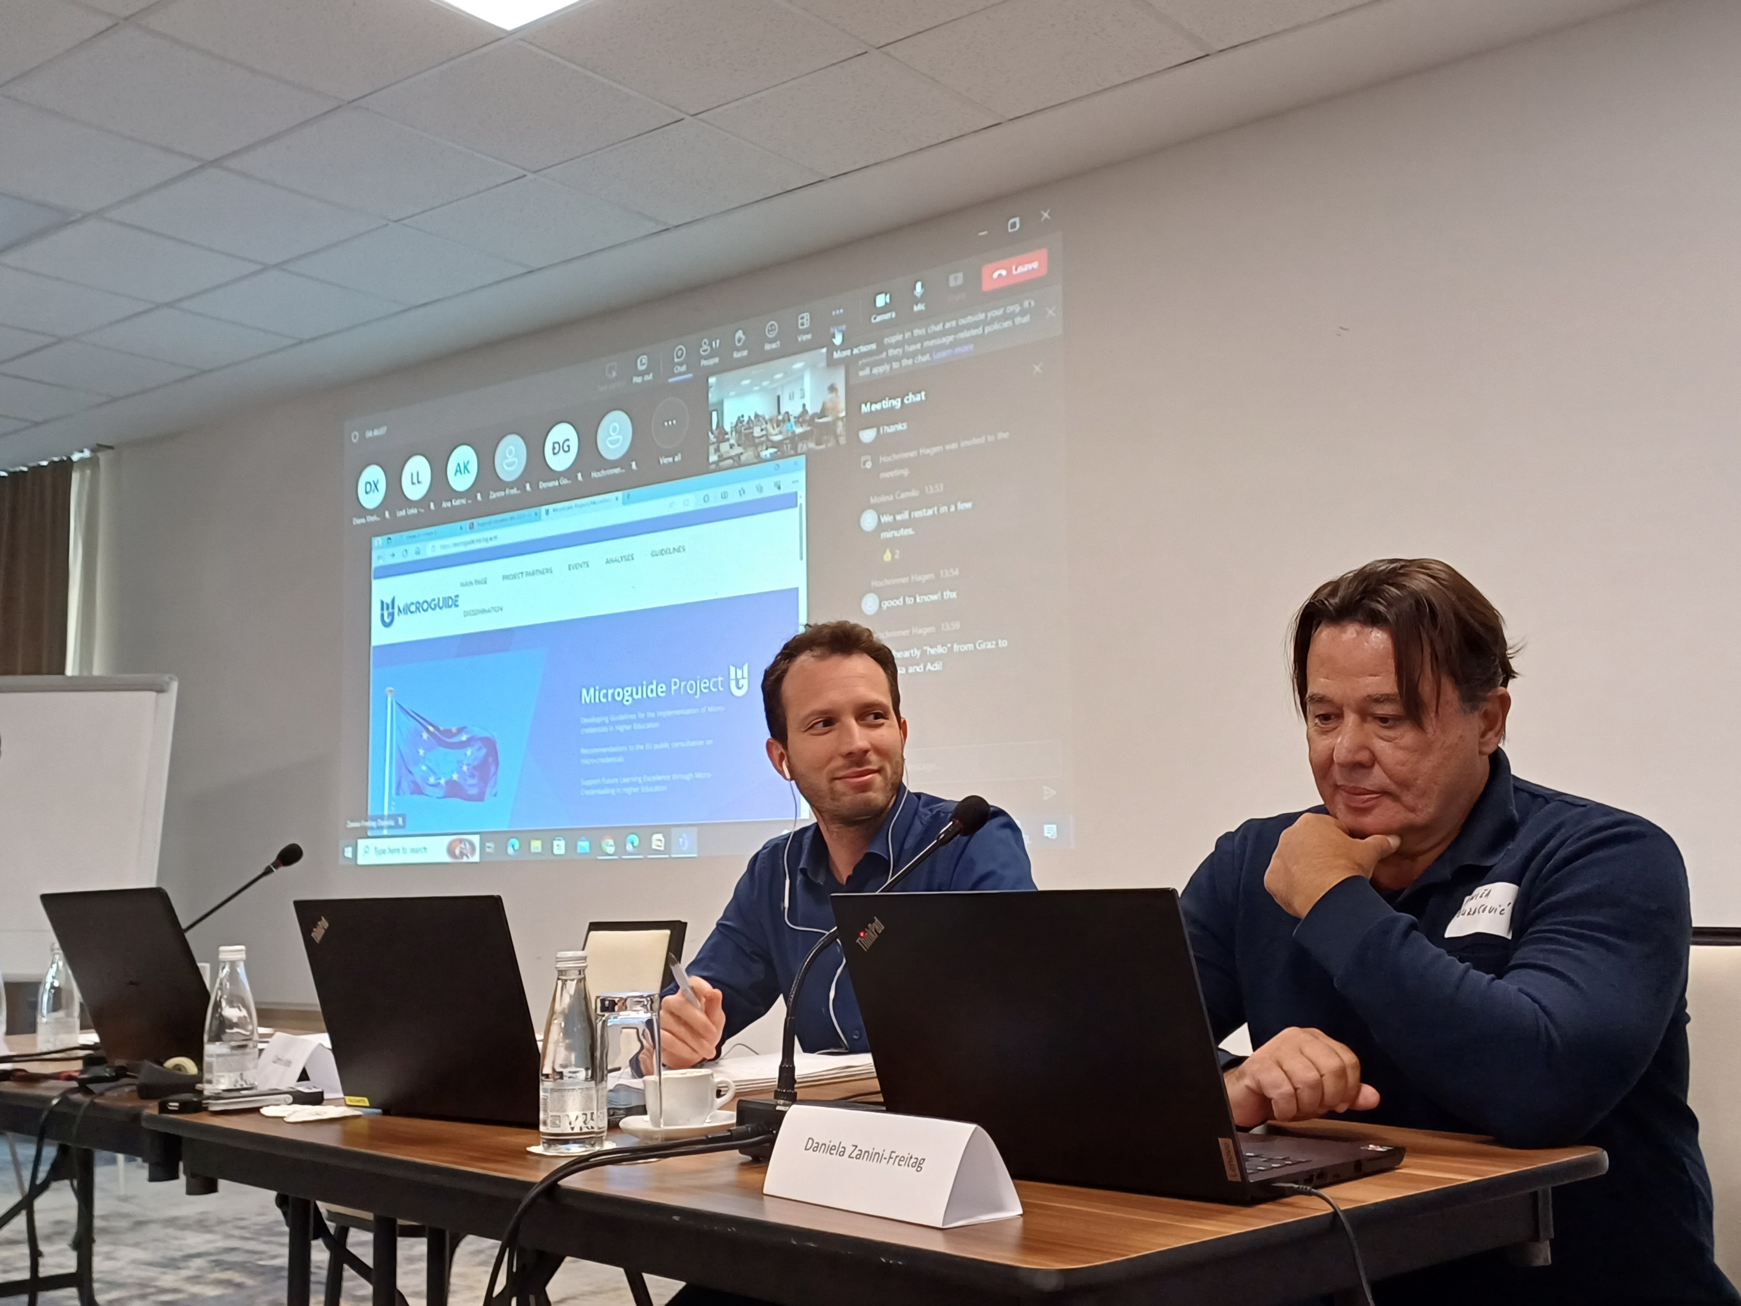

Slide 20
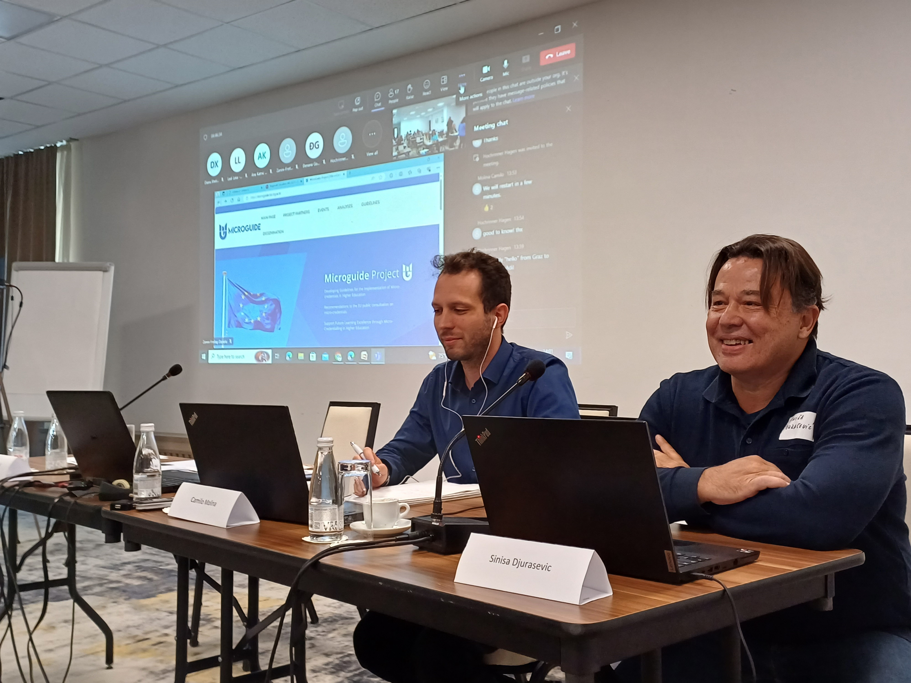

Slide 22
Thank you for your attention
Vielen Dank für Ihre Aufmerksamkeit
Hvala na pažnji
sine@bio.bg.ac.rs

