Slide 1



Project acronym: MICROGUIDE
Project full title: DEVELOPING GUIDELINES FOR THE IMPLEMENTATION OF
MICRO-CREDENTIALS IN HIGHER EDUCATION
Project No. 2021-1-ProjectRS01-KA220-HED-000027585
Funding Scheme: Erasmus+
Micro-credentials – where are we?
Final conference
Belgrade, October 30th
Mag. Maja Dragan, FH JOANNEUM
D.I. Hagen H. Hochrinner, FH JOANNEUM

Slide 2

Micro-credentials - International

Slide 3

Megatrends
Increasing cost of Higher Education
No more jobs for life
Employer demands for flexibility and reaction times
Move to skills-base rather than qualification base
Decreasing value of a degree coupled with degree inflation
Notes:
These megatrends suggest that universities of the future will need to be much more adaptable,
with a focus on personalized education, lifelong learning opportunities, and skill-oriented programs.
Higher education institutions that can successfully respond to these trends are likely to thrive
in a landscape where students and employers increasingly demand flexibility, relevance, and value for their investment.

Slide 4
Value of a Credential
Typically the value of a credential is considered to be a function of the:
reputation of the organization issuing the credential
Quality
Assurance
demand for and/or inherent value of the experience or skill described by the credential
Competence
Standards
the technical quality of the credential
Technology &
Standards

Slide 5

Key Features of Micro Credentials

Slide 6


Slide 7
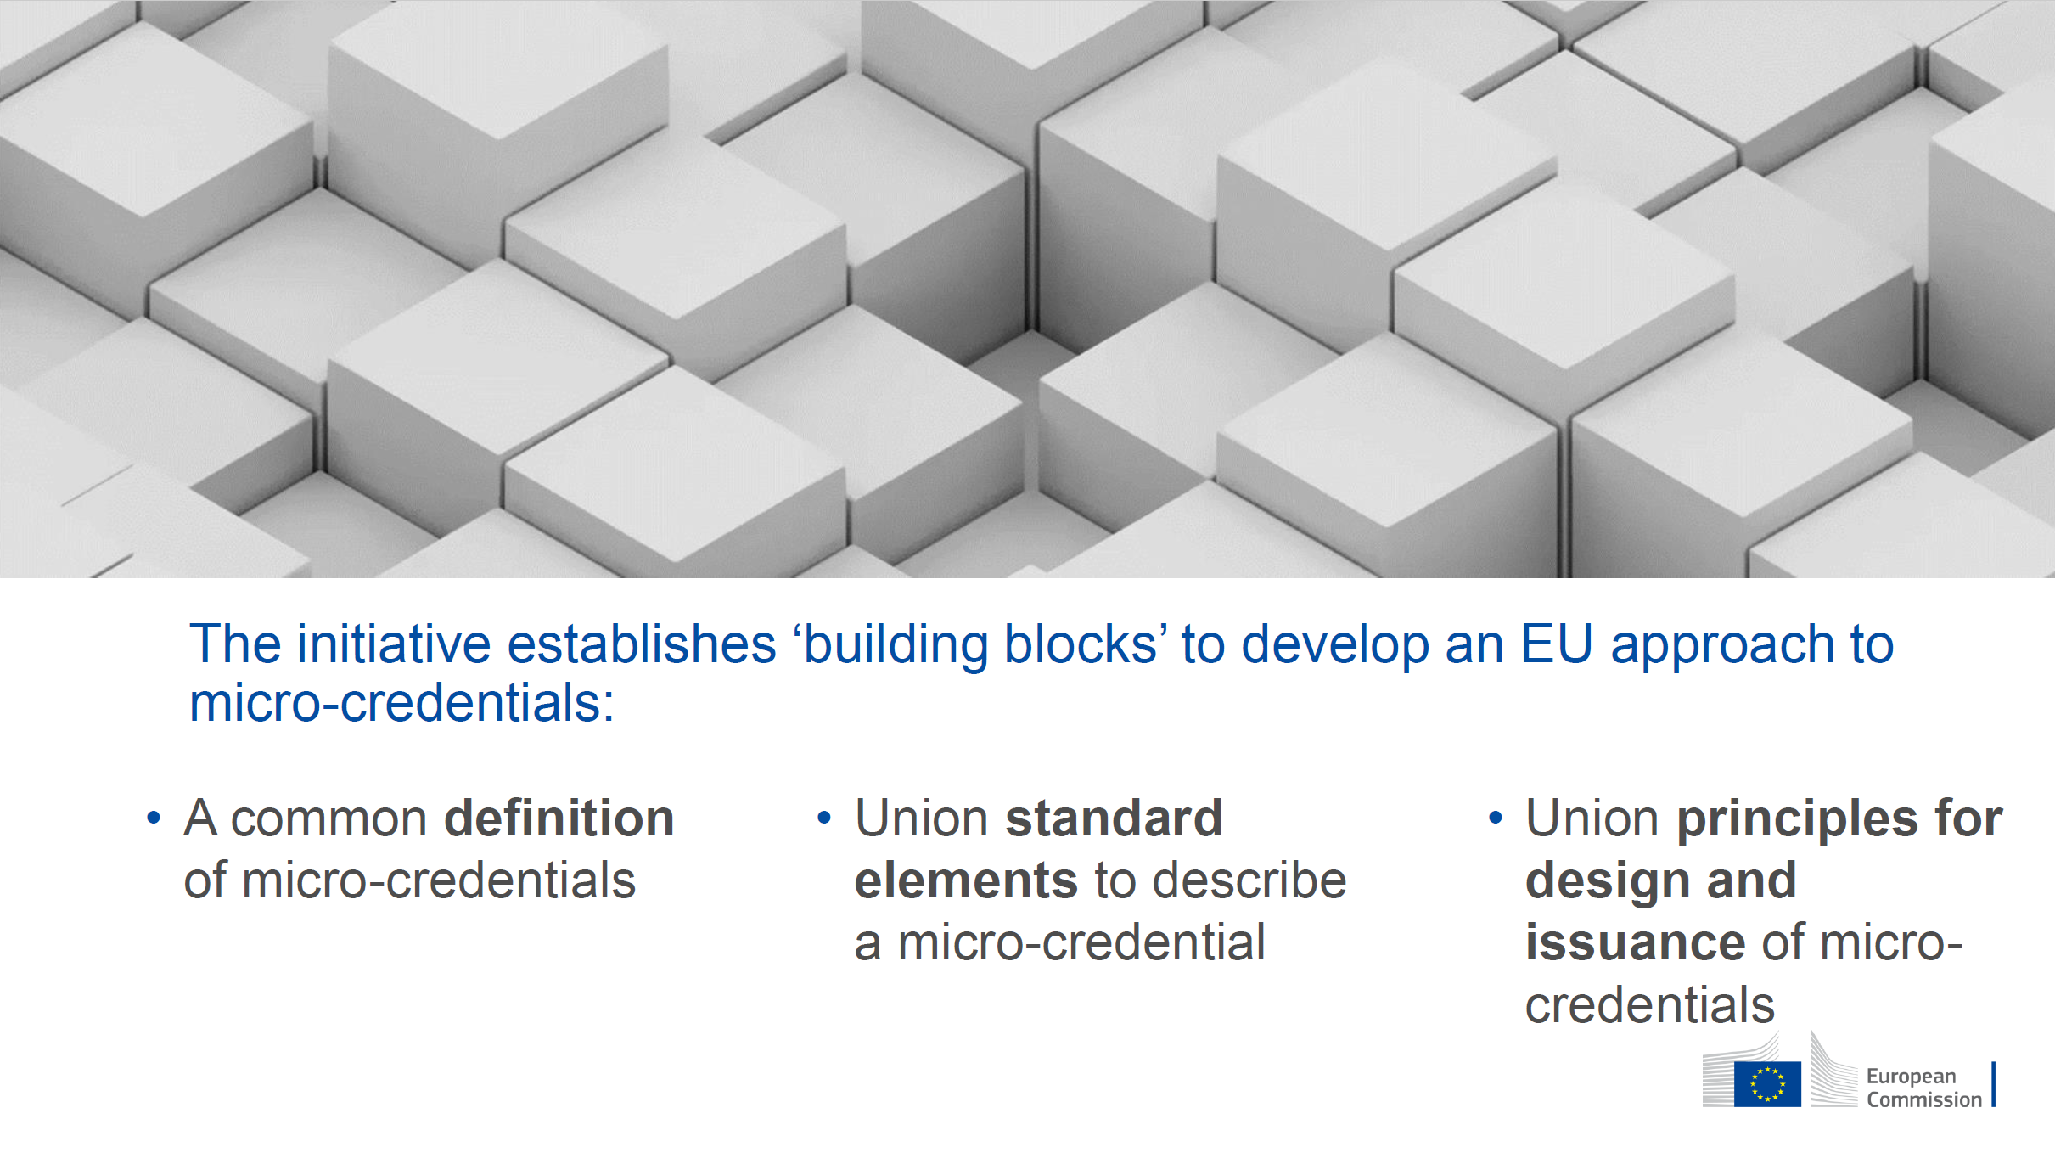

Slide 8
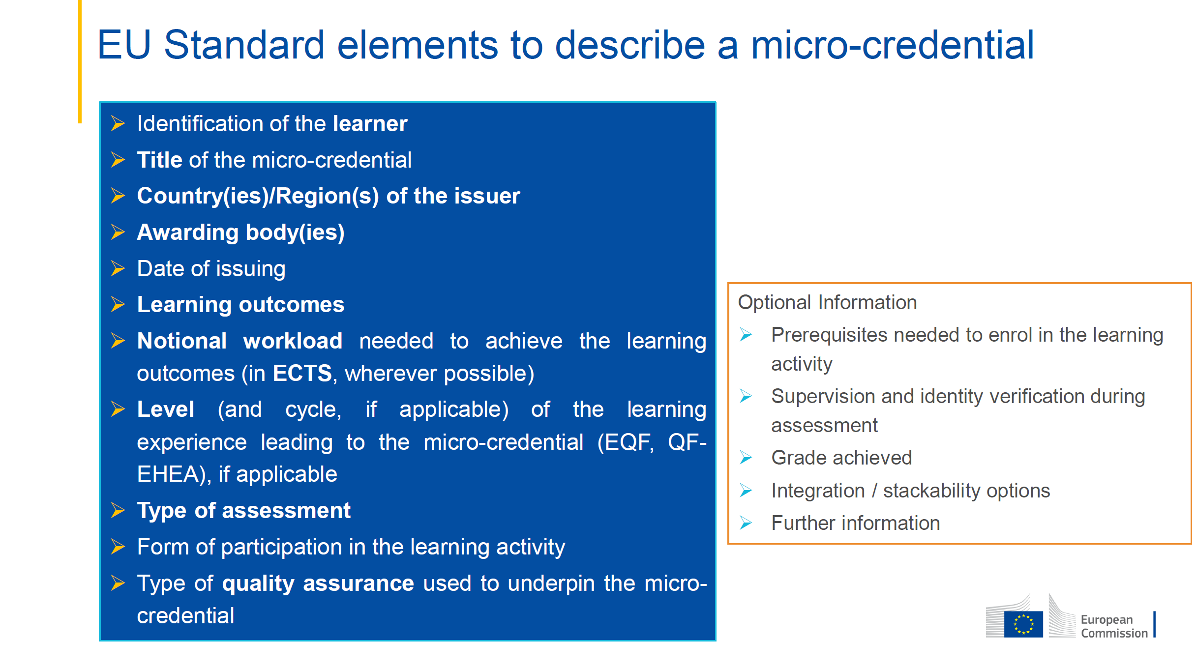

Slide 9


Slide 10

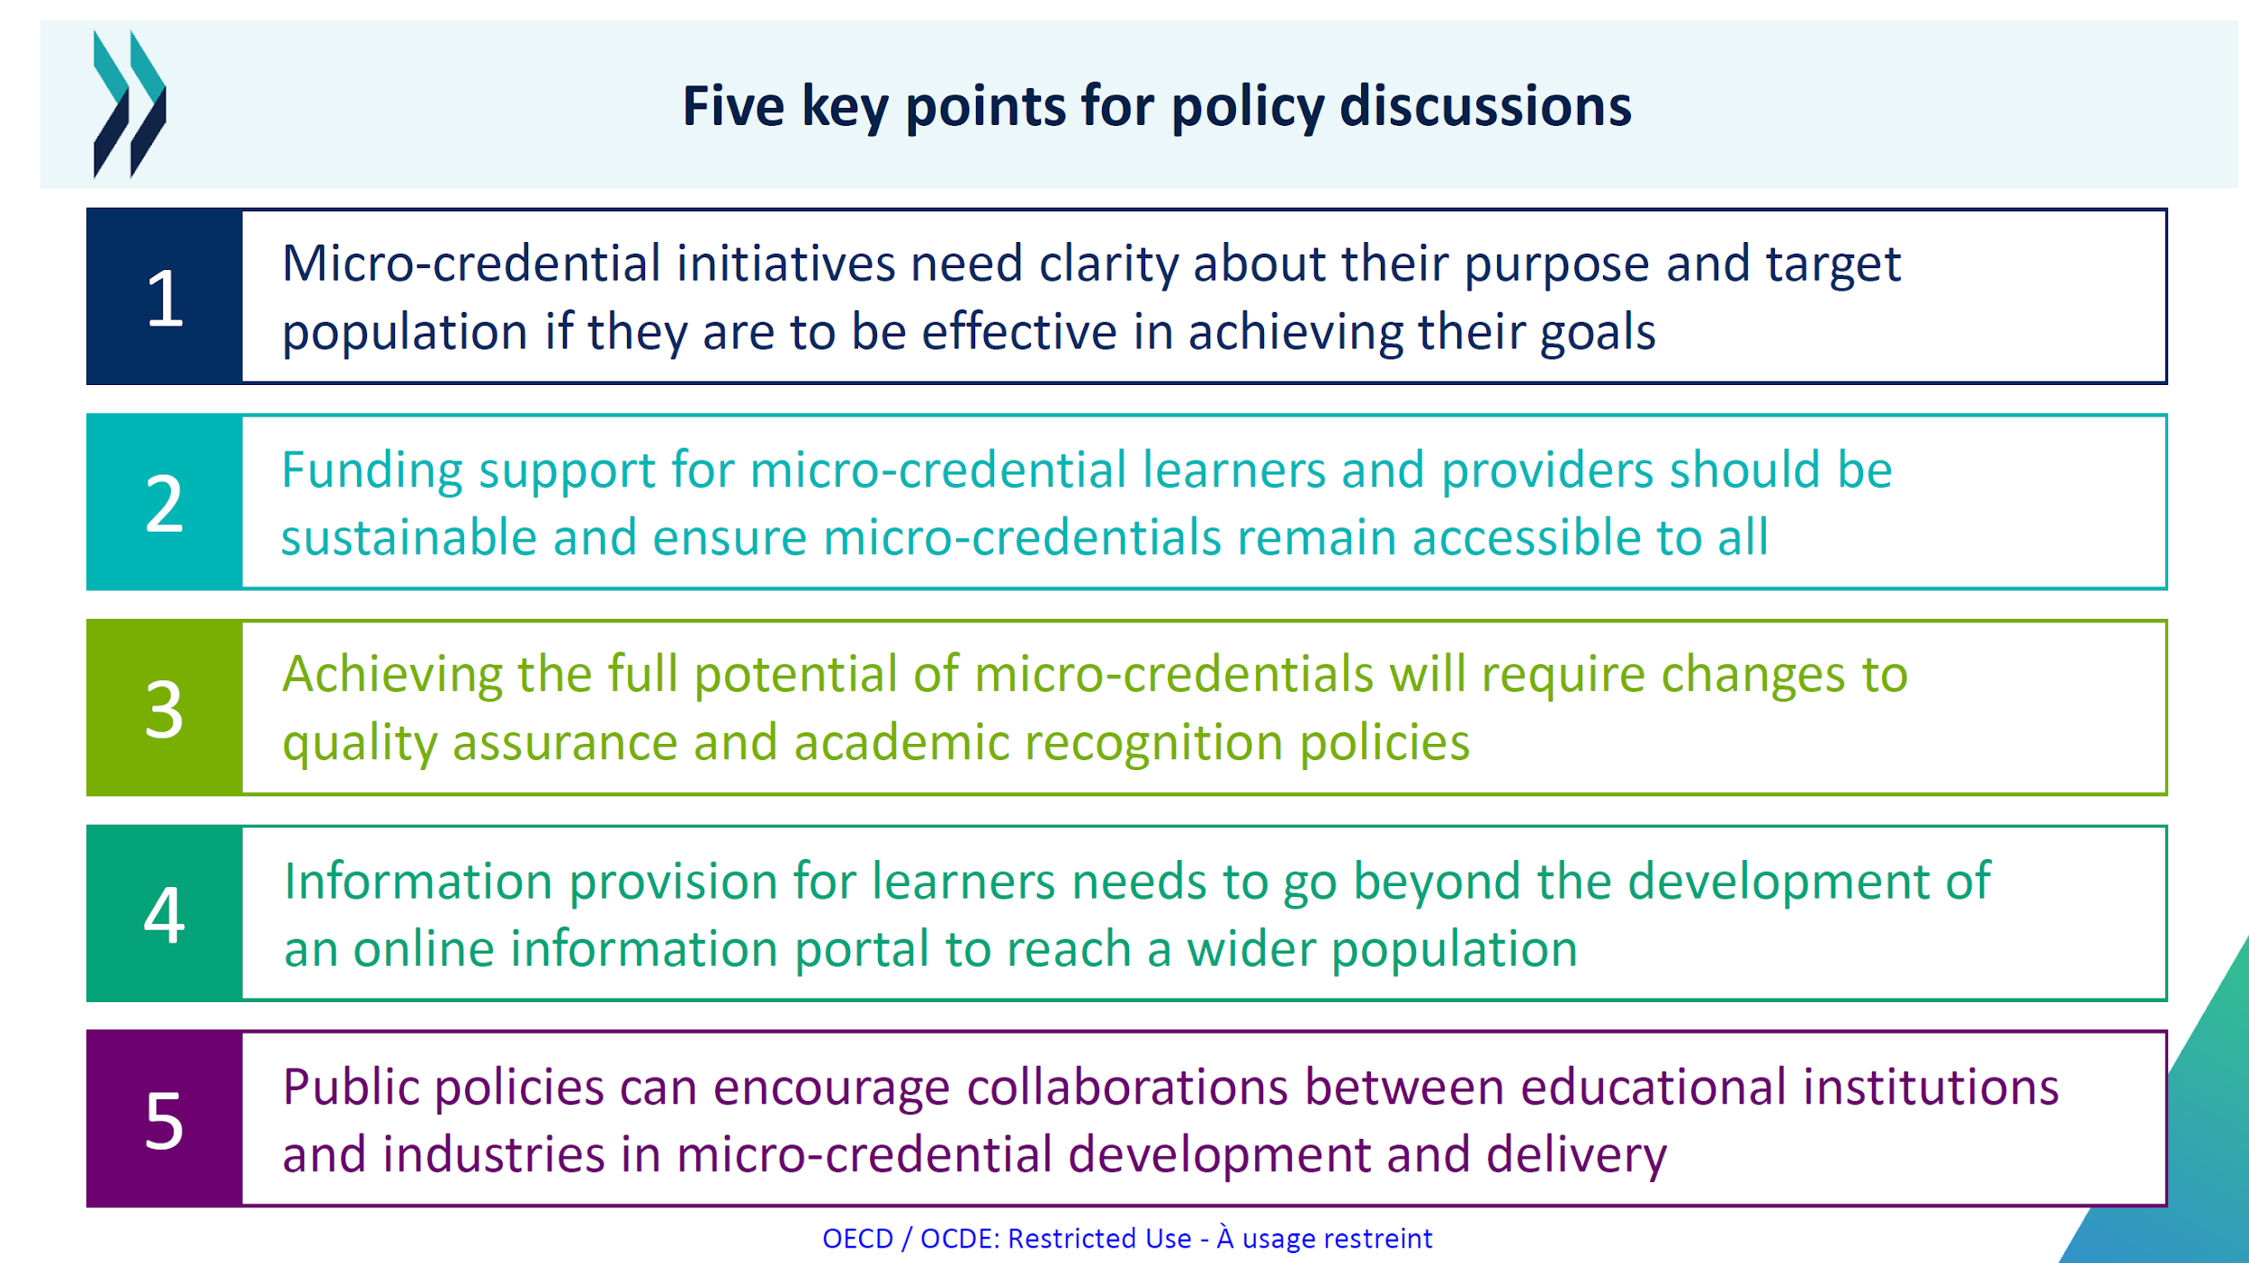

Slide 11
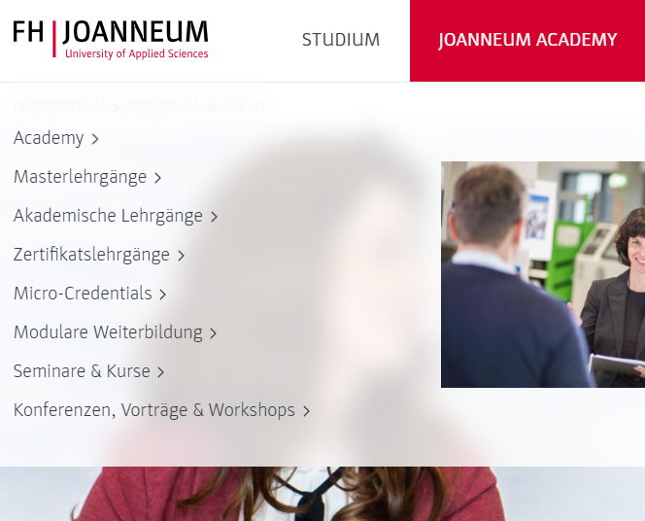
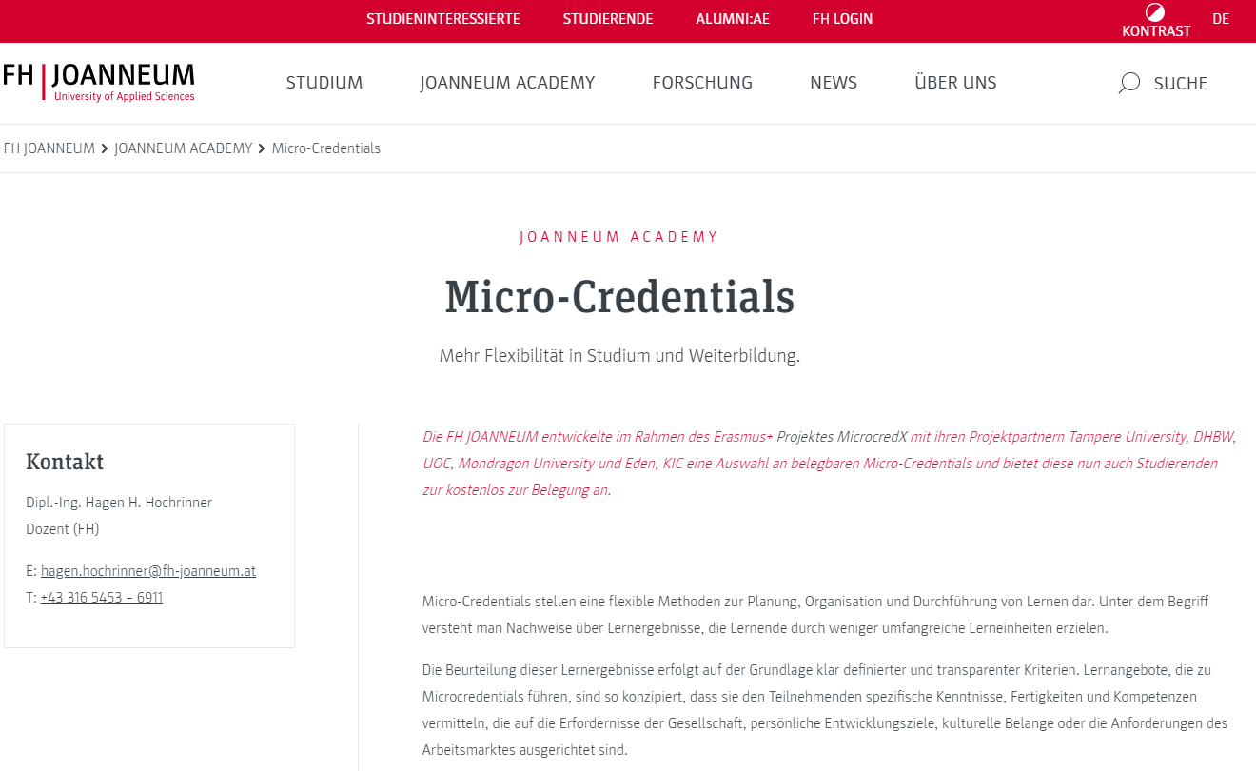
Micro-Credentials - FH JOANNEUM
Micro-credentials at FH JOANNEUM

Slide 12

International projects
Microguide, 2021-1-RS01-KA220-HED-000027585, https://www.aceeu.org/project/Microguide
“Developing Guidelines for the implementation of micro-credentials in higher education in Serbia”
Universität BELGRAD, Qualification Agency HOKC Belgrad, FH JOANNEUM Graz, ACEEU GmbH Münster, Unibersitate di Lleida
EU4Dual, Project: 101089937 — EU4DUAL — ERASMUS-EDU-2022-EUR-UNIV, https://eu4dual.education/
“EU4Dual will form the first European University dedicated to Dual studies characterized by the fact it combines two
places of learning, where, the university, emphasizes "theory" and the workplace, emphasizes "practice".
„WP4 promotion New Learning pathways - establishes methods for offering, collecting and recognizing micro-credentials“
Duale Hochschule Baden-Württemberg DHBW, FH JOANNEUM Gesellschaft mbH, MONDRAGON UNIBERTSITATEA, SAVONIA-Ammattikorkeakoulu Oy (SAVONIA), Politechnika Koszalinska (KTU), Ecole Superieure des Technologiesindustrielles Avancee (Estia),
John v. Neuman Janosegyetem (JVNU), MALTA COLLEGE of Arts Science and Technology (MCAST), VISOKA POSLOVNA SKOLA PAR (PAR)

Slide 13

International projects
MicroCredX, 2021-1-DE01-KA220-HED-000032250, https://microcredx.microcredentials.eu/
“ MicroCredX will prepare institutions to take advantage of the opportunities of unbundled, flexible learning provision models.”
Duale Hochschule Baden-Württemberg DHBW, FH JOANNEUM Gesellschaft mbH Graz , MONDRAGON UNIBERTSITATEA, MONDRAGON Spain, FUNDACIO PER A LA UNIVERSITAT OBERTA DE CATALUNYA, Barcelona, Knowledge Innovation Centre KIC Europe Rotterdam, EDEN Digital Learning EuropTAMPERE University TAU

Slide 14
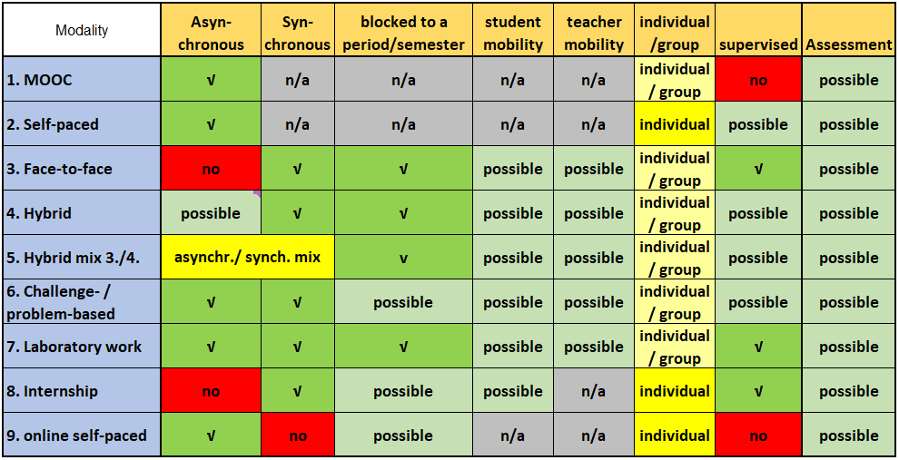
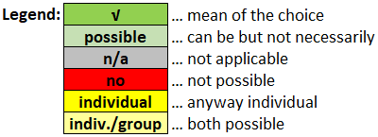
MicrocredX MCs Modalities

Slide 15
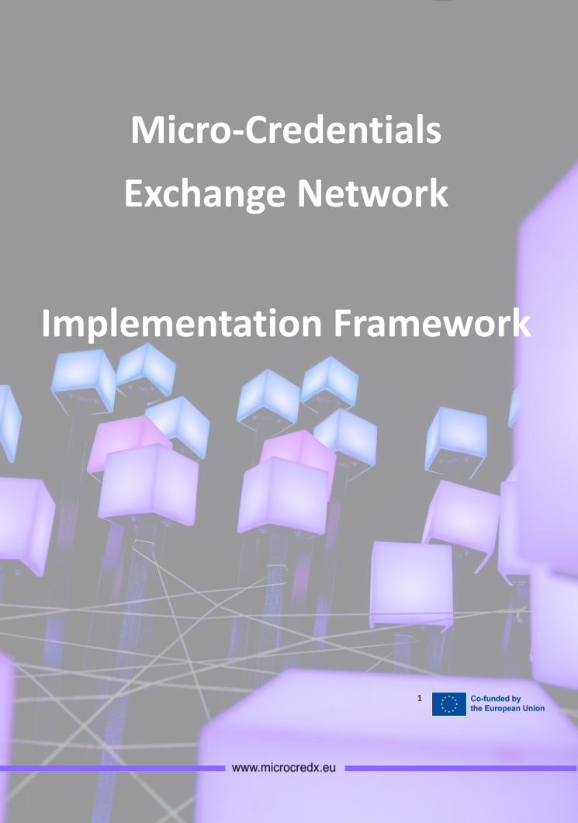
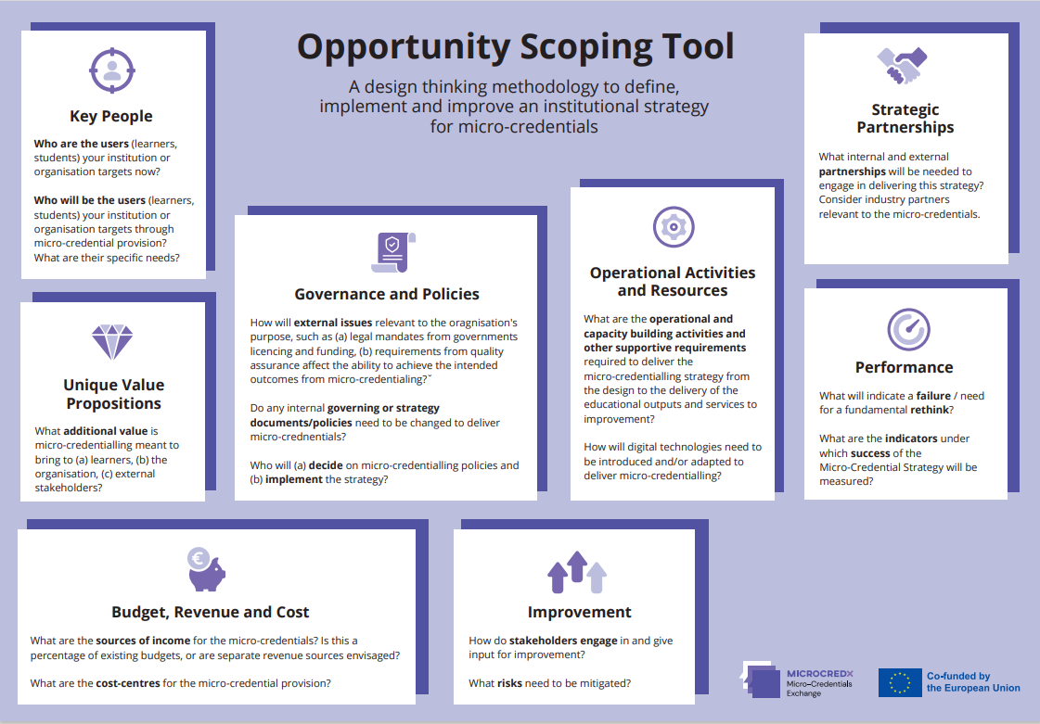
MicrocredX MCs outputs to use
  Opportunity Analysis Tool
  Practical tool to define, propose and execute concrete actions and structures for building a micro-credentials strategy. The strategy should be porous to new ideas and identify opportunities for collaborating on micro-credential provision.
  Implementation Framework
  is to help universities articulate and structure their micro-credential mission and strategy
  by defining key implementation domains and processes within institutions in order to achieve a Joint Micro-credential program.
More on: Home - MicroCredX

Slide 16
Implementation Framework
The aim of the MC Implementation Framework is to help partner universities articulate and structure their micro-credential mission and strategy by defining key implementation domains and processes within institutions in order to achieve a Joint Micro-credential programme across partner institutions.
The MC Implementation Framework presents a common understanding of the key characteristics for the implementation of micro-credentials in our partnership.
It identifies the standards and unifying principles for the exchange and recognition of MCs through a joint programme.
It provides quality, relevant training and learning information and methods for MC assessment
The target stakeholder group is mainly the operational management and academic programme leaders.

Slide 17
FHJ-Taskforce
  Defined 4 core processes:
    Administration of MCs
    Recognition of MCs
    Offers of existing MCs
    Development of new MCs tailored to the target group (academic / LLL)
  - Profile of a central contact point for Micro-credentials
    Definition of access requirements for MCs offers
    Suggestions for business models
    Unified principles of MC design and recognition

Slide 18
Mission:
Promoting new learning pathways
USPs
Direct cooperation with industry partners (needs, tailor made MCs); face-to-face with industry
(Stackability towards European University Alliance Degrees)
Quality in line with European standards
No anonymous mass courses
Integrating student council
Possibility to learn from and/or join the existing platforms
Notes:
USO – unique selling point

Slide 19
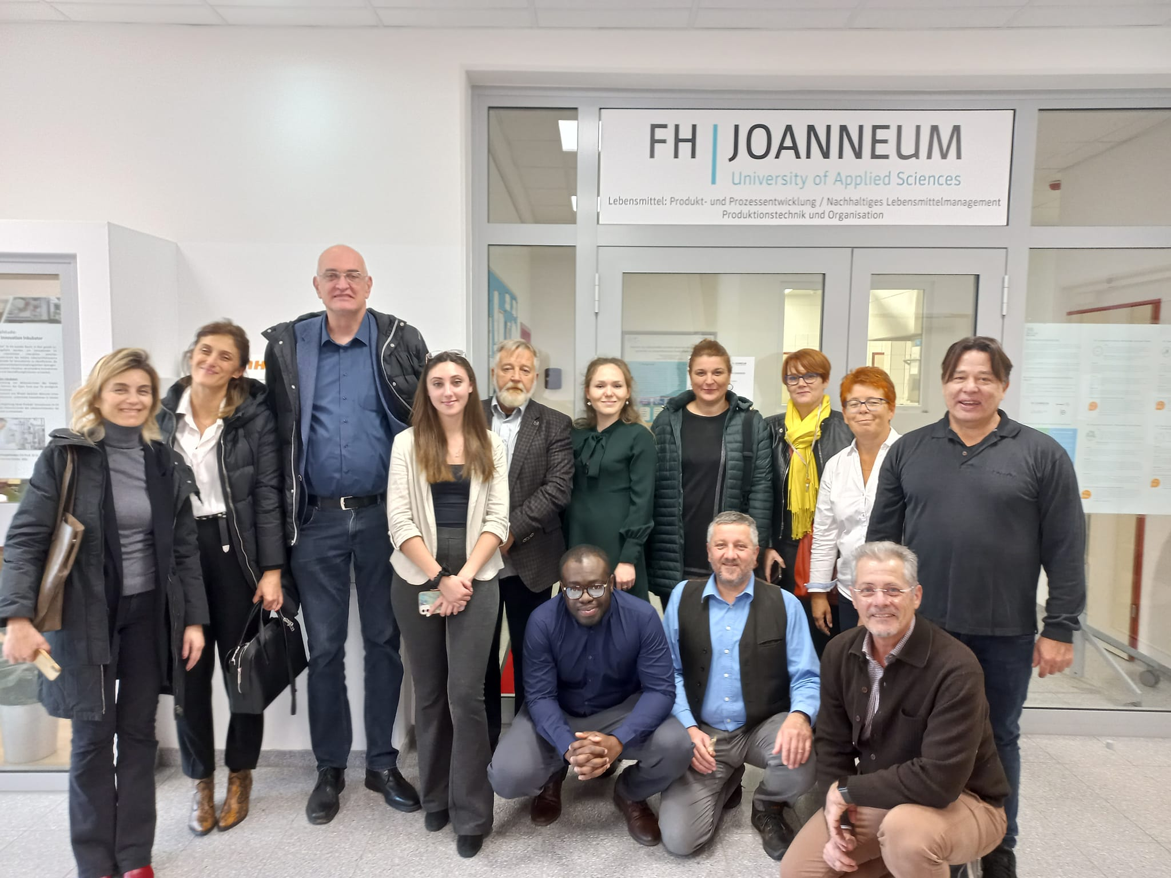
Micro-Credentials in Microguide context

Slide 20
Outcomes
Analysis of the micro-credential implementation practice in Austria, making a list of examples of good practice.
Analysis of the legal framework in Austria, making a proposal for a best legislative model.
Analysis of the micro-credential certification and credit evaluation practice in Austria, making a proposal for the best model of certification and credit evaluation.
Analysis of the micro-credential quality assurance practice in Austria, making a proposal for the best model of MCs accreditation.
Analysis of the linking micro-credential to National Qualification Framework in Austria, making a proposal for the best model of linking.
Implementation of all analysis results and proposals in the Guidelines for the implementation of micro-credentials in higher education.
1 micro-credentials example developed as a proof-of-concept; (Robotics)

Slide 21
National research results (2022)
4 HEI use the name MC
10 HEI plan to introduce MC
8 HEI developed new formats
LLL target group
Center for upskilling and LLL responsible for development
MC added value
Flexibility for learners – individual learning pathways
Benefit for alumni
MC tightly connected with the digital concept
Further discussions on financing, qualification of external teachers, QA
Source 1: Micro-credentials
Source 2: International PLA: Micro-credentials – implementing council recommendation and digital credential frameworks | Agentur für Bildung und Internationalisierung
Notes:
75 HEI taking part at the survey
20 have courses similar to MC
LLL target group meanng – financial plan – to pay for
Added value – upskilling offer, quick and targeted offers to societal changes and market demand/need, flexible continuous educational offers
The obvious target group are alumni – benefit from the MC offer
Digital credentialing

Slide 22


Slide 23
Sources by CEDEFOP
Cedefop, (2023). Microcredentials for labour market education and training: the added value for end users. Publications Office of the European Union. Cedefop research paper. https://data.europa.eu/doi/10.2801/141643
Cedefop, (2024). Microcredentials: striving to combine credibility and agility. Publications Office of the European Union. https://data.europa.eu/doi/10.2801/966682
Pouliou, A. (2024). Exploring the emergence of microcredentials in vocational education and training (VET). Publications Office of the European Union. Cedefop working paper, 22. https://data.europa.eu/doi/10.2801/671358

Slide 24



