Slide 1
Project acronym: MICROGUIDE Project full title: DEVELOPING GUIDELINES FOR THE IMPLEMENTATION OF MICRO-CREDENTIALS IN HIGHER EDUCATION Project No. 2021-1-ProjectRS01-KA220-HED-000027585 Funding Scheme: Erasmus+ https://microguide.bio.bg.ac.rs/
Guidelines overview Belgrade, 30. October 2024
Prof. Dr. Siniša Đurašević
University of Belgrade
sine@bio.bg.ac.rs

Slide 2
EEA strategic framework HE WG (Higher Education Working Group within the European Education Area)

Slide 4
Micro-credential properties
Micro-credentials come in various forms:
Badges: Digital badges earned for completing a course or project
Certificates: Short courses that lead to a certificate of completion
Nano-degrees: More extensive programs offered by organizations like Udacity or Coursera

Slide 5
They are offered by many reputable institutions or organizations:
Harvard University HarvardX Verified Certificate
Google Ads Certification, Analytics Certification and Cloud Certification, Microsoft Certified Azure Fundamentals, Azure Developer Associate and Azure Solutions Architect Expert, IBM Digital Badge program, Adobe Certified Badges
Coursera Specializations, edX Professional Certificate programs, Udacity nano-degrees, LinkedIn Learning Skills Assessments and Learning Certificates, Trailhead Badges and Superbadges

Slide 6
Definition(s) may vary:
Short courses that certify your knowledge in a particular area (Forbes Advisor)
Short, competency-based recognition (National Education Association)
Short certification courses that allow you to learn new professional skills very quickly (Assessment Systems)
Mini qualifications that can help individuals learn new skills, progress in their careers, or change careers entirely (Times Higher Education)
Short certification courses that allow you to learn new professional skills very quickly (Open Universities Australia)

Slide 7
Targeted Skill Acquisition:
to enable individuals to acquire specific, in-demand skills in a life-long learning manner that can boost employability
Link to the labour market needs
Stackability:
Where multiple micro-credentials can be combined to form a comprehensive skillset

Slide 8
Flexibility, both on the pace of development and the way of delivery (blended learning, online learning…):
It allows learners to study at their own pace and can be completed in less time than traditional degrees, which makes them an attractive option for working professionals (no matter on previous education) looking to upskill or change careers

Slide 9
Assessments:
To earn a micro-credential, learners typically need to complete the required coursework or projects specified by the issuing institution or organization.
The specific requirements may vary depending on the micro-credential.
Some may require learners to pass quizzes, exams, or submit assignments, while others may involve practical projects or case studies

Slide 10
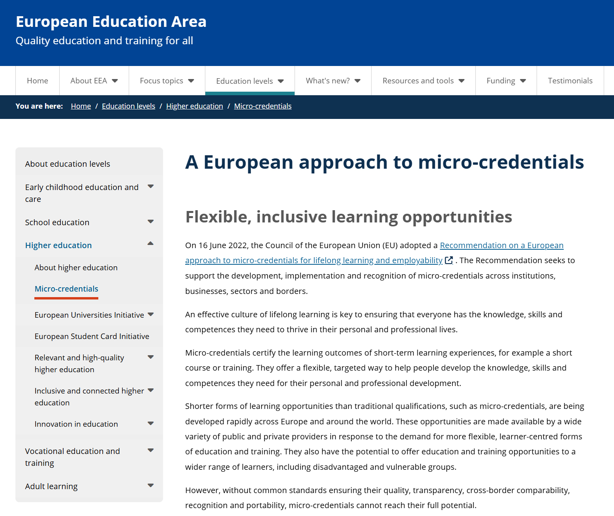

Slide 11
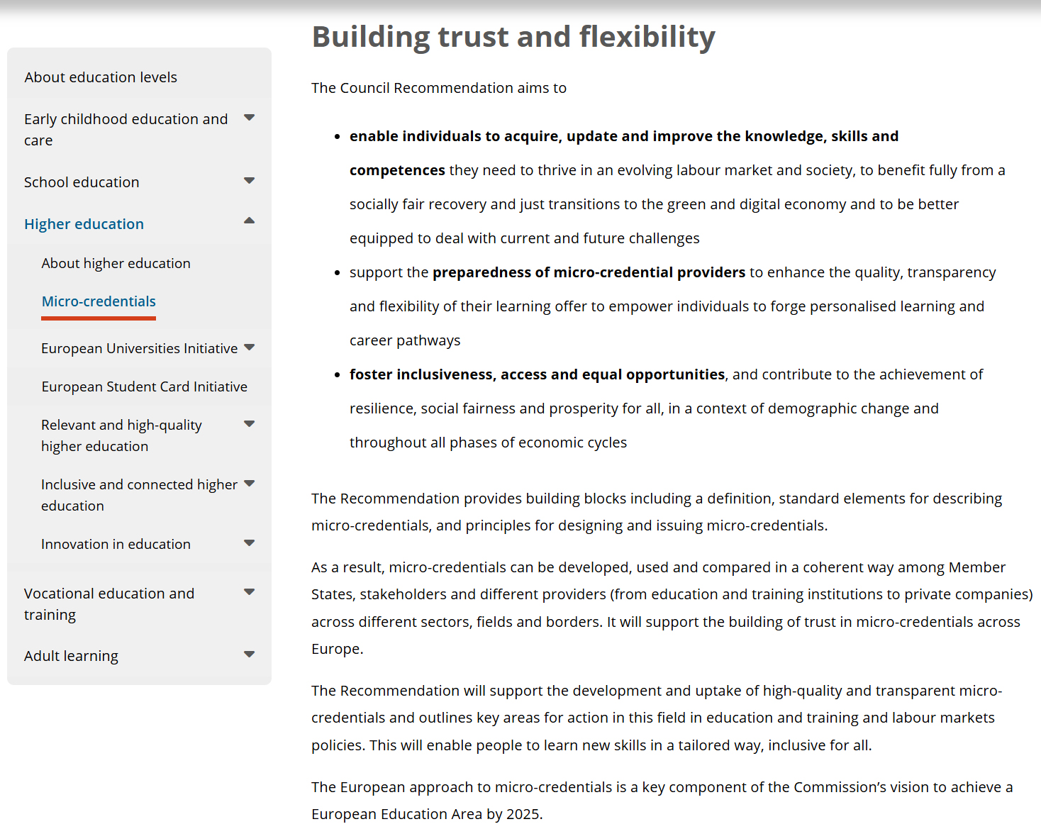

Slide 12
Common EU standards?
Legal Framework:
Is it necessary, and if so, when (Quality vs Flexibility)
ECTS range:
5?, 10? 30?
It must be something MICRO in it – ECTS value based on purpose, having workload (way of delivery?) and stackability in mind

Slide 13
Content:
Is it just a usual HE course or something other?
Quality assurance
Accreditation
Certification:
Certificate and certificate supplement

Slide 14
Stackability:
A way to restrict micro-credentials duration?
How many Certificates?
And what about a degree? (for example 180 micro-credential ECTS)
Link to the NQFs/EQF:
European Common Micro-credential Framework recommends linking micro-credentials issued by HEIs to NQF by integrating or stacking into qualification programs between level 6 to 8
ENIC/NARIC

Slide 15
ERASMUS+ project “Developing Guidelines for the Implementation of Micro-Credentials in Higher Education – MICROGUIDE” (2021-1-RS01-KA220-HED-000027585) - to develop guidelines for implementing micro-credentials in higher education
The project partners were the University of Belgrade, the Qualification Agency of Serbia, FH Joanneum Gesellschaft MBH (Graz, Austria), the Accreditation Council for Entrepreneurial and Engaged Universities (Münster, Germany), and the University of Lleida (Lleida, Spain).

Slide 16
Based on the results of these analyses, a list of exemplary practices from the project partner states was created, along with all prevously mentioned elements, and 3 micro-credential pilots developed as proof-of-concept.
In this way, the Guidelines serve as the theoretical underpinning for implementing micro-credentials in all project partner states and beyond, providing both legislators and higher education institutions (HEIs) with concrete solutions.

Slide 17
https://microguide.bio.bg.ac.rs/

Slide 18
Ministry of Education, Science and Research
Position paper
Austrian HE takes a positive view of the European developments in MCs, especially in the context of the increasingly important lifelong learning and sees this as an opportunity for the universities to expand the quality of their educational offerings, open new target groups and expand cooperation with non-university partner institutions. This can be an important contribution to strengthening the position of the universities in the intensifying competition on the education market.
Working group (all four HE sectors, AQ Austria and the ministry)
Mutual recognition among universities
based on the national QA mechanisms and the ESG principles. The MCs QA must be ensured by the university's internal QM system
The definition of MCs should be as general, reasonable and yet as precise as possible, so that all stakeholders can act from this common basis
MCs should not be assigned to the NQF due to the low workload
The main component of the design of MCs is the common agreement on MC setup and possible parameters such as: ECTS, title, description, target groups, examination/assessment, QA, etc
Agreed extent of hours – as credit points
АУСТРИЈА

Slide 19
Boston Consulting Group (BCG)
Labour markets of the USA, Germany and Australia have similar trends. One of them is a shortage of skilled workers in STEM professions, which will worsen by 2030. As a result of ageing, health and care professions will also be in high demand.
As one of the ways to minimize the risks and consequences, BCG suggests governments of these countries, including Germany, should develop a new approach to MCs.
German Academic Exchange Service (DAAD) President, Professor Dr Joybrato Mukherjee
…does not see any added value in the integration of micro-degrees into the regular academic programmes. Instead, it fears a modularisation of degrees could lead the the fragmentation of the canon of knowledge and criticises the often-commercial use of the micro-parts of conventional degree programmes
Micro-credentials are about flexibilising educational pathways in Germany and the European Union in an increasingly technology-oriented and highly complex work environment. It is gratifying to see that, in addition to their obvious use in connection with higher qualifications, they’re increasingly being perceived as useful measures for the purpose of internationalisation and boosting short-term mobility in the EU
German Rectors’ Conference
The possible fields of application are clearly limited: for example, MCs should be used primarily in the context of orientation courses for students, further training for staff or also in special extracurricular offers for so-called "high-potentials" – i.e., predominantly in the context of academic further education
Federal Government
…expresses scepticism and points out that MCs could represent a disproportionate administrative or financial burden for the Member States, as they could overlap with other existing structures. Moreover, from the German point of view, there is a general danger that the value of qualifications in all educational sectors will be diluted
НЕМАЧКА

Slide 20
Study Case in Catalonia
The only complete experience for implementing MCs in Spain has been done in Catalonia, conducted in collaboration with the Autonomous Government of Catalonia, the Catalan University Quality Assurance Agency (AQU Catalunya), the 12 universities (public and privates) in the Catalan university system, the Catalan Public Employment Service, and the Catalan Continuous Training Consortium
Bearing in mind that legislation in Spain does not provide for the consideration of SLPs within institutional accreditation, a methodology for programme-by-programme accreditation has been developed.
In order to prepare this ex-ante evaluation process, the main references considered are the ESG and the Guide to ex-ante accreditation of official university degrees.
Guide was approved by the Institutional and Programme Assessment Committee (CAIP, from its acronym in Catalan) of AQU Catalunya.
On this basis, 7 different programmes were designed, 6 of them corresponding to EQF level 6 and one to EQF level 7.
They were implemented differently by 9 universities and, consequently, assessed with an ECTS value ranging from 8 to 16.
When designing these programmes, the following were taken into account:
The justification for development
The objective and learning outcomes
The internal QA system (IQAS)
Student access and admission, and student support
Teaching and support staff
Material resources and services
КАТАЛОНИЈА

Slide 21
MicroGuide results
Legal Framework:
It is not binding, but it is certainly desirable
Minimum restrictions, maximum flexibility
ECTS range:
Our recommendation is range 1-15 ECTS
Content:
It must fit the purpose!

Slide 22
Stackability:
A way to restrict micro-credentials duration?
How many Certificates?
And what about a degree? (for example 180 micro-credential ECTS)
Quality assurance
Standards and Guidelines for Quality Assurance in the European Higher Education Area (ESG)

Slide 24
The mandatory elements for micro-credentials certification (Certificate and certificate supplement) are the following:
Identification of the learner;
Title of the micro-credential;
Country(ies)/region(s) of the issuer;
Date of issuing;
Learning outcomes;
Workload in ECTS;
Type of assessment;
EQF/NQF level

Slide 25
EQF/NQF level
If majority of some micro-credential content belongs to the material that is normally offered at level 6 studies at home HEI
If some micro-credential is already a part of level 6 study curricula, either at the home HEI (or the HEI to whose students it is offered)
then that micro-credential should be linked to the level 6 by content, and not by qualification

Slide 26
Preporuke za Srbiju
Postojeći pravni okvir (član 111 Zakona o visokom obrazovanju):
VŠU, u okviru svoje delatnosti, može da sprovodi programe celoživotnog učenja van studijskih programa za koje je dobila dozvolu za rad;
uslovi, metode i procedure za sprovođenje programa celoživotnog učenja su regulisani opštim aktom VŠU;
VŠU izdaje sertifikat osobi koja je završila program celoživotnog učenja;
osoba upisana na program celoživotnog učenja nema status studenta prema ovom Zakonu.

Slide 27
Novi pravni okvir (član 111A Zakona o visokom obrazovanju):
Visokoškolska ustanova može da realizuje programe iz člana 111. ovog zakona u formi mikrokredencijala – malih obrazovnih programa namenjenih osobama sa bilo kojim prethodnim nivoom obrazovanja, a čiji je cilj prvenstveno zadovoljavanje potreba tržišta rada.
S tim u vezi, preporučuje se visokoškolskim ustanovama da prilikom razvoja mikrokredencijala konsultuju tržište rada i, ukoliko je to adekvatno, uključe njegove predstavnike u realizaciju tih programa.

Slide 28
Mikrokredencijali treba da sadrže:
Vrednost u ESPB bodovima definisanu u rasponu od 1 do 15 ESPB;
Akreditaciju od strane odgovarajućeg tela visokoškolske ustanove;
Jasan i transparentan proces ocenjivanja;
Sertifikat i dodatak sertifikatu koji sadrže najmanje sledeće elemente:
Identifikacija korisnika;
Naziv mikrokredencijala;
Vrsta mikrokredencijala (deo akreditovanog kurikuluma, dalje obrazovanje...);

Slide 29
Identifikacija izdavaoca (naziv VŠU, adresa itd., uključujući status pružaoca usluge, npr. javna ustanova, privatna...);
Status akreditacije pružaoca (institucionalna akreditacija, akreditacija od strane drugog tela, naziv akreditacionog tela, datum i broj akreditacije….);
Datum izdavanja sertifikata i njegovog dodatka;
Obim rada izražen u ESPB bodovima;
Nivo EOK-a i NOKS-a. Povezivanje mikrokredencijala sa nivoima EOK-a i NOKS-a se vrši prema principu sadržaja – ako većina sadržaja određenog mikrokredencijala pripada sadržaju koji se predaje na osnovnim ili master studijama na visokoškolskoj ustanovi, tada se taj mikrokredencijal može povezati prema sadržaju, a ne kao puna kvalifikacija, sa odgovarajućim nivoom EOK-a i NOKS-a;

Slide 30
Naučna, umetnička ili stručna oblast kojoj mikrokredencijal pripada;
Opis ishoda učenja;
Preduslovi za upis;
Oblik nastave (na daljinu, uživo, kombinovano, volontiranje, radno iskustvo…);
Tip ocenjivanja i sistem dodeljivanja ocene (testiranje, primena veštine, portfolio…)
Opcije integracije/kombinovanja mikrokredencijala (samostalniili kombinovani). U slučaju kombinovanih mikrokredencijala može se izdati zajednički Sertifikat i Dodatak sertifikata;
Sve druge dodatne informacije (ukoliko je potrebno).

Slide 31
Uslovi, način i postupak realizacije programa mikrokredencijala uređuju se opštim aktom visokoškolske ustanove.
Osoba upisana na program mikrokredencijala nema status studenta prema ovom Zakonu.
Prednost ovog predloga je:
regulacija na nivou Zakona – prema pravnoj praksi u Srbiji, članovi Zakona se prepisuju u Statute VŠU, čime se obezbeđuje harmonizacija na nivou celog visokog obrazovanja
Priznavanje stranih mikrokredencijala (ENIC/NARIC)

Slide 32
Alternativni pristupi:
U slučaju da izmena Zakona nije moguća, postoje dva alternativna pristupa:
Jedan je uvođenje gore predloženog člana u Statut samostalnih visokoškolskih ustanova.
Drugi pristup je uvođenje gore predloženog člana samo u Statut visokoškolskih ustanova koje nisu samostalne.

Slide 33
Neki konkretan primer?
3 Pilot mikrokredencijala namenjena stručnjacima sa nivoom obrazovanja 6-7 NOKS-a
Tehničar za mikrobiologiju/genetiku/imunobiologiju namenjen osobama sa nivoom obrazovanja 4 (ili i niže) NOKS-a
Statistički paket R namenjen prvenstveno stručnjacima sa nivoom obrazovanja 8 NOKS-a

Slide 34
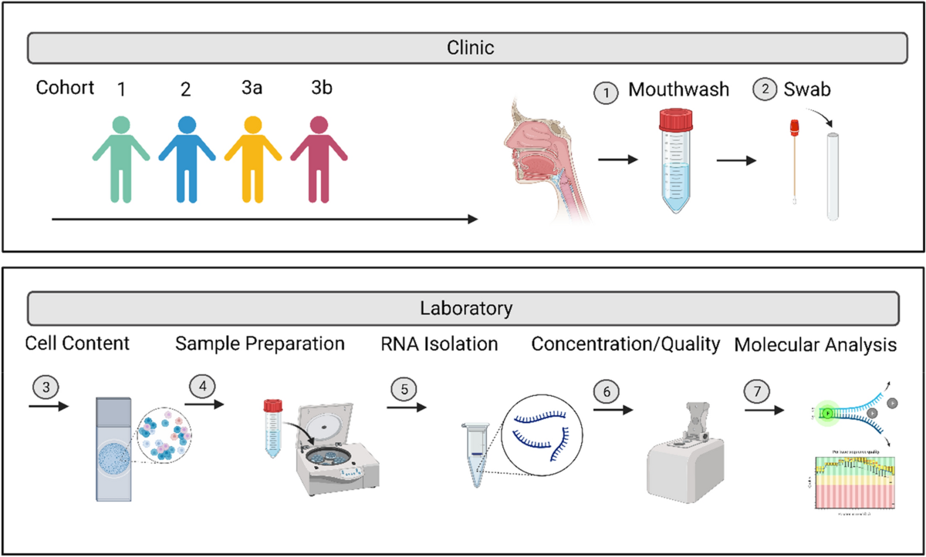

Slide 35
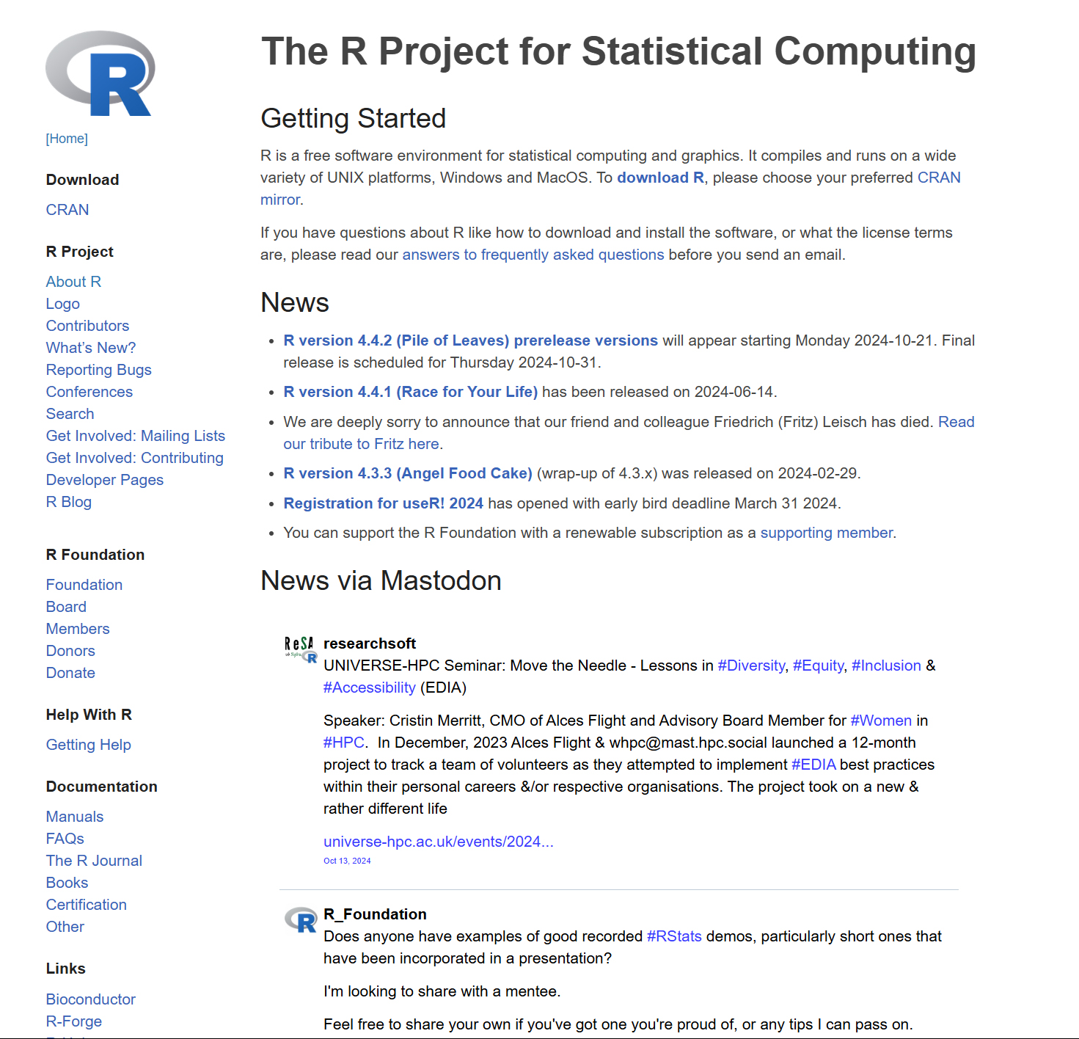

Slide 36
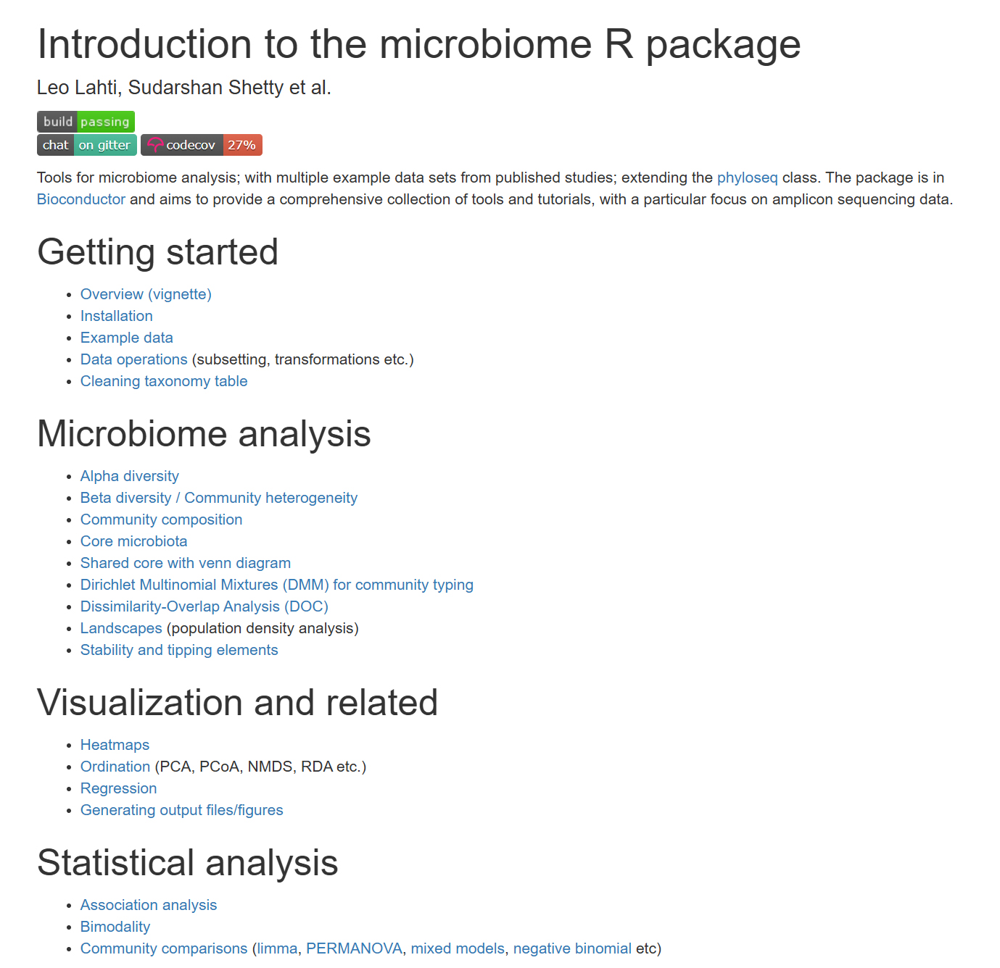

Slide 37
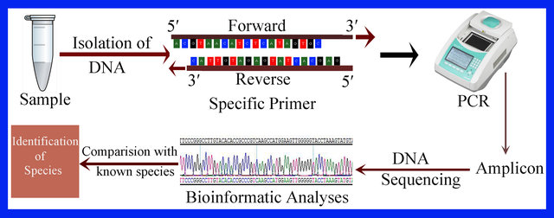

Slide 38
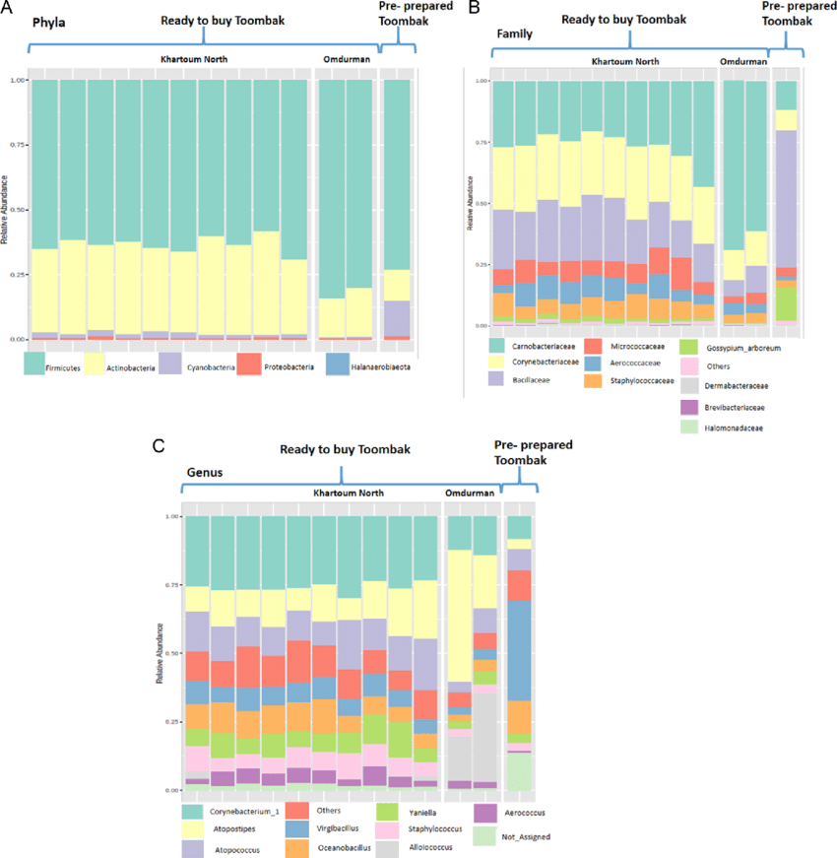
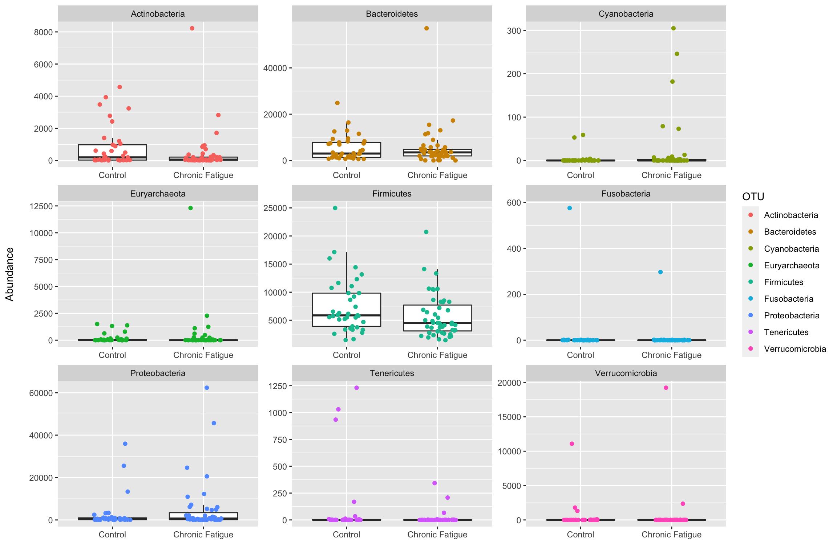

Slide 40
PREDLOG MICROGUIDE ZAVRŠNE KONFERENCIJE
Formiranje Radne grupe na nivou Ministarstva prosvete ili Univerziteta oko dogovora za finalnu verziju izmene odgovarajućeg zakonskog ili podzakonskog akta
Način akreditacije (VŠU/SAMOSTALNA VŠU/NAT)
Potreba za dodavanjem u Sertifikat i Dodatak sertifikatu elemenata ISCO 08 (kod nas Šifarnik zanimanja) i ISCED 2013f (kod nas sistem prema kome se kvalifikacije razvrstavaju i šifriraju u Nacionalnom okviru kvalifikacija Republike Srbije)
I sva ostala pitanja (mikrokredencijal ili mikrokvalifikacija, sertifikat ili uverenje, mikrokredencijali kao izborni predmeti, ko potpisuje sertifikat, akademski/strukovni?)

Slide 41
Thank you for your attention
Vielen Dank für Ihre Aufmerksamkeit
Gracias por su atención
Hvala na pažnji

